Slide 1
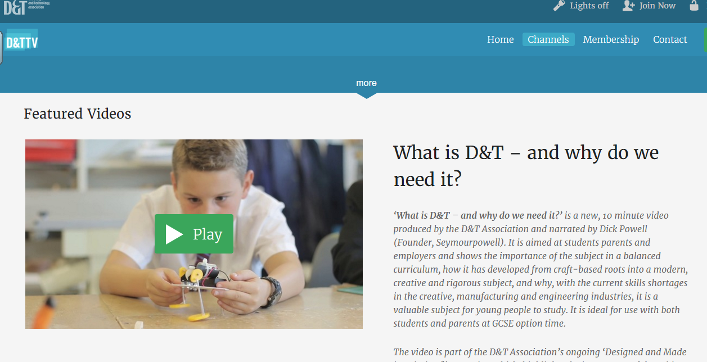
When you open this hyperlink you need to scroll down to this video. It is not the first one that comes up.

Slide 2
Transferable Skills are those skills you acquire which are portable. Employers love them.
Showing initiative
Creativity
Decision making
Problem solving
Leadership
Responsibility
Time management
IT skills
Communicating ideas
Working in a group/team
Research, analyse and evaluate
Design and Technology GCSE equips you with all of these.

Slide 3
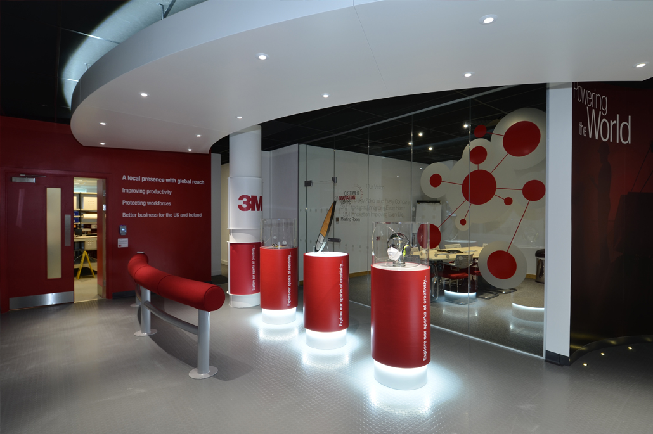
Design and Technology GCSE and Product Design A level
Product designers design products to improve lives
.
Engineering
Marketing
Physics
Business Studies
Maths
Architecture
Design and Technology
Biology
Material Science
Geography
Drama
Environmental Studies
Film and Theatre/
Set design
This is exemplified in our trip to 3M in Bracknell where students see products that have been designed to improve the world.
Healthcare, Automotive, Design and Construction, Architectural, Safety, Manufacturing, Energy, Transportation. These are all areas in which product design plays a major role.

Slide 4
Degree or apprenticeship ?
Design and Technology / Product Design
Aeronautical engineering
Architecture
Art and Design
Civil Engineering
Electronic Engineering
Engineering (General)
Mechanical Engineering
Materials Science
Maths and physics are essential for engineering.
The recommended
3rd A level is Product Design
This demonstrates that you can apply your maths and physics to solve problems.

