Slide 1


Number 22
Telephone support line
For anyone aged 11 – 25 years old

Slide 2

Who are we?
We are a registered charity providing counselling to both adults and young people living in Slough, Windsor and Maidenhead.
In 2021 we set up a telephone support line to support young people.

Slide 3
Is the support line for me?
Are you a person aged between 11-25 years old looking for help and advice?
Then why not book a 25-minute telephone appointment with our friendly telephone support line team.
It’s free

Slide 4
How can you help me?
No problem or worry is too big or small. If something is troubling you then our trained team can help.
You can talk about any difficulties in school, work or at home, anxiety, body image, relationships, sexuality, exam pressure, bullying, self harming or anything that is important to you.

Slide 5

How do I make an appointment?

Slide 6
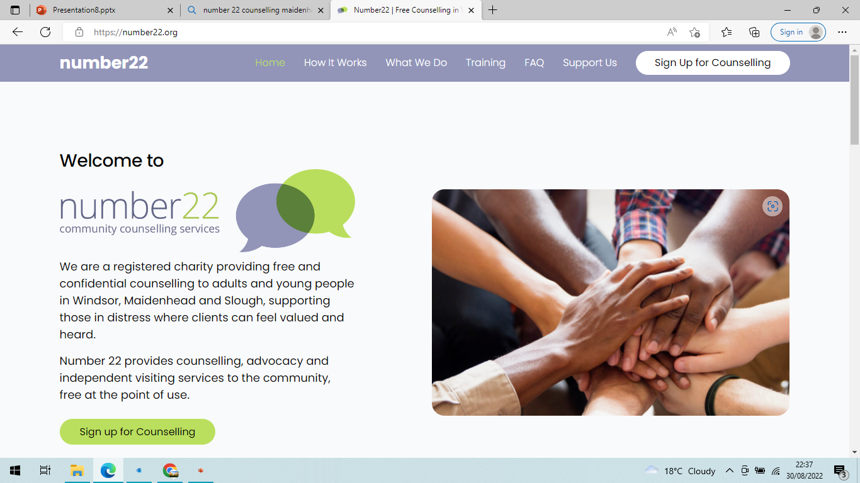
1.
Go to our website
www.number22.org

Slide 7
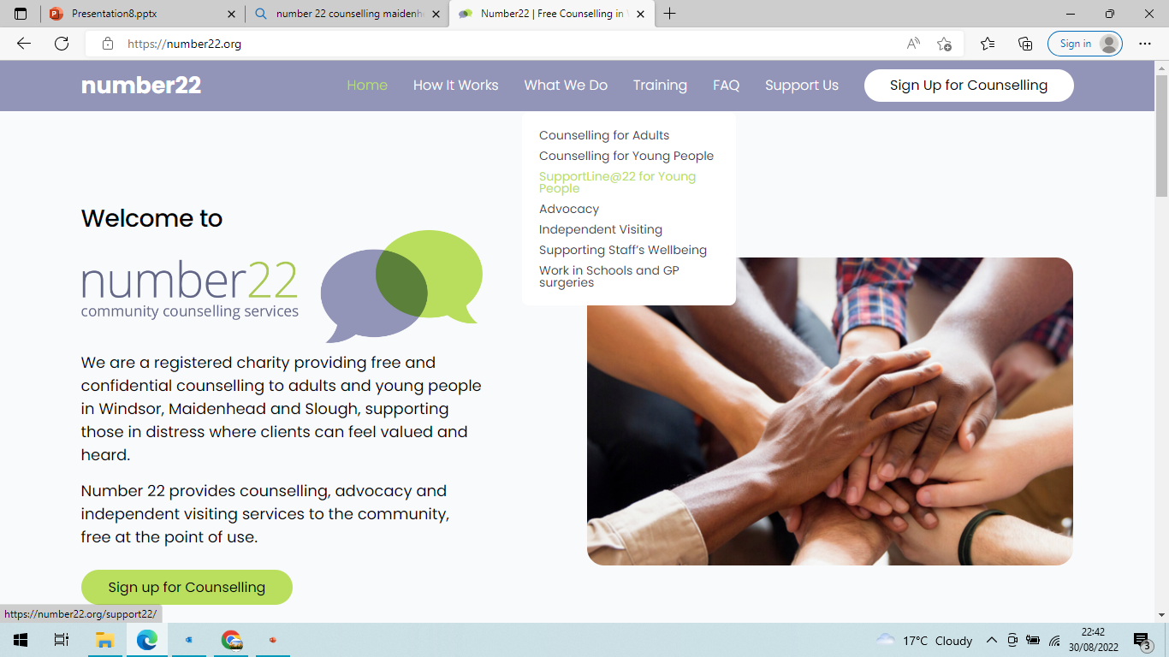
2. Click on 'What we do' then a drop down box will show 'support line for young people' - please click

Slide 8
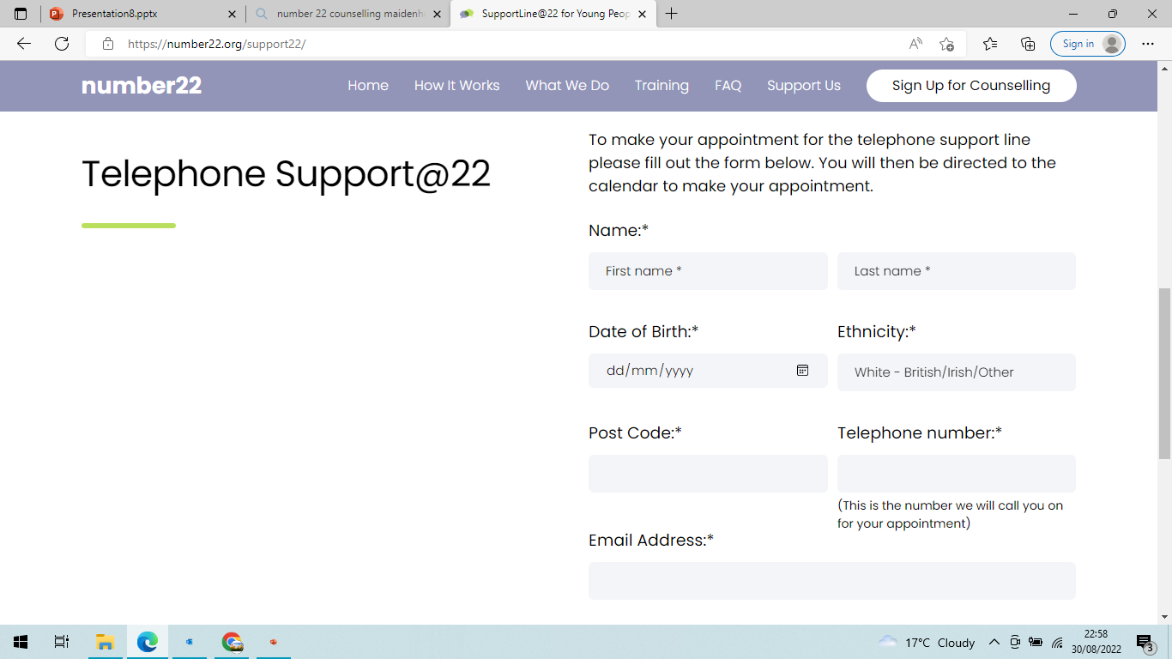
3.
Please complete your details, then click on 'select appointment time'.

Slide 9
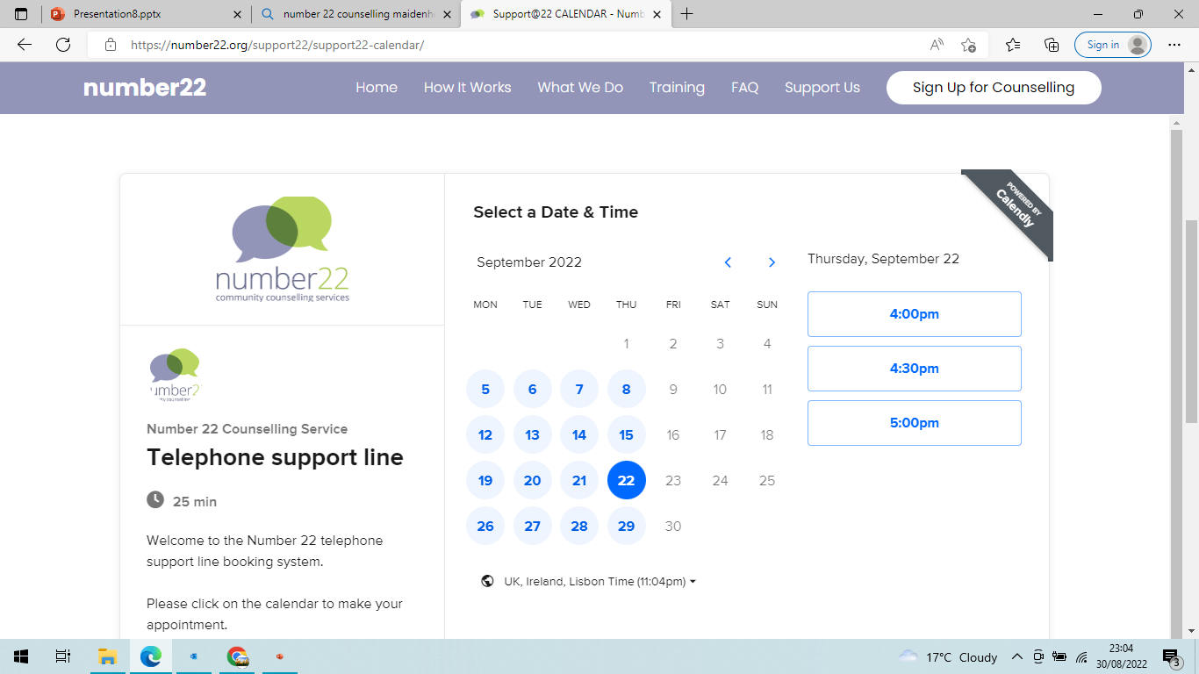
4.
The Calendar will then pop up showing you the available times.
Click on the time that suits you to make your appointment.

Slide 10
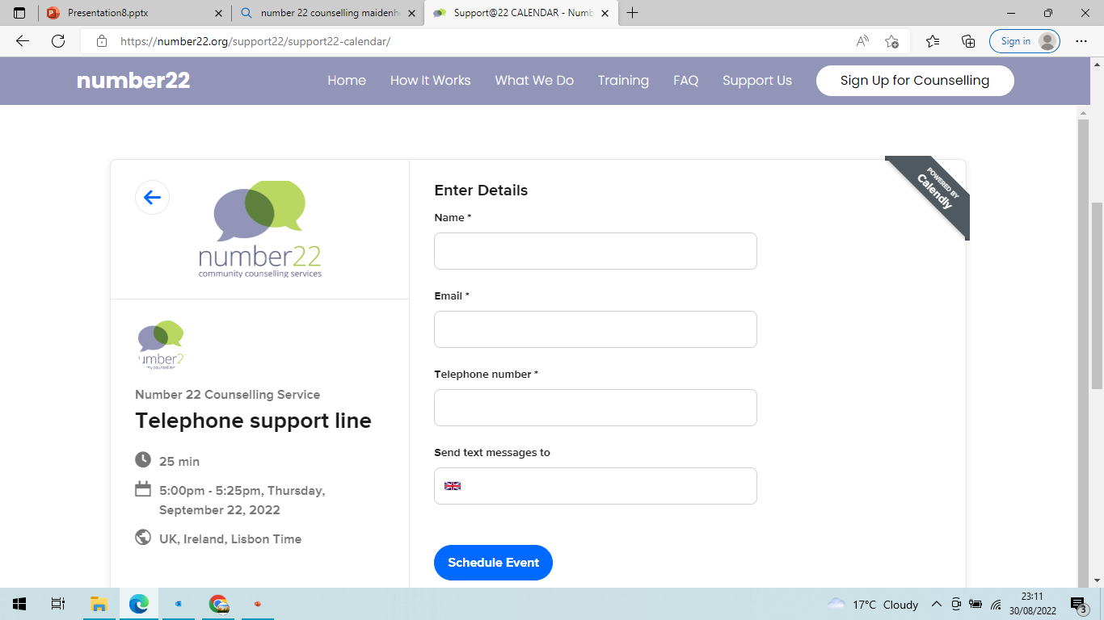
5. Add your details and click schedule event.

Slide 11

Yippee your appointment is made

Slide 12

One of our counsellors will call you at your appointment time.

Slide 13

If you would like any further information, please contact
Sarah.luke@number22.org

