Slide 1

Attitudes to Mental Health

Slide 2

Ground rules
[Add your class rules here]
Notes:
Teacher Notes
Use this slide to display your class agreement / ground rules for PSHE education lessons. See Accompanying Teacher Guidance Notes (separate document). It is probable that a student will have direct experience of someone with poor mental health or a mental health condition. With that in mind give students a chance to ask anonymous questions via your usual method such as a question box or ‘ask it basket’. It is important to address these, with the whole class or individually as appropriate, during the scheme of work.

Slide 3



  We are learning:
  about attitudes to mental health and challenging misconceptions
  We will be able to:
  evaluate the links between mental health and physical health
  identify common misconceptions about mental health
  recognise and challenge prejudice and discriminatory language and behaviour, in relation to mental health
Notes:
Teacher Notes - Learning objectives and outcomes
Introduce the learning objectives and outcomes, explain that today’s lesson is about mental health and how to recognise and challenge myths and misconceptions.

Slide 4

Explain to an alien
Why might some people find it hard to talk about mental health concerns?
What is mental health?
How can people look after their mental health?
What support could be given to someone with mental health concerns?
Notes:
Teacher Notes (10 MIN) Explain to an alien
Ask students to imagine an alien has come to earth and wants to know about mental health. Using Resource 1: Explain to an alien, students should try to answer each of the alien’s questions, with as much detail as they can. As this is a baseline assessment for the scheme of work, they should work individually and without prompting from the teacher, in order to get an accurate representation of their current understanding. Ask students to put the sheets aside as they will be revisited at the end of the lesson.

Slide 5

Defining mental health
“A complete state of physical, mental and emotional wellbeing not merely the absence of disease.”
World Health Organisation’s definition of health
How can we define mental health?
What is the link between physical and mental health?
Notes:
Emphasise at this point that mental and physical health are closely linked, for example by promoting their physical health (through exercise, healthy food choice and quality sleep) a person is also promoting their mental health.

Slide 6



True or false quiz
Notes:
Teacher Notes (10 MIN) True or false quiz
In pairs, ask students to complete Resource 2a: True or false quiz. For a more active version of this activity, students could move to different sides of the room to represent ‘true’ or ‘false’ as each statement is read out.
Take feedback, ensuring that myths and misconceptions are challenged. Resource 2c includes additional teacher information to develop discussion. Students should annotate the ‘true’ information next to any statements marked ‘false’.
Support: Resource 2b is provided which is a simplified version of Resource 2. Questions posed are simplified versions of questions 2, 3, 5, 7, 8 & 9 from Resource 2.
Challenge: Encourage students to consider why they think these misconceptions might have occurred in the past. What could be done to prevent future misconceptions about mental health?

Slide 7

Exploring language
How might these statements make someone feel?
What could some more positive alternatives be?
Notes:
Teacher Notes (15 MIN) Exploring language
Explain to students that sometimes people find it difficult to talk about mental health, or might have little understanding of it and can therefore say things that might be unhelpful or offensive to others, often without meaning to.
Organise students into four groups and give each group a different sheet from Resource 3: Exploring language. Each group should spend 5 minutes adding ideas to the top and bottom half of the sheet, responding to the questions:
How might these statements make someone feel?
What could some more positive alternatives be?
After 5 minutes, have all students stick their sheet to the wall / desk, and ask the groups to move around the room look at each different group’s examples and ideas. They should add any additional ideas as they visit each sheet.
Take feedback, identifying key themes from each sheet:
Black = these statements demonstrate the flippant way people can use mental health language in everyday discussion. This is a subtle way in which mental health stigma is reinforced.
Blue = these statements are common of the types of responses people with a mental health issue sometimes get from friends or family. The statements diminish the issue and try to minimise the impact of experiencing a mental health issue.
Orange = these statements focus around unhelpful behaviours in relation to mental health, primarily excluding or deliberately trying to upset someone known to have mental health issues.
Green = these statements include unhelpful advice that people sometimes receive when discussing a mental health concern.
You can refer to Resource 4: Helpful language to provide examples of more positive alternatives.
Support: Students could be provided with Resource 4: Helpful language prompts or some appropriate responses could be modelled before starting the activity.
Challenge: Ask students to suggest reasons why this sort of language is used.

Slide 8

Challenging discrimination
What could be done by individuals/friends to challenge discrimination?
What could be done in schools to challenge discrimination?
What could be done in wider society to challenge discrimination?
Notes:
https://pixabay.com/photos/team-motivation-teamwork-together-386673/
Teacher Notes (10 MIN) Challenging discrimination
Ask students to work in pairs to suggest ideas about how mental health stigma and discrimination could be challenged using the questions on the slide. If time allows, share ideas as a class, either using post-it notes stuck at the front of the room, a class mind map, or students with the longest list read out their ideas.
Students might suggest ideas such as:
Individuals: avoid using language that might be offensive or upsetting, challenge this language when it is used, encourage people to be understanding and supportive around mental health, avoid trivialising or making fun of mental health issues;
Schools: teach more about mental health, promote school counsellors and other sources of support to normalise help-seeking behaviours, have ‘positive mental health’ events, make all people feel included, use displays to promote mental health;
Society: Mental health campaigns, more funding for mental health charities or services, stronger laws about discrimination of people with mental health, mental health support services in workplaces to both support and destigmatise those with mental health concerns, encourage open-ness around mental health issues, etc.

Slide 9
Revisit your alien
Why might some people find it hard to talk about mental health concerns?
What is mental health?
How can people look after their mental health?
What support could be given to someone with mental health concerns?
Notes:
Teacher Notes (5 MIN) Endpoint assessment
Revisit the baseline activity, using Resource 1: explain to an alien. Ask students to make any additions or edits to their original responses with a different coloured pen to demonstrate what they have learnt. This can be kept as assessment evidence and used to inform future teaching.

Slide 10

What different type of mental health issues do you know?

Slide 11
Anxiety:
A feeling of apprehension and fear, characterized by physical symptoms such as palpitations, sweating, and feelings of stress.
Depression:
A mood disorder that causes a persistent feeling of sadness and loss of interest. It affects how you feel, think and behave and can lead to a variety of emotional and physical problems.

Slide 12
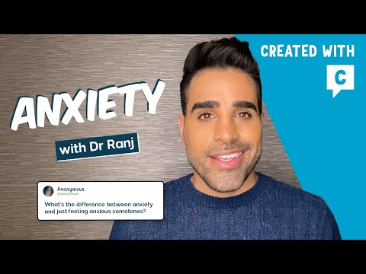

Slide 13
Depression and Anxiety
1 in 4 people will experience some kind of mental health problem in the course of a year
Mixed anxiety and depression is the most common mental disorder in Britain
Women are more likely to have been treated for a mental health problem than men
About 10% of children have a mental health problem at any one time
Depression affects 1 in 5 older people
Suicides rates show that British men are three times as likely to die by suicide than British women
Self-harm statistics for the UK show one of the highest rates in Europe: 400 per 100,000 population
Only 1 in 10 prisoners has no mental disorder

Slide 14
True or false game

Slide 15
False. Sometimes depression can happen even when life is going well. Depression can be set off by things going wrong in your life, but that isn't always the case. Depression might be associated with chemical imbalance in the brain.
Depression happens when something bad goes on in your life, such as divorce, the death of a loved one or losing your job

Slide 16
If you can't snap out of your depression or anxiety, it means you're weak
False. Being able to talk about your mental health issues and seek support is a sign of strength.

Slide 17
Depression or Anxiety means that you have something wrong with your character
False. It doesn't mean you aren't strong enough emotionally. It's a real medical condition, like diabetes or arthritis.

Slide 18
If you wait long enough, your depression or anxiety will always go away
False. If you're suffering from depression or anxiety, it might not just go away. For some people, if it isn't treated, their depression can last months, or even years

Slide 19
Only suicidal people need antidepressants
False. Antidepressants are not just for people who think about suicide. Antidepressants might help people who are depressed feel better.

Slide 20
People who suffer from depression need medication
True/false - sometimes medication can help people to cope with depression temporarily or in the long term. This is unique to each individual and you would need professional advice to consider whether this is best for you if you needed help

Slide 21
People who are depressed can be happy sometimes
True. It is not a fixed state.

Slide 22
Depression can go away and then come back again
True. Sometimes it does go away for good.

Slide 23
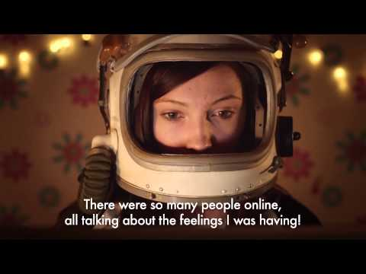

Slide 24
Scenario cards
What assumptions would you make if a friend displayed this type of behaviour?
At what point would you, as a peer start to worry?
Notes:
(Print scenario cards from lesson plan document)
Scenario 1
A young person in your class is
repeatedly missing school and when
they do attend is coming in late to class.
Scenario 2
A young person is being secretive when
eating at break and at lunch.
Scenario 3
A young person in your class is often
seen being argumentative and impatient
with friends.
Scenario 4
A popular young person in your year
group, who you know, has withdrawn
from their friends and is often seen
alone at break and lunchtime.

Slide 25
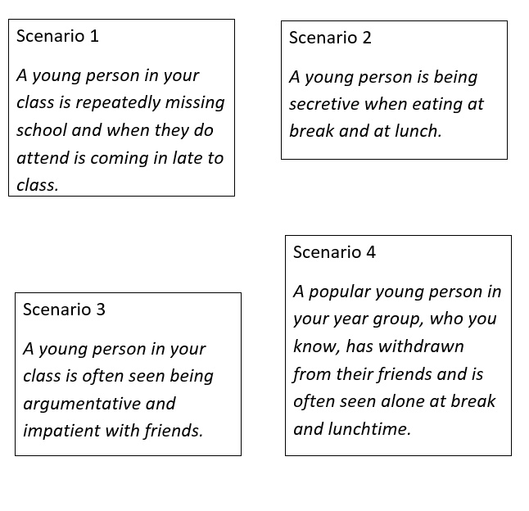
Scenario cards
What assumptions would you make if a friend displayed this type of behaviour?
At what point would you, as a peer start to worry?
Notes:
(Print scenario cards from lesson plan document)
Scenario 1
A young person in your class is
repeatedly missing school and when
they do attend is coming in late to class.
Scenario 2
A young person is being secretive when
eating at break and at lunch.
Scenario 3
A young person in your class is often
seen being argumentative and impatient
with friends.
Scenario 4
A popular young person in your year
group, who you know, has withdrawn
from their friends and is often seen
alone at break and lunchtime.

Slide 26
Being connected to others
In some of those scenarios, people were distancing themselves from others
However, forming bonds and good relationships with others can be helpful in dealing with mental health issues. Not only do they provide a support network but social interaction can make you feel happier and more fulfilled.

Slide 27
What do you think?
One in ten young people have a mental health problem at some point yet stigma and discrimination is preventing them from fulfilling their true potential.
Nine out of ten young people report negative reactions from others as a result of their mental illness.
(Time to Change research, 2012)

Slide 28
It can happen at any age
“Too many people are in a hurry to label someone with depression as weak or just weird. But it is not something the person can control. It takes over your life and smothers you. I've had depression ever since I was 10 years old. And it greatly strained my school performance, and ability to make friends because no one understood. The best thing you can do is be supporting and listen. It is a small thing to do, but the impact you can make on someone's life will last forever.”
--Cynthia.

Slide 29
What would you say?
What would you say to somebody that you know if you found out they were suffering from depression or anxiety?
What would you think?
Notes:
Hope you’re OK? I’ll call you soon.
Let’s get together soon. I am here for you.
Haven’t heard from you in a while. Hope
you are OK? Let’s meet soon.
I could really do with a chat soon.
You around?
I am here and ready any time you want
to chat.
My _____ [fill in appropriate relationship]
had mental health problems, but asked
for help and now they are fully recovered.

Slide 30
What should you do?
What do you think you should do if you think a friend or yourself is suffering from depression or anxiety (or any other mental health issues)?

Slide 31
PLENARY
What is more important, mental health or physical health?

Slide 32
Let’s talk about it!!
Talk to your parents or other trusted family members
Talk to your tutor/HOL/any teacher you feel comfortable talking to
Talk to Mrs Smajlaj
Talk to your GP
Call a helpline – e.g. Samaritans – 116 123
https://www.nhs.uk/conditions/stress-anxiety-depression/mental-health-helplines/

