Slide 1
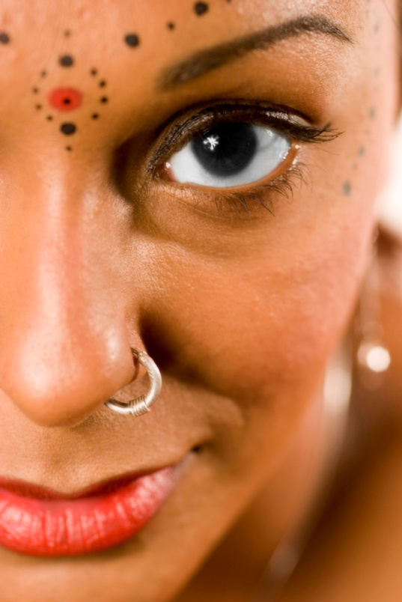

Puberty and Body Image

Slide 2
Puberty and Body Image
        The post-it notes are for you to write down any questions you have at any time. We will go through them at the end of the lesson

Slide 3
WHAT IS PUBERTY?
        Puberty is the stage in someone's life when they develop from a child into an adult because of changes in their body that make them able to have children. These physical changes are accompanied by emotional changes as we develop our identities and our hormones change.
Using the cards, arrange the changes that might occur during puberty into those which are ‘biologically male’, ‘biologically female’, and ‘can happen to anyone during puberty’.
Can happen to anyone during puberty
Biologically male
Biologically female

Slide 4
PUBERTY CHANGES CARD SORT
Biologically male changes
Changes that can happen to anyone during puberty
Biologically female changes
Voice changes to get deeper | Moods seem to change a lot | Spots might start appearing | Period starts
The penis and testes grow | Some people begin to masturbate | Hair starts to grow under arms | Breasts begin to grow
Hair starts to grow on face | Start to sweat more and smell differently | The body starts to change shape and size | Hips grow wider
Shoulders become wider | Feeling intense emotions | Sexual feelings may begin | A white liquid (discharge) starts coming out of the vagina
Sperm starts being produced | Hair may become greasy | Hair starts to grow around the genitals | Eggs start to mature
May have spontaneous erections and wet dreams | Confusion about maturity | Can feel teary or angry for no reason | Sometimes nipples become fuller or darker

Slide 5
Select 5 of the best things to happen to you in puberty and 5 of the worst
Biologically male changes
Changes that can happen to anyone during puberty
Biologically female changes
Voice changes to get deeper | Moods seem to change a lot | Spots might start appearing | Period starts
The penis and testes grow | Some people begin to masturbate | Hair starts to grow under arms | Breasts begin to grow
Hair starts to grow on face | Start to sweat more and smell differently | The body starts to change shape and size | Hips grow wider
Shoulders become wider | Feeling intense emotions | Sexual feelings may begin | A white liquid (discharge) starts coming out of the vagina
Sperm starts being produced | Hair may become greasy | Hair starts to grow around the genitals | Eggs start to mature
May have spontaneous erections and wet dreams | Confusion about maturity | Can feel teary or angry for no reason | Sometimes nipples become fuller or darker

Slide 6
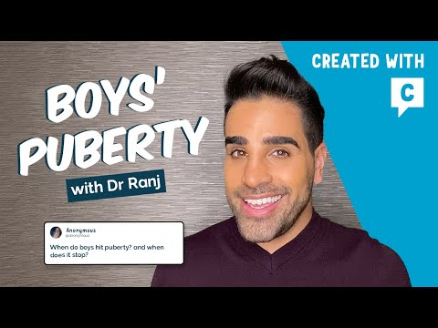

Slide 7
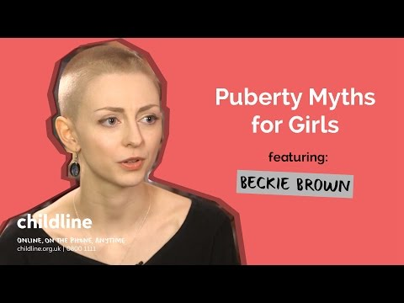

Slide 8
What is body image?
‘Your body image is how and what you think and feel about your body.’
It also includes the picture of your body that you have in your own mind, which might or might not match your body’s actual shape and size.

Slide 9
A positive body image
‘A positive or healthy body image is feeling happy and satisfied about your body, as well as being comfortable with and accepting the way you look.’

Slide 10
A negative body image
‘A negative or unhealthy body image is being unhappy with the way you look. It’s often associated with wanting to change your body size or shape.’

Slide 11
What affects our body image?
In pairs think of as many things that could affect a persons’ body image.

Slide 12
What affects our body image?
family
The media
Peer groups
culture
movies

Slide 13
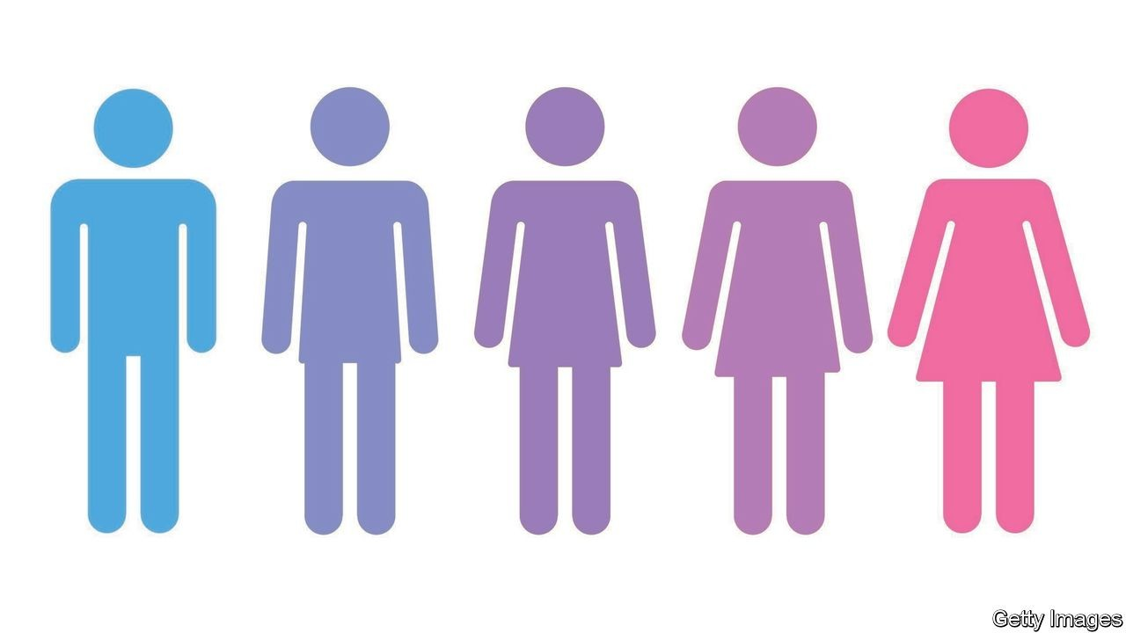
Remember
As your body changes through puberty it is important to remember that everyone’s bodies are different and to try to maintain a positive body image.

Slide 14
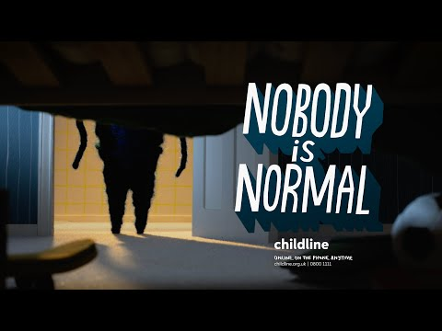

Slide 15
Final Task
Please fill out the "after" column on the first page of the booklet and the box at the bottom of the page.
Post-it note questions?????

Slide 16


