Slide 1



Slide 2



Starter discussion -
Defining peer pressure
In pairs you have 1 minute to write a definition of peer pressure.
1 minute

Slide 3

How does peer pressure make you feel?
What can you do if you feel peer pressure?
#
Who can put peer pressure on you?
What can peer pressure online look like?
!!!
???
What is the difference between pressuring someone and encouraging them?

Slide 4





Activity –
Peer pressure:
myths –v- truths?
Your teacher will read out statements about peer pressure. If you think it is a myth, stick your thumb down, if you think it is a truth, do a thumbs up!

Slide 5

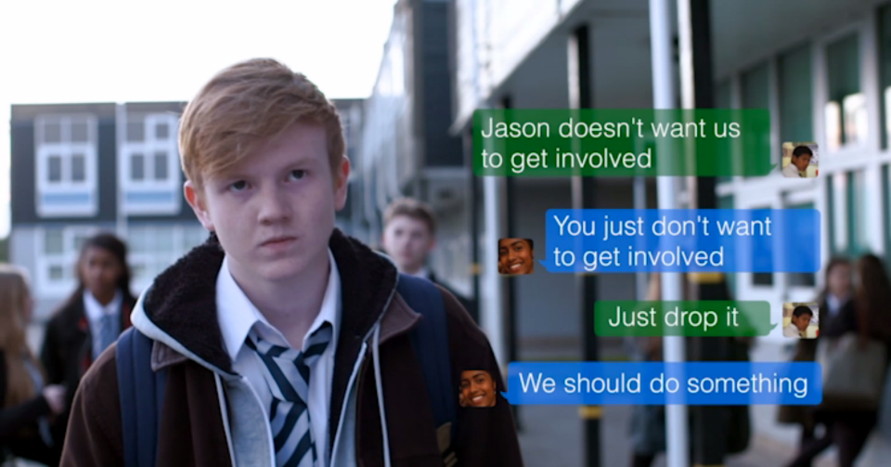
Watch “Back me up”
http://www.childnet.com/resources/pshetoolkit/peer-pressure/back-me-up

Slide 6







Why does Jack go along with what Charlie is doing? Why is Charlie able to manipulate him?
Are Jack and Charlie equally responsible for bullying Jason? eg. because Jack allowed Charlie to use his phone?
If others like the pictures or share them, are they also joining in with the bullying?
A bystander is someone who sees bullying happen and although they don’t get involved, they don’t speak out against it either. Can you name the bystanders in this film?

Slide 7


Ben, Jenna and Leah are Jason’s friends. Why are they reluctant to stand up for Jason or want to get involved? Do you think they are bad friends? Would you expect your friends to stick up for you online?
What would happen if Jenna, Leah and Ben wrote back on behalf of Jason and said something mean back to Charlie?

Slide 8






Why do you think the teacher, Ms Thomas, wants to speak to Jack?
Charlie says the picture with the mean comments will ‘disappear in a second, no harm done’. Is this true?
Do we know who stepped in to take action to report the cyberbullying to the school? Leah? Ben? Someone else anonymously? Why did they step in at that point? Was this the right thing to do?
What do you think happens at the end of the film? Does the situation improve?
What do you think would happen if no one reported or said anything about the cyberbullying to the school. Is there a reason why you might not report to the school?

Slide 9
The sending of explicit images
Sending or sharing explicit images is breaking the law.
If you are under 18 and you send, upload or forward indecent images or videos on to your friends or partner, this would be breaking the law, even if they are photos of you.
Another person could share the photo with other people, or post it online, which means anyone could see it, (e.g. family, friends, teachers, even future employers).
In extreme cases, it could be used to blackmail the sender into sending more photos or videos.
If the relationship ends, the images could be shared as a way to humiliate the former partner (‘revenge porn’).
It could lead to a range of other consequences, including bullying or unwanted attention from others.

Slide 10
… and for the person asking for explicit images
If someone pressurizes another person to send them sexually explicit or nude pictures, this is abusive and not normal or acceptable..
Even asking for a explicit image can be considered sexual harassment, this can result in charges or prison time
If someone has any indecent images or videos of somebody who is under the age of 18 they would technically be in possession of an indecent image of a child, even if they are the same age. This is in an offence under the Protection of Children Act 1978 and the criminal Justice ACT 1988.
Read the following article for how widespread this problem is
https://www.bbc.co.uk/news/education-57411363

Slide 11
What to do if an image is sent?
1 – Take the picture down, if you posted it log into the app and delete it
2 – Ask others to delete it if someone else has posted it. Report the incident to a teacher.
3 – Report it to the website and ask them to remove it.
4 – Get help if you are being bullied. If people are being mean about an image of you or sharing a video to embarrass you, ask for help from an adult you trust.
5 – Report if you are being threatened.
You can talk to an adult you trust or report directly to CEOP. Under 18s can report to CEOP concerns over online images or sexual abuse

Slide 12


What would you do quiz?
What would you do quiz?
In pairs, ask and answer the quiz on worksheet 3.2. Be as honest as you can!
In pairs, ask and answer the quiz on worksheet 3.2. Be as honest as you can!
10 minutes
10 minutes

Slide 13
What would you do quiz?
What would you do quiz?
Add up your scores.
1: A (2), B (1), C (0),
2: A (2), B (0), C (1),
3: A (1), B (2), C (0),
4: A (2), B (1), C (0),
5: A (0), B (2), C (1)
In pairs, ask and answer the quiz on worksheet 3.2. Be as honest as you can!
10 minues
10 minutes

Slide 14
10 minutes
How did you do?
0–4: You’ve got some work to do. It is difficult to know what the right thing is to do online. Try to chat to your friends about the pressures you feel while online and chat about what you expect from each other.
4–6: You’re on the way! You are on the right path and you have a good group of friends. You know what is right, but sometimes you allow yourself to be influenced by others.
6–10: You’re a good online friend! Well done, you are a really strong individual and you try to do the right thing online and offline. You try not to allow peer pressure affect you and you are well able to speak your mind.

