Slide 1
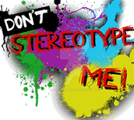

Challenging Stereotypes

Slide 2
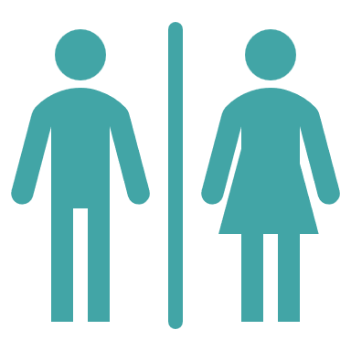

Gender stereotypes
Split your page in half and create two mind-maps, titled male and female.
Add at least three personality traits to each mind-map that you think society associates with identifying as male or female. For example, caring, ambitious, confident, shy, etc.
Male
Female
You do not have to agree with these associations yourself!
Notes:
Teacher’s notes:
Students are to annotate their mind-maps with at least three personality traits they think society associates with being male or female. Students don’t have to agree with these associations (they might strongly disagree!)
You may wish to remind students that lots of people identify as a gender other than male or female. For this task, male and female are used as examples of gender.
Students do not need to share their personality traits with the class. They will use their mind-maps to answer the reflection questions on the next slide.

Slide 3
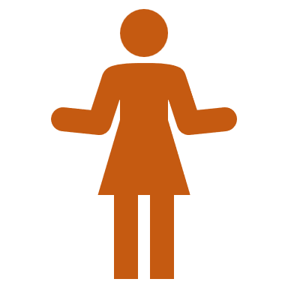
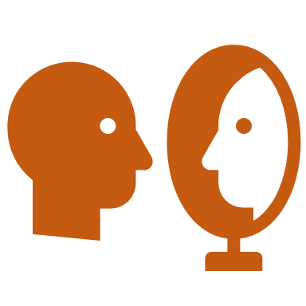
Gender stereotypes
The phrases in your mind-maps would be examples of gender stereotypes or gender roles: the way that society expects people to think, feel, and act, based on their gender.
Revisit the words in your mind-maps and think about these questions:
1. Can anyone have the personality traits you’ve written down?
2. What might be the problem with society having gender stereotypes?
3. How might people feel if they don’t match society’s expectation for their gender?
Notes:
Teacher’s notes:
Suggested answers:
Yes! Gender roles don’t define or limit our personality. Everyone is unique in their personality, regardless of gender identity. Gender roles can be different in different cultures, and they can change and develop over time.
There can be lots of consequences of gender stereotypes and gender roles, such as:
Feeling pressure to act a certain way.
Expectations of gender roles within a relationship, for example, childcare, being the ‘bread winner’ (contributing money,) making decisions, household duties, etc.
Expectations at work and inequalities in promotions and subsequent pay.
Seeing some careers as unattainable.
Not feeling comfortable to talk about emotions and seek support for mental health concerns. For example, society often stereotypes males are being strong and resilient. This could lead to some males thinking that society will see them as weak if they talk about emotions. The Mental Health Foundation reported that 28% of males hadn’t sought medical help for their last mental health problem, compared to 19% of females.
Gender stereotypes can lead to struggles for people who feel like they don’t fit society’s expectations of their gender. For example, if a society has a gender stereotype that females are ‘nurturing’ then a woman who wants to be single and who doesn’t want to have children may feel like something is wrong with them. In reality, nothing is wrong with them! Society’s expectations can put pressure on people to feel, think, and behave in certain ways.

Slide 4
What do we mean by gender?
Match the terms relating to gender with their definitions.
a) Having the same gender identity as our sex assigned at birth
b) The label assigned at birth based on genitals, hormones, and chromosomes
Sex
Gender identity
Non-binary
c) Personal sense of having a particular gender (could be the same or different as our assigned sex)
d) Having a gender identity different to our sex assigned at birth
Transgender
Sexual orientation
e) Identifying as a gender other than male or female
f) The label we give ourselves based on who we’re attracted to
Cisgender
Notes:
Teacher’s notes:
Students to use the accompanying letters to match the definitions to the correct terms. Click to reveal answers.
Answers and additional information:
Sex: B. This is the biological label given at birth based on genitals, hormones, and chromosomes. Some people prefer to use the phrases ‘assigned male at birth’ (AMAB) or ‘assigned female at birth’ (AFAB) as these phrases recognise that sex was a decision made by a doctor at birth, not something the person has decided themselves. Intersex is an umbrella term to describe biological variations that do not fit neatly into male or female categories.
Gender identity: C. This is our personal sense of having a particular gender, which could be the same or different as our sex assigned at birth. It is an internal, personal feeling. It’s about the relationship between a person’s body, their identity and expression, and how they and society view those things. A gender identity does not have to relate to a biological sex. There are a wide range of gender identities, including non-binary and gender-neutral.
Non-binary: E. This is identifying as a gender other than male or female. The concept of categorising people as male or female is called gender binary. Whereas, some people feel their gender doesn’t fit into these categories, as gender identity is more varied than this.
Transgender: D. This is having a gender identity that does not align with the sex assigned at birth. This is sometimes abbreviated to trans. For example, someone born with a vulva and vagina would have been labelled female at birth. Later on, if that person grows up and knows they’re male, they may identify as transgender.
Sexual orientation: F. This is a label we give ourselves based on who we are romantically and sexually attracted to. There are lots of different sexual orientations. For example, the phrase gay is often used by people who feel romantically and sexually attracted to people of the same gender as themselves. The phrase straight is often used by people who feel romantically and sexually attracted to people of a different gender than themselves. The phrase bisexual is often used by people who feel romantically and sexually attracted to more than one gender. These are just a few examples!
Cisgender: A. This is having a gender identity that aligns with the sex assigned at birth. For example, someone born with a vulva and vagina would have been labelled female at birth. Later on, if that person grows up and knows they’re female, they may identify as cisgender.

Slide 5
What do we mean by gender?
Sex b) The label assigned at birth based on genitals, hormones, and chromosomes
Gender identity c) Personal sense of having a particular gender
Non-binary e) Identifying as a gender other than male or female
Transgender d) Having a gender identity different to our sex assigned at birth
Sexual orientation f) The label we give ourselves based on who we’re attracted to
Cisgender a) Having the same gender identity as our sex assigned at birth
This slide doesn’t contain every term relating to gender. There are lots more to explore!
Notes:
Teacher’s notes:
Click to reveal answers.
Answers and additional information:
Sex: B. This is the biological label given at birth based on genitals, hormones, and chromosomes. Some people prefer to use the phrases ‘assigned male at birth’ (AMAB) or ‘assigned female at birth’ (AFAB) as these phrases recognise that sex was a decision made by a doctor at birth, not something the person has decided themselves. Intersex is an umbrella term to describe biological variations that do not fit neatly into male or female categories.
Gender identity: C. This is our personal sense of having a particular gender, which could be the same or different as our sex assigned at birth. It is an internal, personal feeling. It’s about the relationship between a person’s body, their identity and expression, and how they and society view those things. A gender identity does not have to relate to a biological sex. There are a wide range of gender identities, including non-binary and gender-neutral.
Non-binary: E. This is identifying as a gender other than male or female. The concept of categorising people as male or female is called gender binary. Whereas, some people feel their gender doesn’t fit into these categories, as gender identity is more varied than this.
Transgender: D. This is having a gender identity that does not align with the sex assigned at birth. This is sometimes abbreviated to trans. For example, someone born with a vulva and vagina would have been labelled female at birth. Later on, if that person grows up and knows they’re male, they may identify as transgender.
Sexual orientation: F. This is a label we give ourselves based on who we are romantically and sexually attracted to. There are lots of different sexual orientations. For example, the phrase gay is often used by people who feel romantically and sexually attracted to people of the same gender as themselves. The phrase straight is often used by people who feel romantically and sexually attracted to people of a different gender than themselves. The phrase bisexual is often used by people who feel romantically and sexually attracted to more than one gender. These are just a few examples!
Cisgender: A. This is having a gender identity that aligns with the sex assigned at birth. For example, someone born with a vulva and vagina would have been labelled female at birth. Later on, if that person grows up and knows they’re female, they may identify as cisgender.

Slide 6

What do we mean by stereotypes?
You will have 45 seconds to complete a task that will soon appear on the slide. Make sure you have paper and a pen or pencil in front of you.
Ready, set, go!
Sketch a drawing of two people on a first date at a restaurant
Times up!
Pens and pencils down!
Notes:
Teacher’s notes:
Click to reveal task: sketch a drawing of two people on a first date at a restaurant. Once the task is revealed, the ‘times up!’ message will appear automatically after 30 seconds.

Slide 7
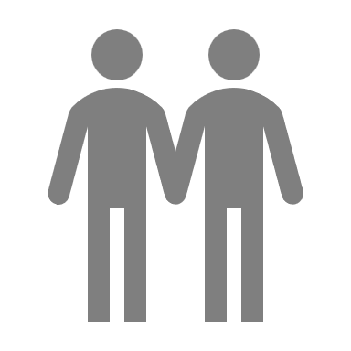
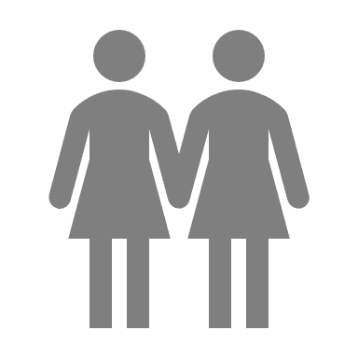

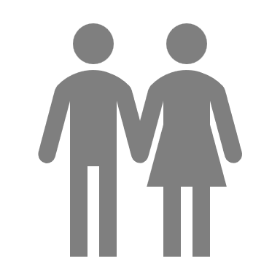

What do we mean by stereotypes?
You don’t need to share your drawing with anyone or answer these questions out loud. But take a moment to think…
Did you draw someone with a non-binary gender identity?
Did you draw two females?
Did you draw two males?
Did you draw a male and a female?
When asked to complete this task, most people would draw a cisgender heterosexual couple.
Why do you think this is?
Notes:
Teacher’s notes:
Students should not be forced to share their drawing with others or state the implied sex, gender, or sexual orientation of the people they drew. This task is designed for students to recognise that they may have their own implicit stereotypes about relationships and gender.
Prompt questions:
What gender identities are people most familiar with?
What sexual orientations are people most familiar with?
What types of couples are we most likely to see in society? How could this make someone feel if they are different to this?
What types of couples are we most likely to see in the media? How could this make someone feel if they are different to this?
Key words:
Cisgender. This is having a gender identity that aligns with the sex assigned at birth.
Heterosexual. Being romantically and sexually attracted to people of a different gender than themselves. This is often called being straight.
Heteronormativity: Society seeing heterosexuality as normal and other sexualities as abnormal.

Slide 8


What do we mean by stereotypes?
It’s common to hold stereotypes about gender and relationships. A stereotype is a fixed idea about a group of people based solely on one of their characteristics (e.g. race, age, sexuality, nationality, etc.)
But we also have a responsibility to recognise and challenge these stereotypes, as they can be inaccurate, harmful, or prejudiced.
Notes:
Teacher’s notes:
Key words:
Stereotypes. Fixed ideas about a group of people based solely on one of their characteristics (e.g. race, age, sexuality, nationality, etc.) This idea could be positive or negative. For example, believing that all British people like drinking tea is a stereotype.
Prejudice. Pre-judging someone, or making a decision about who they are, before learning anything about them. This judgement is usually based on a stereotype.
Discrimination. Treating a person, or a group, unfairly based on characteristics such as race, gender, age, or sex. For example, in the UK it is illegal to not employ someone because of their gender identity.
Heteronormativity: Society seeing heterosexuality as normal and other sexualities as abnormal.

Slide 9




Gender stereotypes: what’s the harm?
A study in the UK asked people aged 7-11 to draw different professionals, similar to the activity you just did. Write down your predictions for each result of the study.
1) ____% of children drew nurses as male.
19%
2) ____% of children drew builders as male.
88%
3) ____% of children drew bankers as male.
80%
4) ____% of children drew lawyers as male.
65%
Notes:
Teacher’s notes:
Click to reveal answers.
Answers:
19% of children drew nurses as male.
88% of children drew builders as male.
80% of children drew bankers as male.
65% of children drew lawyers as male.

Slide 10

Gender stereotypes: what’s the harm?
Gareth is a 16-year-old male, and he wants to become a nurse. He has just arranged work experience in a hospital. Some of Gareth’s friends laughed and made jokes when he told them about his career goal. One friend said, ‘that’s a woman’s job.’
Why might Gareth’s friends think nursing is a ‘woman’s job?’ List as many reasons as possible.
Why do you think some people laugh when they see others going against gender stereotypes?
How might the friends’ reactions make Gareth feel? Do you think they intended for him to feel this way?
Notes:
Teacher’s notes:
Gender stereotypes can lead to limitations of aspirations. For example, in this scenario, Gareth’s aspiration to become a nurse may be diminished due to his friends’ reactions. In 2020, around 90% of the world’s nurses were women. According to the National Health Workforce Data Portal, the percentage of male nurses differs across the world, ranging from a mean of 11% in the European region, to 38% in the African region between 2009 and 2019.
Additional prompt questions:
What other negative reactions could Gareth’s friends have had?
What positive reactions could Gareth’s friends have had instead?
Suggested answers:
They may live in a society that has a gender role of females being expected to be nurturing and caring (traits that are also associated with nursing.) These stereotypes may be reinforced by friends, family members, and the media. They might be copying what they’ve heard other people say, without understanding the negative consequences of this stereotype. The friends may have only ever encountered female nurses in their own lives. They may not understand the role of a nurse and the capability for people of any gender to carry out the role successfully.
Gareth’s friends may not have known how to react to someone going against a gender stereotype if they have never encountered this before. They may laugh due to feeling uncomfortable or nervous. They may be trying to reinforce the gender stereotype or change Gareth’s behaviour.
Disappointed, rejected, deflated, sad, angry, resentful, confused, doubtful, embarrassed, determined, courageous, enthusiastic. The comments could pressure him to question or change his career aspiration. Or he might feel empowered to challenge society’s gender stereotypes regarding nursing. Gareth’s friends may or may not have intended to make Gareth feel these emotions. They may be using ridicule and shame to try to reinforce cultural gender norms. People who do not conform to the gender stereotypes may make them feel uncomfortable and they might not know how to appropriately respond. They may be trying to purposely change Gareth’s behaviour.

Slide 11


How can we challenge gender stereotypes?
Remind yourself of Gareth’s case study.
Imagine you are friends with Gareth.
Gareth is a 16-year-old male, and he wants to become a nurse. He has just arranged work experience in a hospital. Some of Gareth’s friends laughed and made jokes when he told them about his career goal. One friend said, ‘that’s a woman’s job.’
Write down one thing you could do to support Gareth.
Write down one thing you could do to challenge the behaviour of Gareth’s other friends.
Notes:
Teacher’s notes:
Suggested answers:
Congratulate him about his work experience. Ask him questions about his career goal to show you’re interested. Offer a safe space for Gareth to talk about his aspirations without judgement or criticism.
Challenge sexist and stereotypical comments when they are made. Identify the gender role and question it – where has this idea come from? Explain the emotional impact that gender stereotypes can have. Be a positive role model and respect people regardless of whether they conform to gender stereotypes.

Slide 12
What other types of stereotypes can you think of?
Discuss in groups other stereotypes you have heard or witnessed.
https://www.youtube.com/watch?v=IocLkk3aYlk
Notes:
Teacher’s notes:
Key words:
Stereotypes. Fixed ideas about a group of people based solely on one of their characteristics (e.g. race, age, sexuality, nationality, etc.) This idea could be positive or negative. For example, believing that all British people like drinking tea is a stereotype.
Prejudice. Pre-judging someone, or making a decision about who they are, before learning anything about them. This judgement is usually based on a stereotype.
Discrimination. Treating a person, or a group, unfairly based on characteristics such as race, gender, age, or sex. For example, in the UK it is illegal to not employ someone because of their gender identity.
Heteronormativity: Society seeing heterosexuality as normal and other sexualities as abnormal.

