Slide 1



Slide 2





Students can understand the pressures on young people online
Students can understand the pressures of sending nudes/semi-nudes
Students can understand the possible consequences of sending such an image/message including the legal consequences
Students can understand a range of support available

Slide 3




“Girls have a more negative experience online”
Starter -
What do you think?
Speak to the person beside you: do you agree, do you disagree? Why?
Class vote

Slide 4

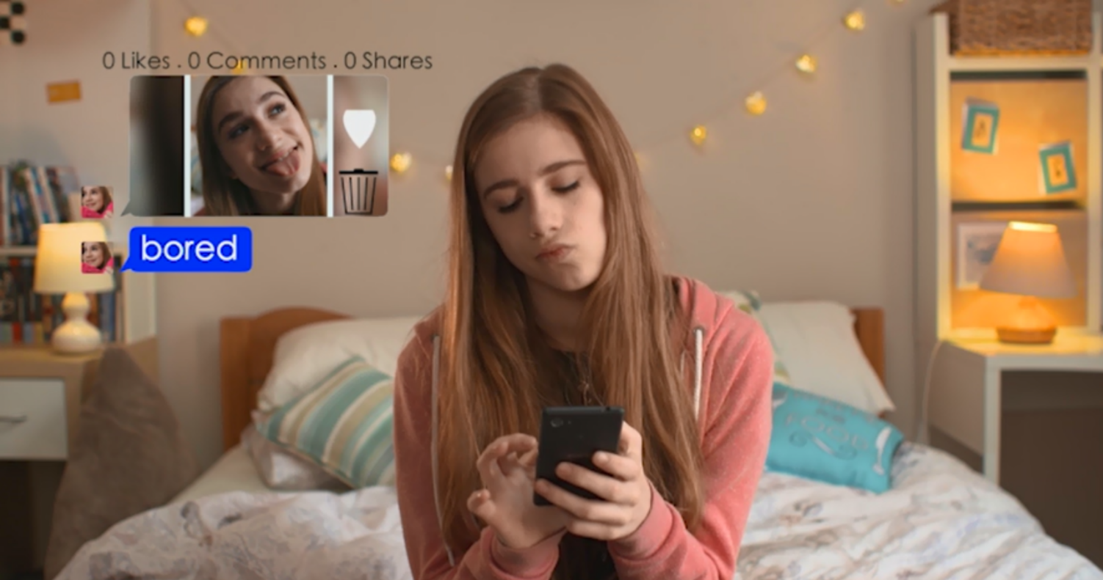
Watch “Just send it”
Crossing the Line PSHE Toolkit: Sexting - Just Send It - YouTube

Slide 5



Is this story realistic? Could a similar situation happen in this school?
The title of this toolkit is ‘Crossing the Line’. In this film, where do you think the line was crossed?
Why does Josh mention possible involvement from the police at the end of the film? Who do you think broke the law in this film?
Notes:
Suggested answers for teachers:
2) When Josh asked for the photo? When Abi sent the photo? When Brandon shared the photo?
3) Read more about the laws online in the guidance for educators section

Slide 6





Abi was reluctant at first to send the image to Josh. What made her change her mind?
Why did Josh ask for the photo? Did he feel any pressure to have images like this?
Did Abi give consent for her photo to be shared around the school? In this situation, who is more at fault – Josh, Abi or Brandon? Anyone else?
Do you think Josh respected Abi? How can you tell if someone respects you?
Notes:
Suggested answers for teachers:
Influence from her friends? Pressure from Josh? Wanting to keep Josh as her boyfriend?
4) He/she doesn’t pressure you into doing anything you don’t want to, they want to keep you happy

Slide 7



Some of the comments under Abi’s photo are quite mean. None of them seem to portray Josh in a negative light. Do you think there are different standards between boys and girls: if a guys sends the picture around or if a girl does?
Abi receives a naked picture of Josh first. What would happen if Abi decided to share this picture around to others?
What do you think of the comment that Eve makes when she says, “Gotta keep your man happy”? Is this how girls can feel; that they must keep their boyfriends or friends happy?

Slide 8







Instead of sharing the naked photo, what could Abi have done to let Josh know that although she likes him, she doesn’t want to send him a nude photo?
When she discovered the picture had been shared around, Abi didn’t want to go to school. She eventually told her mum, but who else could she have spoken to about her situation?
What could the other characters have done to help Abi?
What do you think happens next in the film? What happens when Abi goes back to school? What happens when Abi meets Josh for the first time? Would Abi want to meet Josh again?
Notes:
Suggested answers for teachers:
Zip-it app, made a joke, shared a selfie of herself but not a naked one
A pastoral head in school, a Year Head, Childline, friends, older brothers and sisters
Asked others to delete the picture, not share the picture around, explain/consider the consequences more

Slide 9
Zipit app
Zipit app is a Childline’s app and is free to download. If someone is trying to get you to send a naked/semi-naked image of yourself, use the Zipit app to keep control of the situation.
Remember, no-one should be making you do anything you don’t want to.
Think about last week’s lesson on healthy relationship.
A healthy relationship is characterised by equality and if someone is trying to make you/coerce you into doing something, that is not ok.

Slide 10


Activity 1 -
How to help Abi
In groups of three, use worksheet 2.1 to devise the response Abi should have written back to Josh in response for the naked picture, and the conversation she may have had with her friend Jenna about it.
7 minutes

Slide 11
Activity 2 -
‘What does the law say?’
1. Answer the quiz (worksheet 2.2) by yourself, to the best of your knowledge. (3 minutes)
2. Then, check your answers with the person beside you. (2 minutes)
5 minutes

Slide 12




What does the law say?
There are some laws that apply including:
Protection of Children Act 1978
To take, share or possess a nude or sexually explicit photo of someone under 18 is illegal even if it’s of yourself.
Malicious Communications Act 2003
Sending any form of message, including online, that is extremely offensive, obscene, menacing or indecent can break the law if sent on purpose.
Computer Misuse Act 1990
It can be illegal to impersonate or steal someone’s identity online.
If it’s unwanted, then it’s unacceptable.
Notes:
Explain that some incidents of online sexual harassment can break the law. There are several laws which can apply, including those on this slide.
Whilst they have a duty to investigate any crime that is reported to them, the police do so in order to ensure young people are being protected and to stop any further risk of harm.
They would need to speak to all persons involved in order to make the most appropriate decision on what to do next.
It is crucial to explain that if the police need to be involved, the school will support all students through that process.
Emphasise that even though the law gives us some boundaries, any behaviour which is unwanted is unacceptable, regardless of whether it breaks the law or not.

Slide 13
Key points:
Taking, sending a nude or semi-nude photo or video of anyone (including yourself) is illegal.
The law is there to protect young people, not to criminalise them and the police work to ensure young people are being protected and to stop any further risk of harm.
If the police need to be involved, the school will support all students through that process.
Even though the law gives us some boundaries, any behaviour which is unwanted is unacceptable, regardless of whether it breaks the law or not.
If you send or receive a nude or semi-nude, you should tell a trusted adult in order that we can help you to put it right.

Slide 14
Explicit images on the Internet/ social media
Unfortunately, explicit and pornographic images/videos are becoming more and more available on the Internet and social media.
This may have exacerbated the sending of nudes and semi-nudes and some people may think that it is normal to do so.
Remember what the law says and what we’ve just covered.

Slide 15
Who could you talk to if you receive or send a nude/semi-nude photo or video?
Any trusted adult.
Whilst you may discuss with friends, you need to involve a trusted adult so that they can fully support you.
This could include a member of the safeguarding team.
Remember the safeguarding team wear green lanyards and we are:
Mrs Rodriguez Designated Safeguarding Lead
Mrs Sharpe Deputy Designated Safeguarding Lead
Mr Parsons Deputy Designated Safeguarding Lead
Mr O’Donnell Deputy Designated Safeguarding Lead
Ms Rockall Deputy Designated Safeguarding Lead

Slide 16
Reporting concerns
We appreciate that, at times, it may be daunting raising or reporting a concern because you may not know what might happen.
To help remove this uncertainty as a possible obstacle to you reporting concerns, we have put together a list of possible issues and the likely action for the victim and (alleged) perpetrator.

Slide 17
Receiving/sending nudes or semi-nudes
For the victim
For the ‘alleged’ perpetrator
You will be advised by a member of the safeguarding team or your HoL as to the next steps.
It is vital you don’t share or distribute the image with anyone (even with the safeguarding team) as this is illegal.
You will be advised by a member of the safeguarding team as to the next steps. These will depend on many factors, such as who the image was sent to and whether it has been distributed.
Support offered to help remove image if it has been put online.

Slide 18
Receiving/sending nudes or semi-nudes(continued)
For the victim
For the ‘alleged’ perpetrator
If you have already shared it, please let a member of the safeguarding team know. The law is there to protect you and not to criminalise you. It’s better you let us know than try and keep it to yourself.
Support offered to help remove image if it has been put online.
Please remember that taking or sending nudes or semi-nudes if you’re under 18 is illegal.
However the law is there to protect you and not to criminalise you.
Non-consensual sharing of nudes/semi-nudes is illegal and abusive.

Slide 19
Being coerced into sending nudes or semi-nudes
For the victim
For the ‘alleged’ perpetrator
A member of the safeguarding team will advise you and take a statement from you to establish facts.
Support offered
Parents/carers informed
Report to the Police if coercion or threatening behaviour
Referral to Children’s services
Appropriate sanction issued and logged on your school record.
Behavioural support offered if appropriate.

Slide 20
Please note that for all safeguarding issues we consider working in partnership with parents/carers to be important.
We work with a range of external agencies to provide support in these situations.
Support and action will be considered on a case by case scenario and there may be times where the action taken differs from what has been outlined.

Slide 21

School staff might not always be experts in social media but that doesn’t mean they can’t help.
Schools have access to resources and support services which are specifically intended for these kinds of situations.
Using the tools on social media is a positive first step, but even if you successfully block someone online, it doesn’t always block the emotions you might be feeling.
If you don’t feel comfortable talking to teachers right away, there are helplines you can call for advice and support too.
Notes:
Talk through the response to the scenario, with input from students where appropriate.
Explain to students that you will signpost them to helplines where they can get support and advice at the end of the session.
Explain to students that before moving to the next slide, you want to emphasise the following point:
“Even if you successfully block someone online, it doesn’t always block the emotions you might be feeling.”
You might want to ask students what they think this means, or how they think you can deal with the emotional response to an incident of online sexual harassment.

Slide 22
Support
The Online Safety section of the Students section of the school website
https://www.herschel.slough.sch.uk/For-Students/Online-Safety
There is a link to this on you Safeguarding channel on Teams.
There are links to useful reporting tools, such as to Childline, CEOP, the IWF (Internet Watch foundation) which has support on how to get an online image removed.

Slide 23
To finish
If there is anything that has concerned or worried you from this session, please speak to a trusted adult.
Or think about all the other ways you could raise a concern and choose one of those.
Now please complete the ‘just send it’ evaluation sheet.

Slide 24



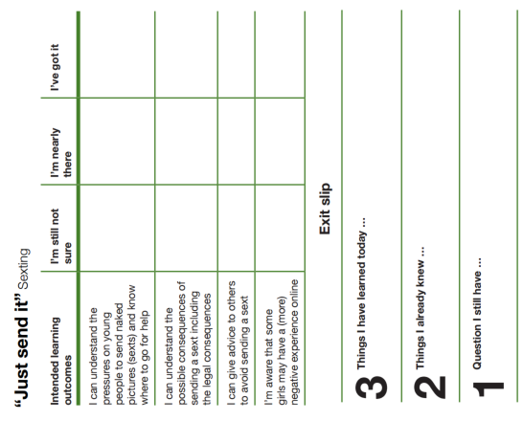

What do you now think about our starter question?
“Girls have a more negative experience online”
Fill out exit slip and tear off any question you have and put it in the anonymous question box. This will be answered at the next lesson.

Slide 25

Q&A
During next week’s session there will be a Q and A session, so please make a note of any questions you may have
However, if you have any concerns about any of the issues raised today, please don’t wait until next week. Please raise them immediately.
You can do this be speaking to your teacher after the lesson or if you are more comfortable doing so, by messaging any teacher you feel comfortable raising your concerns with.

