Slide 1

To understand a range of strategies for identifying and managing peer pressure in the context of intimacy.
To understand about sexual health and the different types of contraception
To understand about STIs

Slide 2


A reminder of the ground rules
We listen and respect everyone when they are speaking and when we are responding.
We know that we don’t have to participate in any activities or questions which make us feel uncomfortable.
We know that we are not expected to share our own personal experiences but are free to do so without judgement if we want to.
We speak about a ‘friend’ or ‘someone we know’ instead of using real names if we share experiences or stories.
Refer to page 16 of the guidance for full details

Slide 3
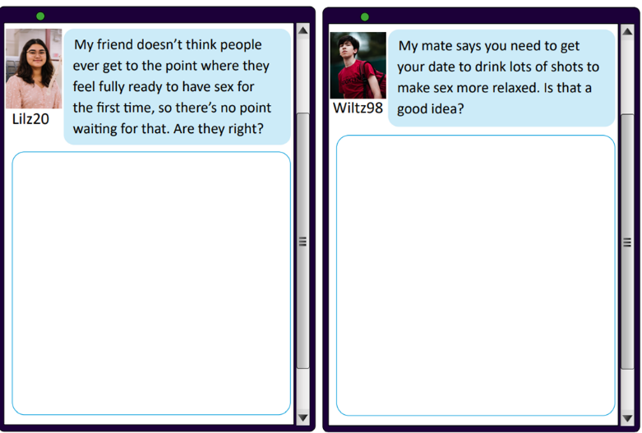
Starter: Read the 2 messages and note your thoughts/responses to them
Notes:
Give pupils a few minutes to discuss. Obviously challenge number 1 and remind them that the use of alcohol in number 2 can lead to risky sexual behaviour.

Slide 4
Intimacy in relationships
When is the right time to become intimate in a relationship?
When BOTH of you are ready to, provided you are both at least 16.
The law is clear that you must be 16 or over to have sex.
It is therefore illegal to have sex under the age of 16.
No-one should ever pressure you to have sex or do anything that you do not want to do.
Think about the work we did in lesson 1 on healthy relationships and also the work we have done on consent.

Slide 5
Sexual health: What about when you are ready…
We are now going to consider what you need to think about when you ARE ready to have sex.
We are going to look at contraception, what it is, the various different types of contraception and why contraception is so important.
Let’s start by seeing what you think you already know.

Slide 6
Sexual health Quiz
1. What are the risks of unprotected sex?
2. How can people protect themselves from unplanned pregnancies and STIs?
3. People who’ve not had sex before don’t need to worry about STIs – true or false?
4. You can’t get pregnant if it’s your first time of having sex- true or false?

Slide 7
Sexual Health Video: https://www.youtube.com/watch?v=pcjW34YkyDo

Slide 8
Contraception: What is it and what does it do?
Helps prevent pregnancy
Helps protect against STIs.

Slide 9
Contraception: Watch this short video https://www.youtube.com/watch?v=lM86exl8tIU

Slide 10
Contraception negotiation
How could someone respond assertively to these statements?
I’m on the pill, you don’t need a condom
It doesn’t feel as good if we use protection
Using protection interrupts everything
I guess you don’t really trust me
We’re both virgins so there aren’t any risks

Slide 11
STIs
We’ve seen how some forms of contraception can prevent against STIs.
But what are STIs?

Slide 12
Fact finding tasks
You are going to be passed some different fact sheets which you can use and then pass to different pairs/groups.
You will also have a double-sided worksheet to complete: Which STI? Multiple choice and Information hunt
You need to use the fact sheets to complete this.
If you finish, make some additional notes from what you have found out.
Notes:
Question sheet is page 36 of booklet
Fact sheets: p.39-44

Slide 13
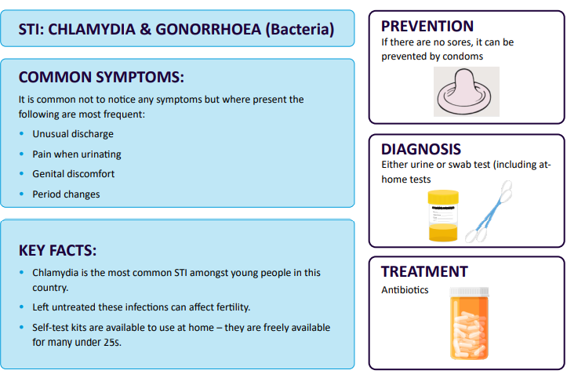

Slide 14
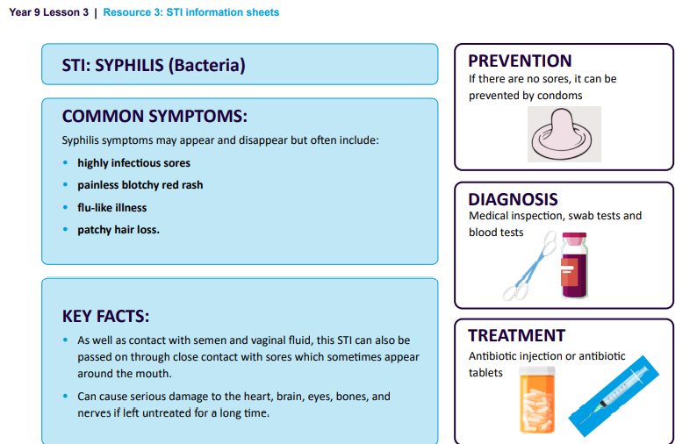

Slide 15
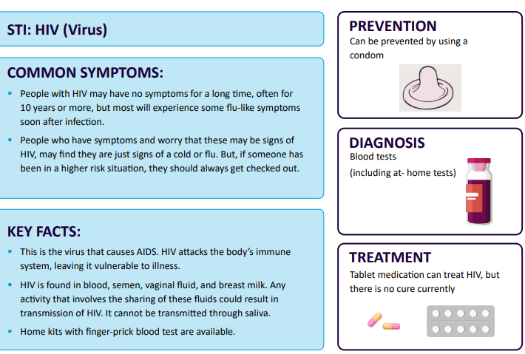

Slide 16
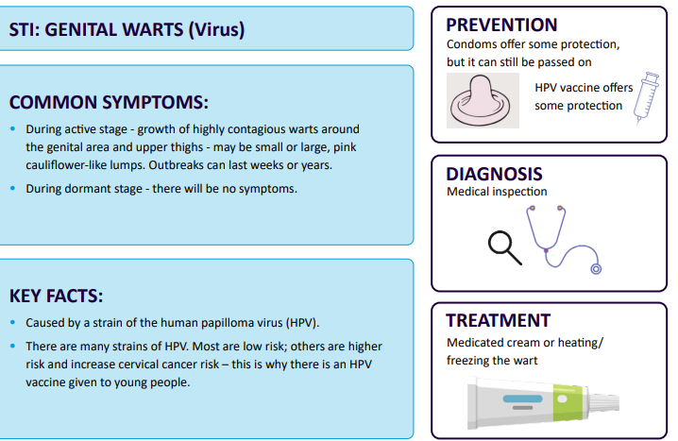

Slide 17
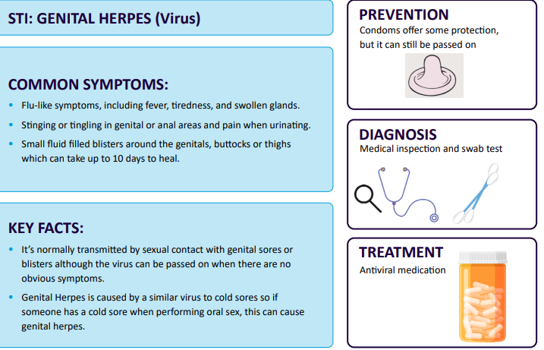

Slide 18
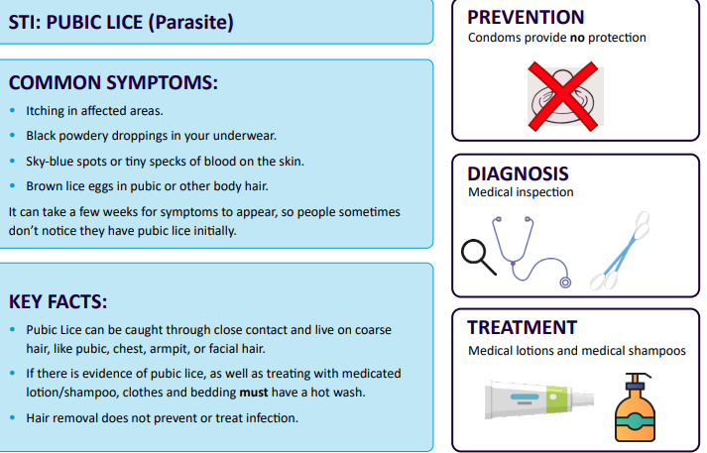

Slide 19
Answers: Which STI
1. always shows symptoms?
C: None of them
2. can cause unusual discharge?
A: Gonorrhoea
3. Cannot be prevented by using a condom
B: Pubic Lice

Slide 20
4. Is managed by using drugs to slow down the spread of the virus in the body?
B: HIV
5. Is diagnosed using a urine sample?
B: Chlamydia
6. can be treated if someone seeks medical support?
C: All of them.

Slide 21
Secret Lives of S.T.I’s video: https://www.truetube.co.uk/resource/the-secret-lives-of-stis

Slide 22
Where can you get contraception from?
Sexual health clinics, GP surgeries, and some pharmacies.
Even though you must be 16 or over to have sex, you can get some forms of contraception before then.

Slide 23
How can you get tested for an STI
You can order home test kits online
Visit family planning clinics
Visit your GP
Visit Nhs online

Slide 24
Useful sources of support
Family planning clinics
The Garden Clinic Slough
School
School nurse
Nhs website
Childline
https://www.brook.org.uk/

Slide 25
How well have you understood…
Let’s revisit the learning outcomes for today.
How well have you understood what we set out to achieve?
Notes:
Give pupils 5 minutes to discuss

Slide 26
To understand a range of strategies for identifying and managing peer pressure in the context of intimacy.
To understand about sexual health and the different types of contraception
To understand about STIs

