Slide 1
Interim Results 2015
22 October 2015
Energy ● Aviation ● Infrastructure

Slide 2
Interim Results 2015
  Contents
    Group Summary
    Financial Review
    Energy
    Aviation
    Infrastructure, Rail, Investments
    Outlook

Slide 3
Strategy
Identify opportunities
Realise value for shareholders
Grow businesses to create value
2018
3
1. Group Summary
2. Financial Review
1. Group Summary
3. Energy
4. Aviation
5. Infrastructure
6. Outlook

Slide 4
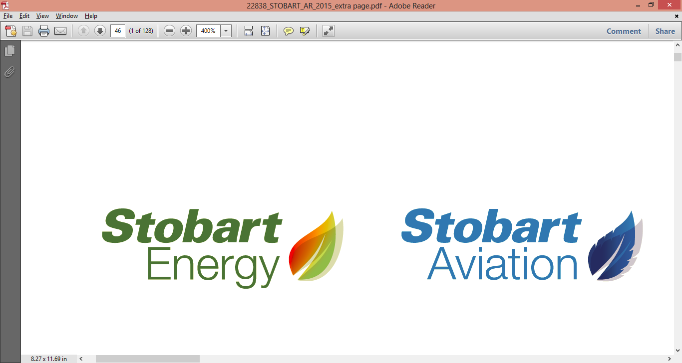
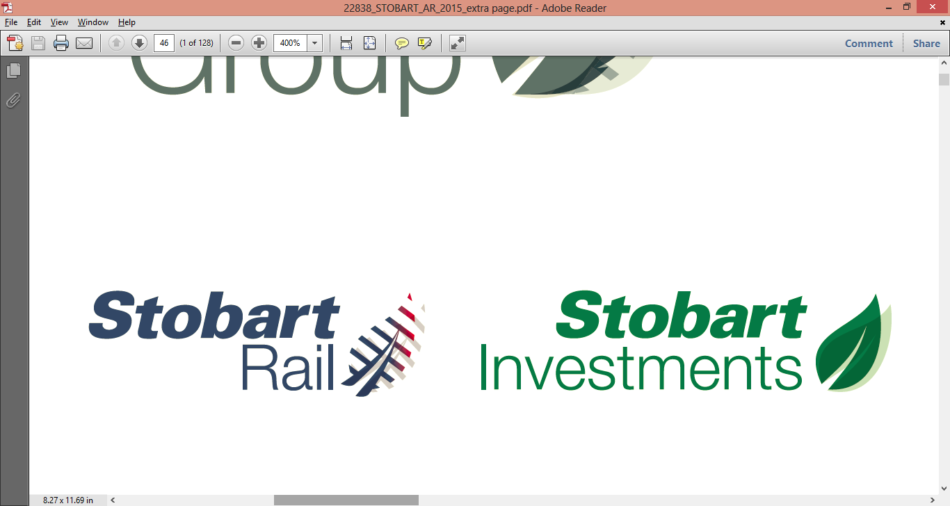

Strategic Update
Division | Medium Term Objective | Progress Towards Medium Term Plan (FY16)
 | Supply 2m+ tonnes of biomass annually by 2018 | Secured two new supply contracts guaranteeing 366,000 tonnes. Expected supply of 2.5m tonnes by 2018 (90% under contract)
 | 2.5m passengers annually by 2018 | Recruitment of new CEO and COO each with significant industry experience. easyJet yield and load factors improving Ongoing talks with major airlines
 | Leading provider of specialist civil engineering services to third parties | Strong order book for future and external works with value of c£68m
 | Realise value from property assets, invest in energy assets | Realised £6.2m from one property disposal Further realisations of c£25m expected in second half. Acquired Pollington processing site
 | Realise value from investments at the optimum time | Performing to management expectations Disposal of UK Automotive business at good value
1. Group Summary

Slide 5
15/16 Performance v Objectives (1 of 2)
Division | Stated Objective 2015/16 | Achieved?
 | Implement Evermore project in Northern Ireland | Yes
 | Improve EBITDA per tonne | Yes
 | Invest in new machinery at Pollington to reduce processing costs | Yes
 | Secure three additional processing sites | Commenced
 | Secure another significant airline operator | Ongoing
 | Exploit USPs of speed, convenience and excellent rail connection | Ongoing
 | Deliver customer service excellence | Yes
 | New website and strong online presence | Yes
 | Secure significant contract c£5m for track work | Yes
 | Agree commitment from Network Rail for the ballast undercutters | Yes
 | Win a framework contract from Network Rail for devegetation | Yes
5
1. Group Summary
2. Financial Review
1. Group Summary
3. Energy
4. Aviation
5. Infrastructure
6. Outlook

Slide 6
15/16 Performance v Objectives (2 of 2)
Division | Stated Objective 2015/16 | Achieved?
 | Secure occupiers for Widnes development site | Ongoing
 | Complete distribution centre development at Carlisle Lake District Airport | Yes
 | Achieve minimum £19m proceeds from sale of mature property assets | Ongoing
 | Grow value of Investments | Ongoing
6
1. Group Summary
2. Financial Review
1. Group Summary
3. Energy
4. Aviation
5. Infrastructure
6. Outlook

Slide 7
Financial Highlights
Turnover
  Unchanged
Solid underlying profitability
  Underlying EBITDA of £9.0m (+3.4%)
  Underlying EBITDA for operating divisions up to £11.8m (+43.9%)
  Underlying profit before tax of £4.6m (+4.5%)
  Profit before tax after exceptional items of £0.6m (prior period loss of £8.6m)
Strong balance sheet
  Gearing of 13.2%
  Returned £13.1m to shareholders during the period through dividends
Turnover
£57.6m
Underlying EBITDA
+3.4%
Gearing
13.2%
2. Financial Review

Slide 8
Headline Financial KPIs
£'m | 31-Aug-15 | 31-Aug-14 | 28-Feb-15
 | 6 months | 6 months | Year
Revenue from continuing operations | 57.6 | 57.6 | 116.6
Underlying EBITDA | 9.0 | 8.7 | 17.7
Underlying PBT | 4.6 | 4.4 | 9.3
Operating cash flow | 2.3 | (0.6) | 5.8
Net debt | 51.9 | 8.1 | 19.1
Gearing | 13.2% | 2.0% | 4.7%
2. Financial Review

Slide 9
Headline Financial KPIs
 | £m
Hp at Feb 15 | 25.7
Trucks & Trailers | 4.0
Hp at Aug 15 | 29.7

Slide 10
Divisional Analysis (£’m)
2. Financial Review

Slide 11
Income Statement (1)
£'m | 31-Aug-15 | 31-Aug-14 | 28-Feb-15
 | 6 months | 6 months | Year
Revenue | 57.6 | 57.6 | 116.6
Operating expenses | (54.4) | (52.7) | (106.9)
Share of JV profits | 6.4 | 3.2 | 6.7
Movements in value and disposal of properties | (0.6) | 0.6 | 1.3
Underlying EBITDA | 9.0 | 8.7 | 17.7
Restructuring and new contract incentives | (0.6) | (1.1) | (2.5)
49% share of ESL restructuring and deal costs | - | (0.7) | (1.6)
EBITDA | 8.4 | 6.9 | 13.6
2. Financial Review

Slide 12
Income Statement (2)
£'m | 31-Aug-15 | 31-Aug-14 | 28-Feb-15
 | 6 months | 6 months | Year
EBITDA | 8.4 | 6.9 | 13.6
Underlying
Depreciation | (3.9) | (3.1) | (6.7)
Finance cost (net) - underlying | (0.5) | (1.2) | (1.7)
Non underlying
Amortisation of brand | (2.0) | (1.9) | (3.9)
49% share of ESL contract amortisation | (1.4) | (1.2) | (2.6)
One-off interest and break fees on debt repayment | - | (8.1) | (8.1)
Profit/(loss) before tax | 0.6 | (8.6) | (9.4)
Add back non-underlying items | 4.0 | 13.0 | 18.7
Underlying profit before tax | 4.6 | 4.4 | 9.3
Profit from discontinued operation, net of tax | - | 7.6 | 6.9
2. Financial Review

Slide 13
Balance Sheet (1)
£m | 31-Aug-15 | 28-Feb-15
Intangible assets | 114.3 | 116.2
Infrastructure assets | 280.8 | 272.5
Plant and machinery | 13.4 | 13.7
Fixtures, fittings and equipment | 0.9 | 1.0
Commercial vehicles | 20.4 | 18.1
ESL investment | 49.2 | 44.7
Propius investment | 12.6 | 12.3
Current assets (excluding cash) | 46.4 | 45.2
Cash and restricted cash | 8.0 | 5.7
Gross assets | 546.0 | 529.4
2. Financial Review

Slide 14
Balance Sheet (2)
£m | 31-Aug-15 | 28-Feb-15
Trade and other payables | (59.4) | (68.8)
Loans and borrowings | (59.9) | (24.8)
Provisions | (6.0) | (6.2)
Defined benefit pension scheme | (2.6) | (2.3)
Tax and deferred tax | (23.8) | (21.1)
Gross liabilities | (151.7) | (123.2)
Net assets | 394.3 | 406.2
Net debt | 51.9 | 19.1
Banking facility headroom | 27.0 | 50.0
Gearing | 13.2% | 4.7%
2. Financial Review

Slide 15
Cash Flow Analysis (1)
£'m | 31-Aug-15 | 31-Aug-14 | 28-Feb-15
 | 6 months | 6 months | Year
Profit/(loss) before tax from continuing operations | 0.6 | (8.6) | (9.4)
Cashflow from continuing operations | 2.3 | (0.6) | 5.8
Tax | 3.2 | - | -
Purchase of property and vehicles (net of finance lease) | (24.9) | (11.9) | (10.1)
Sale of property and vehicles | 5.6 | 0.3 | 28.5
Sale of assets held for sale | 6.2 | 12.8 | -
Proceeds from sale of ESL | - | 189.9 | 189.6
Green Energy JV investments | (3.0) | - | (9.0)
Other | - | 0.6 | 0.9
Investing activities | (16.1) | 191.7 | 199.8
Cashflow after investing activities | (10.6) | 191.1 | 205.6
2. Financial Review

Slide 16
Cash Flow Analysis (2)
£'m | 31-Aug-15 | 31-Aug-14 | 28-Feb-15
 | 6 months | 6 months | Year
Cashflow after investing activities | (10.6) | 191.1 | 205.6
Net debt drawdown/(repayments) | 26.8 | (122.6) | (134.2)
Interest / transaction costs | (0.8) | (2.4) | (3.4)
Dividend | (13.1) | (13.2) | (19.8)
(Purchase) / Sale of own shares | - | (34.8) | (34.8)
Financing activities | 12.9 | (173.0) | (192.2)
Discontinued cashflow | - | (17.2) | (17.2)
(Decrease)/increase in cash | 2.3 | 0.9 | (3.8)
Cash at the beginning of the year | 5.7 | 9.5 | 9.5
Cash at the end of the year | 8.0 | 10.4 | 5.7
2. Financial Review

Slide 17

Energy
  Customer contracts to deliver our strategic aims now secured
    clear visibility for consistent supply volumes of 2.5m tonnes into biomass market by 2018 at an average price of c£40 per tonne
  Biomass tonnages supplied slightly down year on year primarily due to issues with the Eurotunnel and unexpected plant closures
  Two new long-term fuel supply agreements signed since May 2015
    minimum of 116,000 tonnes per annum to a new 30MW biomass plant at Cramlington
    250,000 tonnes per annum to a new 40MW plant at Port Clarence, Teesside
  Focus on development of processing sites in Pollington and London in the second half of the year
  Develop undermanaged woodland to support our virgin supply
This year
3. Energy

Slide 18
Financial Summary
Energy | 31-Aug-15 | 31-Aug-14 | 28-Feb-15
£'m | 6 Months | 6 Months | Year
Revenue - Biomass supply | 20.9 | 18.3 | 39.4
Revenue - Biomass transport | 14.7 | 14.4 | 29.0
Revenue - Total | 35.6 | 32.7 | 68.4
Underlying EBITDA - Total | 4.1 | 2.8 | 7.8
Tonnes sold (number) | 469,000 | 482,000 | 987,000
Revenue per tonne* (£) | 44.56 | 37.97 | 39.92
Underlying EBITDA per tonne (£) | 8.71 | 5.83 | 7.90
* Relates to Stobart Biomass Products Limited supply
Improved revenue per tonne attributable to increase in supply from Pollington at an improved period to period gate fee.
Supply volumes have also increased in the London area which command higher gate fees.
This is coupled with new supply contracts which yield a higher than average revenue per tonne.
3. Energy

Slide 19
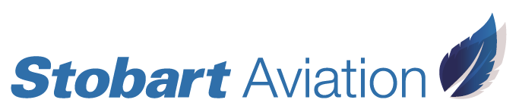
Operational Summary
London Southend Airport
  Today
  Appointed two aviation industry specialists (CEO and COO) to lead operations and deliver objectives
  Passenger numbers down 20% year on year
  Passenger related revenue up year on year
  Airline load factors and yields improved year on year
  easyJet performance exceeds expectations. Two new routes announced for winter 2015 plus Paris to commence in spring 2016
Passengers (m)
4. Aviation

Slide 20
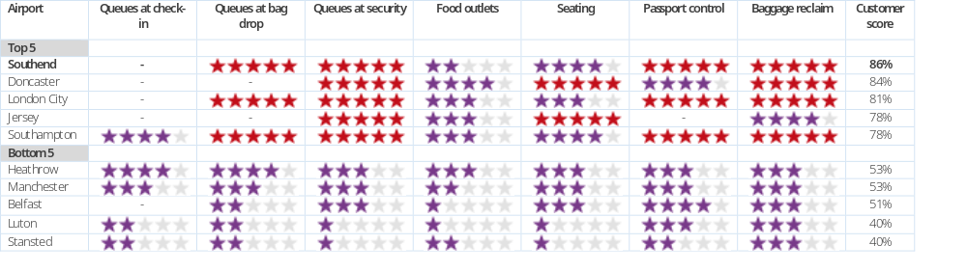

Operational Summary
  Best in UK Which? airport passenger survey three years running
    maximum 5 star rating in four of the seven categories;
    improved upon first place scores from 2014
  Which? Survey: Best and Worst UK airports

Slide 21
Operational Summary
  Looking Forward
  Progress towards securing long-term growth
  Substantive discussions with major airlines around terms for introducing sustainable new routes
    active discussions with a range of European operators
    working with existing operators to increase load factors yield
  Carlisle Lake District Airport
    Shortlisted for route support on proposed networks
    Ongoing consideration of sources of funding for airport development
4. Aviation

Slide 22
Financial Summary
Aviation | 31 Aug 15 | 31 Aug 14 | 28 Feb 15
£'m | 6 Months | 6 Months | Year
Revenue | 11.9 | 12.3 | 23.6
Underlying EBITDA | 0.4 | 1.4 | 1.4
Passengers (number) | 504,000 | 628,000 | 1,088,000
Revenue per passenger (£) | 22.4 | 18.7 | 20.8
Divisional EBITDA is stated before internal rent
4. Aviation

Slide 23

Rail
Operational summary
  Record order book for work with a value of c£68m (£61m external works)
  Completed the construction of a new air and road distribution centre at Carlisle Lake District Airport on time and on budget
  A £4m track lowering scheme from Walsall to Rugeley was completed for Network Rail
  Commenced work on a civils package worth £7.2m at the Widnes biomass plant
  Construction of a £2.1m solar farm at London Southend Airport due to be completed in December 2015
Financial summary
  External revenue has decreased by 4% due to lower than expected expenditure by Network Rail but margins remain strong
  Rail infrastructure work is expected to pick-up in the second six months supported by the strong order book
5. Infrastructure

Slide 24
Infrastructure
Operational summary
  Offer secured for the Chelford freehold site for residential developer
  Full committed amount invested in Widnes CHP Biomass plant
  Expected property realisations in H2 of c£25m
Financial summary
  £6.2m net proceeds from disposal of Worcester property
  £8.4m investment in biomass processing site at Pollington
  £8.8m investment in Carlisle Airport DC
  Further £2.7m invested in Widnes CHP
£287m
5. Infrastructure

Slide 25
Financial Summary
Infrastructure | 31-Aug-15 | 31-Aug-14 | 28-Feb-15
£'m | 6 months | 6 months | Year
Revenue | 2.3 | 2.9 | 5.0
Underlying EBITDA | 0.7 | 2.4 | 4.0
Number of disposals | 1.0 | 5.0 | 10.0
Proceeds from disposals | 6.2 | 14.7 | 27.2
Infrastructure asset values
Airport properties | 160.9 | 139.8 | 160.1
Investment and operational properties | 105.9 | 112.8 | 101.7
Green Energy and other property related investments | 14.0 | 7.3 | 10.6
 | 280.8 | 259.9 | 272.4
Divisional EBITDA is stated before internal rent
5. Infrastructure

Slide 26
Financial Summary
ESL
  New CEO, Alex Laffey, appointed in May
  Net new business won with annual value of £32m
  Realisation of UK Automotive business
  Debt reduction of £21.1m
Investments | 31 Aug 15 |  | 28 Feb 15
 |  | 31 Aug 14
£'m | 6 Months | 6 Months | Year
Underlying EBITDA
Eddie Stobart | 6.1 | 3.0 | 6.3
Propius | 0.3 | 0.3 | 0.5
Underlying EBITDA - Total | 6.4 | 3.3 | 6.8
Realisation of UK Automotive business reflected in the period
5. Infrastructure

Slide 27

Outlook
  Target customer volumes achieved - focus on delivery and supply chain management
  New management team in place to focus on delivering new airlines, new passengers and enhancing commercial offering
  Record order book in external works with Network Rail and other third party customers
  Asset management, and realisations
  Supporting management teams to deliver value
  Grow businesses, realise value
6. Outlook

