Slide 1

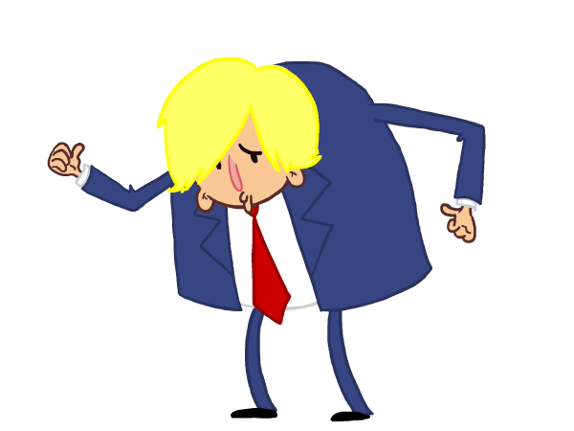
Is the statement made by Prime Minister Boris Johnson true or false?

Slide 2
Is the statement made by Prime Minister Boris Johnson true or false?
This is false
Of the 56 people who have served as Prime Minister, 20 were educated at Eton. 7 were educated at Harrow and 6 were educated at Westminster.
What are the possible advantages and disadvantages for a political system where such a large proportion of high ranking politicians were educated in a relatively small pool of establishments?
I am the first person to become Prime Minister having been educated at Eton College

Slide 3
Is the statement made by Prime Minister Boris Johnson true or false?
This is false
Prorogation is the formal process of ending a session of Parliament, approved by the Monarch, and occurs regularly.
Why is this prorogation by Johnson’s government so controversial?
I am the first Prime Minister to prorogue Parliament (formally shut down a Parliamentary session) this century

Slide 4
Is the statement made by Prime Minister Boris Johnson true or false?
This is false
Both Gordon Brown (2007) and Theresa May (2016) were elected as leader of their party and immediately became Prime Minister without winning a General Election first.
What are the possible disadvantages for a Prime Minister if they have not gained their position through winning a General Election?
I am the first person to be made Prime Minister this century without winning a General Election first?

Slide 5
Is the statement made by Prime Minister Boris Johnson true or false?
This is true
66% of Conservative Party members voted for Johnson in the final part of the election process for its leader. Theresa May avoided being elected by party members as she was unopposed at the final stage of her election process.
What are the possible advantages and disadvantages of having a PM elected by party members rather than by sitting MPS that belong to the same party?
I am the first Prime Minister to be elected by a single party’s membership

Slide 6
Is the statement made by Prime Minister Boris Johnson true or false?
This is false
Johnson was Mayor of London between 2008 and 2016. He was elected as MP for Uxbridge and South Ruislip in the 2015 General Election. Ken Livingstone remained as an MP for a short period after being elected as Mayor in 2000.
It’s estimated that nearly 20% of MPs have regular paid work outside of Parliament. What are the advantages and disadvantages of allowing MPs to have outside paid work?
I was the first person to be Mayor of London and a sitting MP at the same time.

Slide 7
Is the statement made by Prime Minister Boris Johnson true or false?
This is false
Johnson has held two of the Great Offices (PM and Foreign Secretary). However, so did Theresa May (PM, Home Secretary), Gordon Brown (PM, Chancellor) and John Major (PM, Foreign Secretary and Chancellor).
How might having previously held one of the Great Offices help an incoming Prime Minister?
I am the first Prime Minister for over 40 years to have held two of the Great Offices of State (PM, Chancellor, Foreign Secretary and Home Secretary)

