Slide 1

How much do you know about economics in the real world? Here are 10 questions about trivia related to economics.
You have the time it takes for the music to finish to decide you answer!

Slide 2

1
In what year did Philip Hammond become Chancellor of the Exchequer?
A | B | C | D
2015 | 2016 | 2014 | 2017
B | Hammond was appointed by Theresa May when she become Prime Minister after the Brexit referendum.
Press space for answer

Slide 3
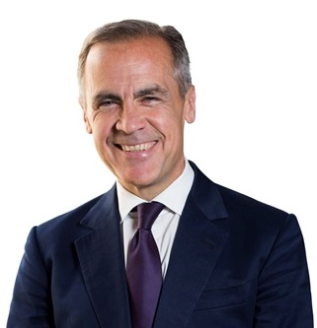
2
Who is this man?
A | B | C | D
Greg Clark, Secretary of State for Business | Mel Stride, Paymaster General | John McDonell, Shadow Chancellor of the Exchequer | Mark Carney, Governor of the Bank of England
D | Carney has been Governor since 2013 and currently expects to finish in 2019.
Press space for answer

Slide 4
3
Paul Pester has said this week that he is going to resign as Chief Executive of which major Bank
A | B | C | D
Natwest | Lloyds | TSB | Barclays
C | Pester resigned over an ongoing scandal relating to IT failures.
Press space for answer

Slide 5
4
The Human Development Index (HDI), ranks countries based upon life expectancy, education and income per capita. Which country currently tops the list?
A | B | C | D
USA | UK | Ireland | Norway
D | The UK currently ranks 16th.
Press space for answer

Slide 6
5
According to the Office for National Statistics, what proportion of people in the UK are self-employed?
A | B | C | D
25% | 5% | 15% | 35%
C | This number has been continually rising since 2001.
Press space for answer

Slide 7
6
What is the current rate of unemployment in the UK (measured between April and June of 2018)?
A | B | C | D
2% | 4% | 8% | 15%
B | Unemployment has been on a downward trend since 2011.
Press space for answer

Slide 8
7
Who has the largest economy in the world?
A | B | C | D
China | USA | Japan | Germany
B | The US economy is worth $20.4tr. In order: USA, China, Japan, Germany.
Press space for answer

Slide 9
8
Who has the largest economy in Africa?
A | B | C | D
Nigeria | South Africa | Egypt | Ghana
A | The Nigerian economy is worth $376bn.
Press space for answer

Slide 10
9
Outside of the EU, who is the UK’s most important trading partner in terms of UK exports?
A | B | C | D
Saudi Arabia | China | Switzerland | USA
D | The UK exports approximately £45bn worth of goods and services to the US per year.
Press space for answer

Slide 11
10
By 2022, which country/region will be the largest producer of renewable energy in the world?
A | B | C | D
EU | USA | China | India
C | By 2022, China, USA and India will account for 2/3 of worlds production of renewable energy.
Press space for answer

