Slide 1
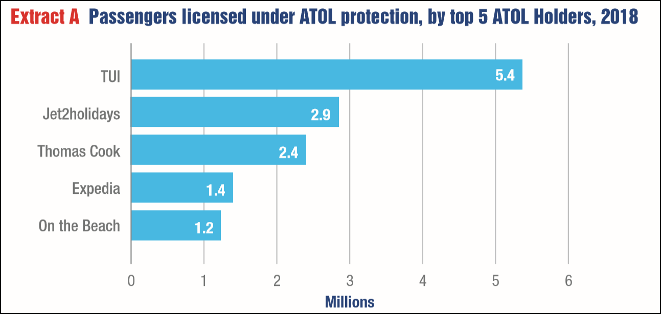
Extract A

Slide 2
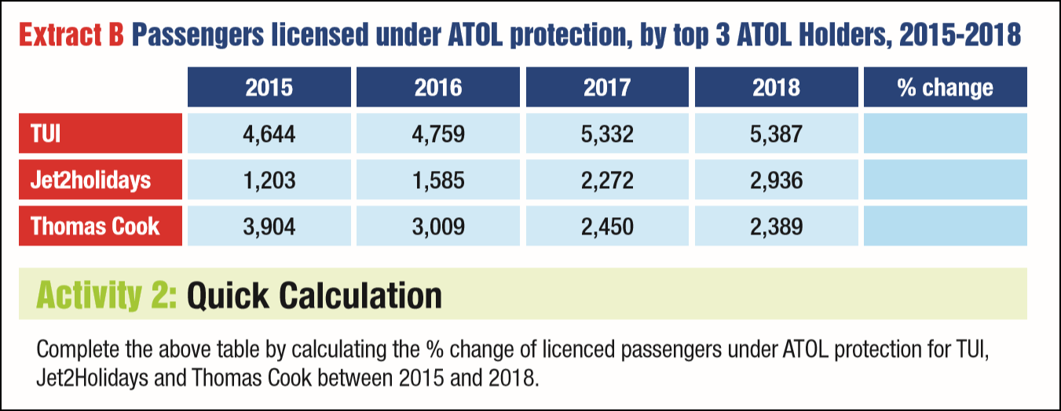
Extract B
+16%
+144%
-39%

Slide 3
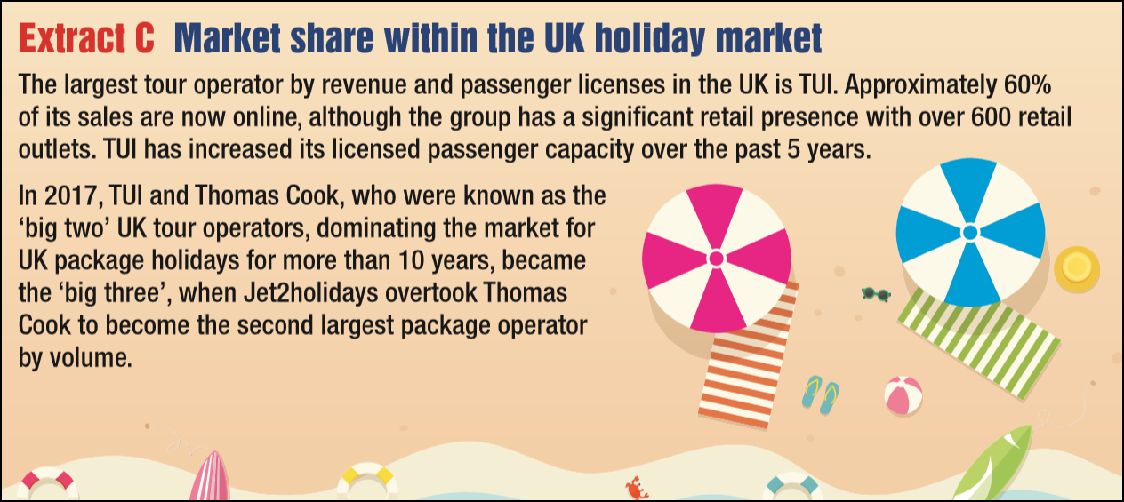
Extract C

Slide 4
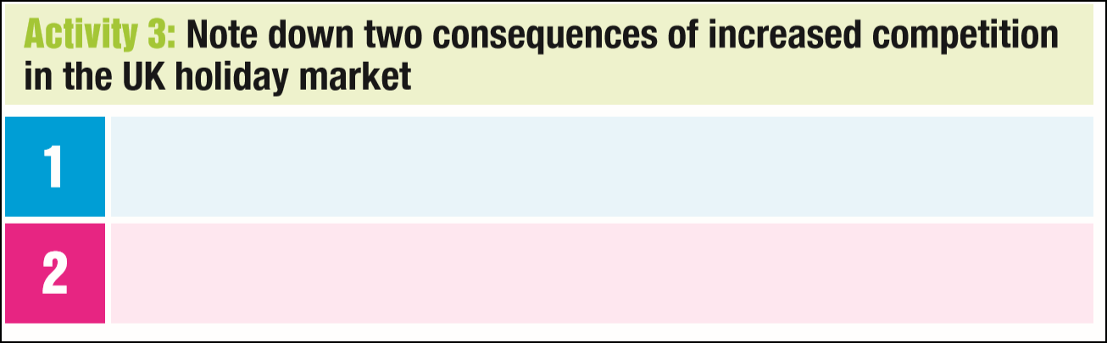
Activity 3
May force holiday and travel companies to lower their prices which could result in lower their profit margins
Holiday and travel companies may need to invest in a new and innovative ways to attract potential holiday makers

Slide 5
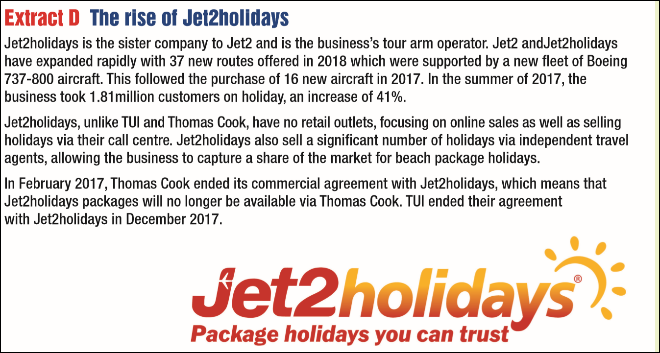
Extract D

Slide 6
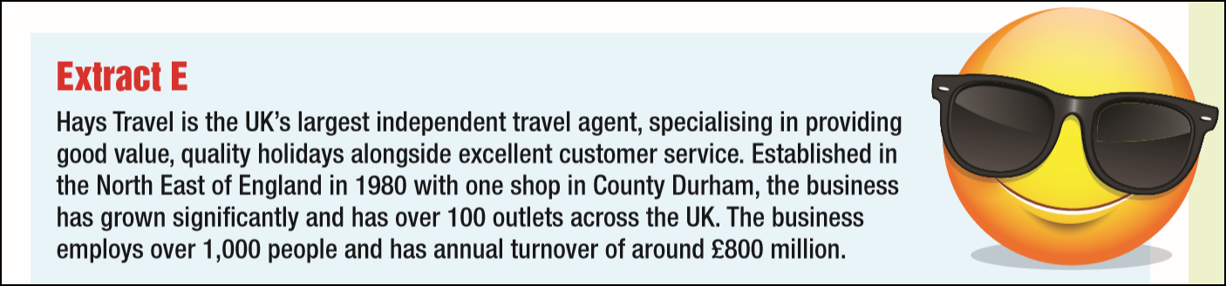
Extract E

Slide 7

The 8 Mark Questions

Slide 8
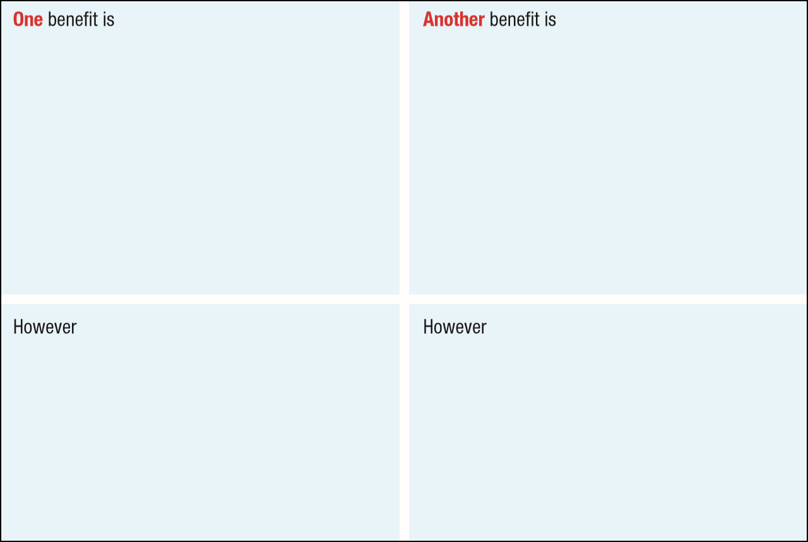
Assess two benefits to Jet2holidays of taking over Hays Travel
increased market penetration for Jet2holidays as they don’t have any physical travel agents unlike their rivals TUI and Thomas Cook. This could allow them to penetrate the market further and reach out to more holiday makers.
that they could ensure that TUI and Thomas Cook holidays are not sold within the newly taken over travel agents which could result in fewer holidays booked for their competitors and more holidays booked for Jet2holidays.
, financing the takeover could be expensive and their overall cost base would increase as they would need to pay all the costs associated with running the retail outlets.
, no longer selling holidays from other companies could upset customers who were loyal to Hays, forcing them to book their holidays elsewhere, resulting in less revenue.

Slide 9
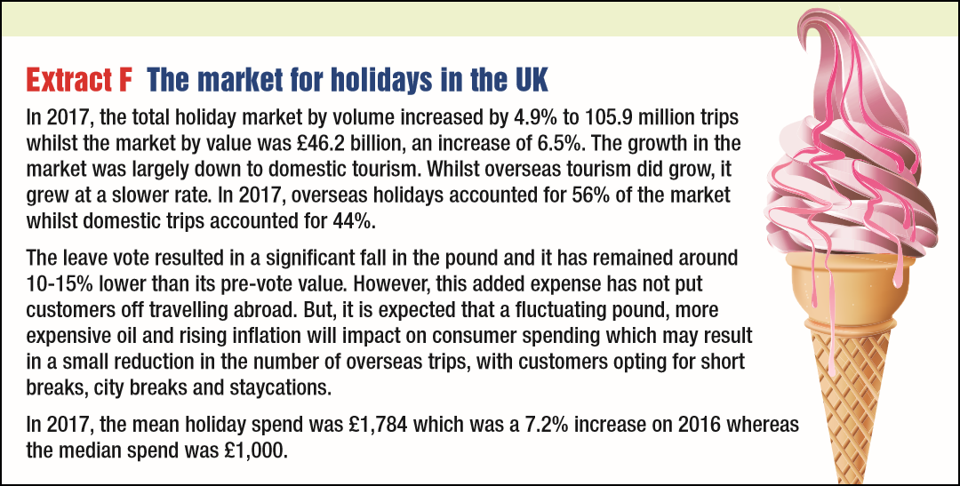
Extract F

Slide 10
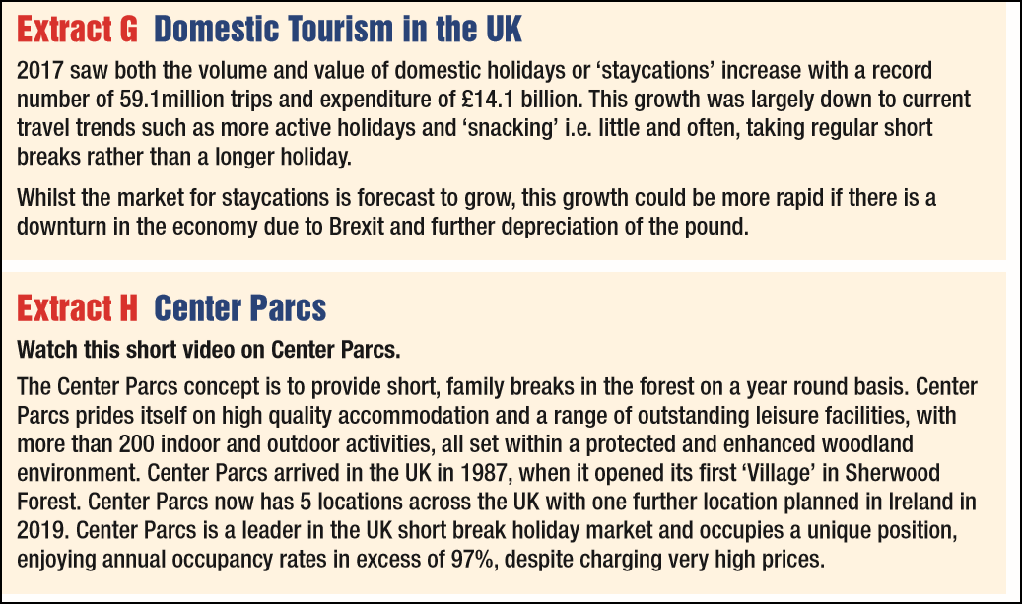
Extract G and H

Slide 11
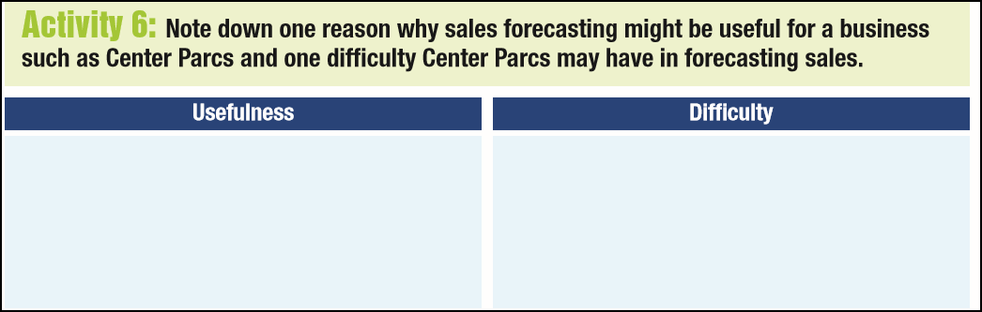
Activity 6
Sales forecasting will help Center Parcs to have the correct staffing levels so that they have enough employees to run the different activities
The market they operate in is highly seasonal and also economic factors such as exchange rates can affect domestic tourism and subsequently sales

Slide 12
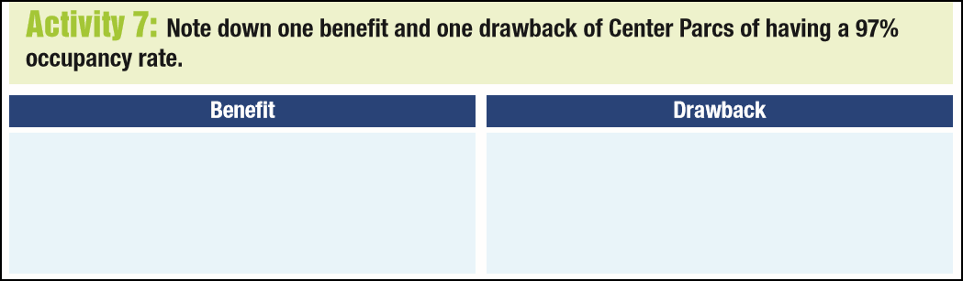
Activity 7
Increased staff motivation as workers may feel more secure in their jobs. This could lead to better customer service.
At certain times of the year it may be difficult for customers to book resulting in them taking their holidays elsewhere

