Slide 1
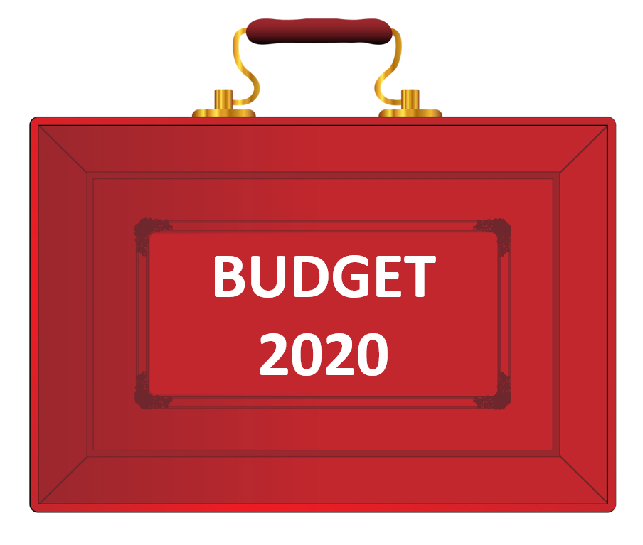
At –a- Glance

Slide 2
State of the economy
Economy predicted to grow by 1.1% this year, not taking into account the impact of coronavirus
Economic growth forecast to be 1.8% in 2021-22, 1.5% in 2022-23 and 1.3% in 2023-24
Inflation forecast of 1.4% this year, increasing to 1.8% in 2021-2022
Public sector net borrowing set to rise this year to 2.1% of GDP, rising to 2.4% and 2.8% in subsequent years
Debt as a percentage of GDP forecast to be lower at end of current Parliament than now

Slide 3
Combatting Coronavirus
A £30bn package to help the economy get through the coronavirus outbreak.
Statutory sick pay for "all those who are advised to self-isolate" even if they have not displayed symptoms
Business rates for shops, cinemas, restaurants and music venues in England with a rateable value below £51,000 suspended for a year
A £500m "hardship fund" to be given to local authorities to help vulnerable people in their areas
"Fiscal loosening" of £18bn to support the economy this year, taking the total fiscal stimulus to £30bn
A "temporary coronavirus business interruption loan scheme" for banks to offer loans of up to £1.2m to support small and medium-sized businesses
The government will meet costs for businesses with fewer than 250 employees of providing statutory sick pay to those off work "due to coronavirus"
Those on in-work benefits who get ill will be able to "claim from day one instead of day eight".

Slide 4
Personal taxation, wages and pensions
National Insurance Contributions tax threshold to rise from £8,632 to £9,500 - saving employees just over £100 a year
5% VAT on women's sanitary products, known as the tampon tax, to be scrapped

Slide 5
Alcohol, tobacco and fuel
Fuel duty to be frozen for the 10th consecutive year
Duties on spirits, beer, cider and wine to be frozen
Business rate discounts for pubs to rise from £1,000 to £5,000 this year

Slide 6
Business, digital and science
Entrepreneurs' Relief will be retained, but lifetime allowance will be reduced from £10m to £1m
£5bn to be spent on getting gigabit-capable broadband into the hardest-to-reach places
Science Institute in Weybridge, Surrey to get a £1.4bn funding boost
An extra £900m for research into nuclear fusion, space and electric vehicles.
VAT on digital publications, including newspapers, books and academic journals to be scrapped from December

Slide 7
Environment and energy
Plastic packaging tax to come into force from April 2022
Manufacturers and importers whose products have less than 30% recyclable material will be charged £200 per tonne
Subsidies for fuel used in off-road vehicles - known as red diesel - will be scrapped "for most sectors" in two years' time
Red diesel subsidies will remain for farmers and rail operators
£120m in emergency relief for communities affected by this winter's flooding and £200m for flood resilience
Total investment in flood defences to be doubled to £5.2bn over next five years
£640m "nature for climate fund" to protect natural habitats, including 30,000 hectares of new trees

Slide 8
Transport, infrastructure and housing
More than £600bn is set to be spent on roads, rail, broadband and housing by the middle of 2025
£2.5bn will be made available to fix potholes and resurface roads over five years
£1.5bn in capital spending on further education colleges
£650m package to tackle homelessness, providing an extra 6,000 places for rough sleepers
Stamp duty surcharge for foreign buyers of UK properties to be levied at 2% from April 2021
£1bn fund to remove all unsafe combustible cladding from all public and private housing higher than 18 metres

Slide 9
Nations and Regions
An extra £640m for Scotland, £360m for Wales, and £210m for Northern Ireland.
Treasury's Green Book rules to be reviewed to put regional prosperity at heart of spending decisions
Treasury to open new offices in Wales and Scotland
New civil service hub in the North of England, employing 750 staff

Slide 10
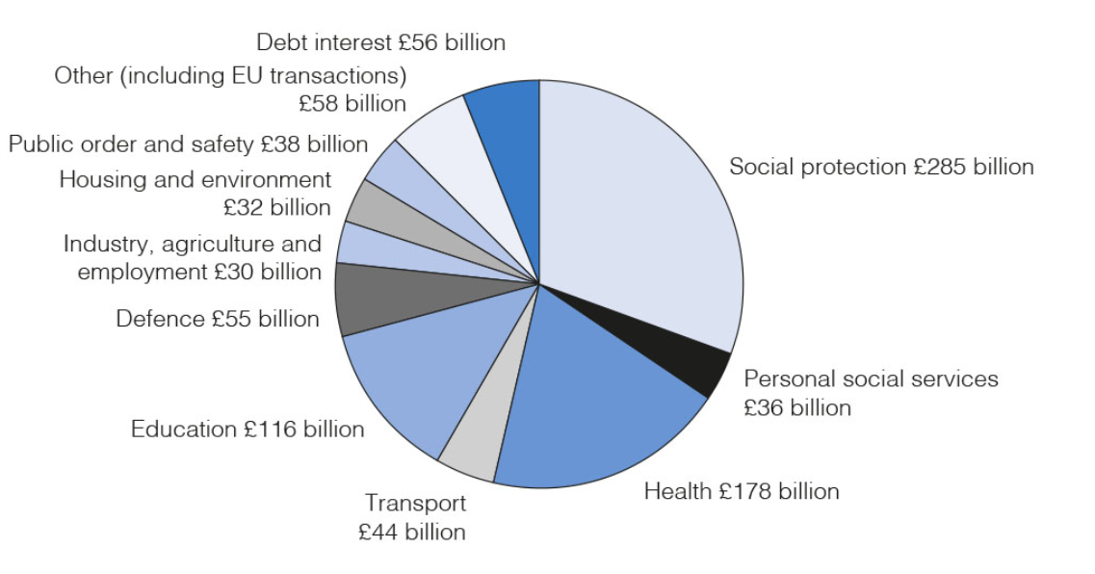
Public Sector spending 2020-21
Source: OBR and HM Treasury

Slide 11
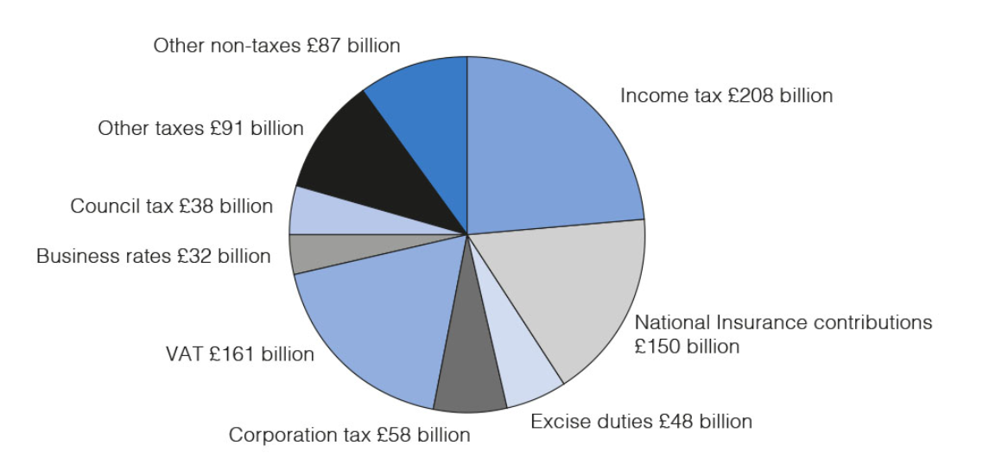
Public Sector Current Receipts (2020-2021)
Source: OBR and HM Treasury

Slide 12
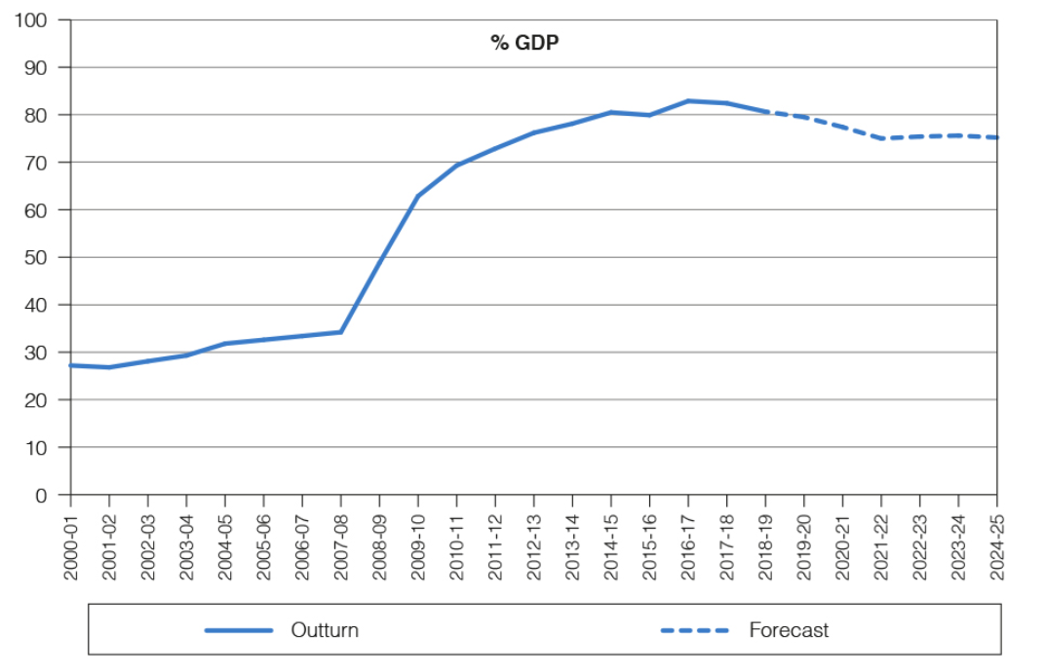
Public sector net debt from 2000-01 to 2024-25
Source: ONS and OBR

