Slide 1


Slide 2

Coming soon…Student Revision Workshops
GRADE BOOSTER (Year 13)
Market Structures
Labour Markets
Financial Markets
Global Economy
Synoptic Thinking
FLYING START (Year 12)
Think of a Number
Market Failure and Government Intervention
UK Economic Performance
Demand Side Policies
Supply Side Policies

Slide 3
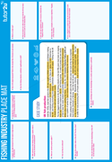

From the tutor2u shop
Launched this week!
Model Essay booklets, complete with examiner commentary and essay structure advice.
Booklets will include:
International trade
Advanced Macro
Theory of the Firm
Development Economics
Financial Markets
Synoptic Essays
…and many more!

Slide 4
Today’s Session Aims
To understand the demands of the new Paper 3 for A-level and the impact on your teaching
To gain confidence with synoptic exam technique
To consider some approaches for helping students to revise in a ‘synoptic’ way

Slide 5
A quick poll…
Concern over preparing students for the new Paper 3?

Slide 6
Paper 3 – what is it?
Covers ALL of the microeconomics and macroeconomics from both years of the A level economics course – no new material but tests different thinking skills
Worth 30% of the overall final A level grade
Structure – 2 compulsory data responses, each with a choice of essays (1 from 2)

Slide 7
The challenges of synoptic examination
Students
Unsure of the difference between micro and macro
Sheer volume to revise
Teachers
Split teaching – who is responsible?
Uncertainty over exam technique and advice to give to students
Making ‘connections’
“Fitting it all in!”

Slide 8
Real teacher comments…
Wait, what? There’s 3 papers?!
We’ve stuck to the micro/macro divide but aim to finish the teaching by Feb, then focus on drawing it together
We’ve had to completely change our SOW on the fly to revisit AS material and make synoptic links
We rejigged the teaching so one teacher takes all classes for a given Year 13 class – no micro/macro split
It’s much easier to be synoptic if we’re not entering students for the AS exams
We really hope that the markers are actually up to the task of examining both micro and macro

Slide 9
A quick poll…
Who teaches what in your centre?

Slide 10

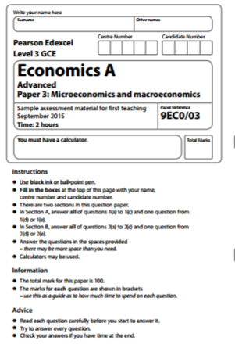
Exam focus – paper structure
2 data responses
Compulsory
Drawing on all content
For each data response:
2 to 3 pages of data – tables, charts and text
5m “explain” question
8m “examine” question
12m “discuss” question
25m “evaluate the likely microeconomic and macroeconomic effects of…” question

Slide 11
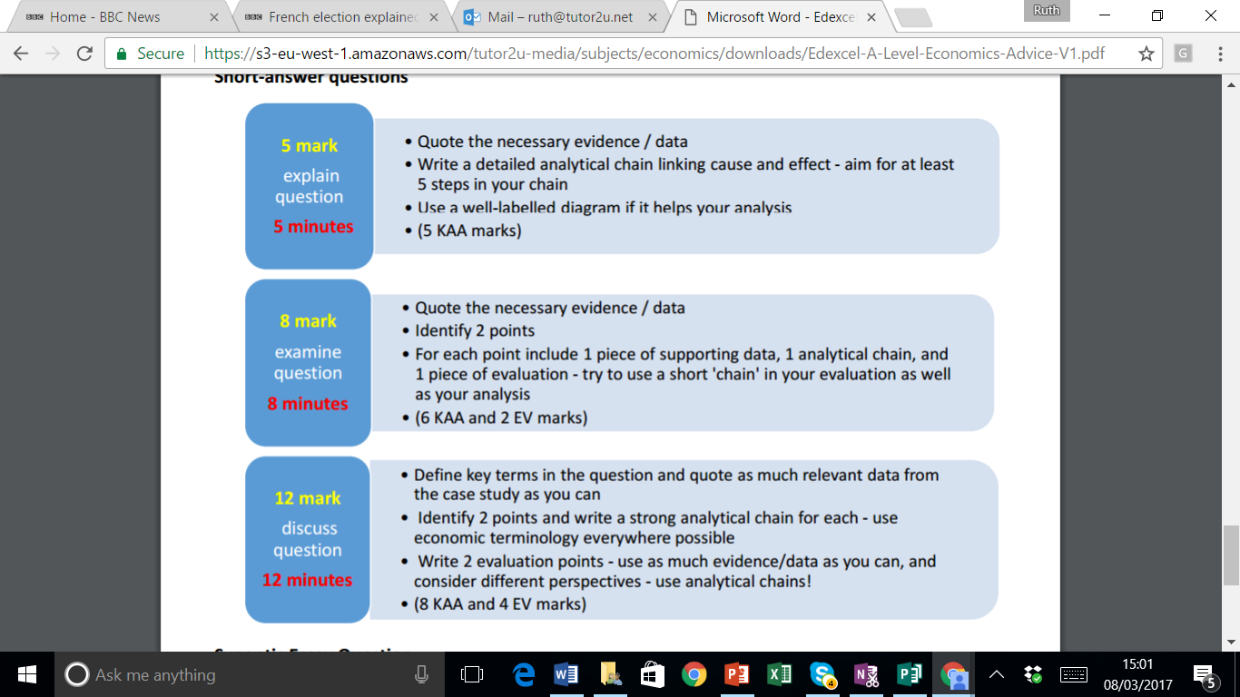
Exam focus – exam technique

Slide 12
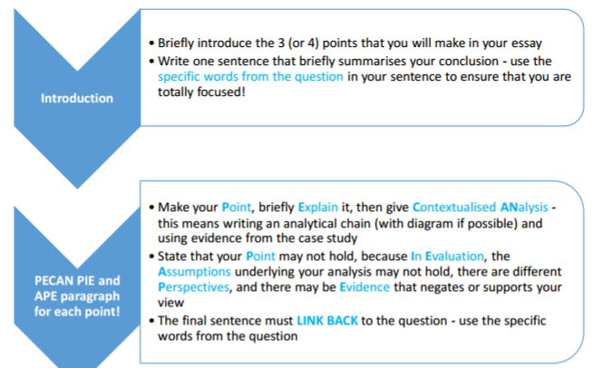
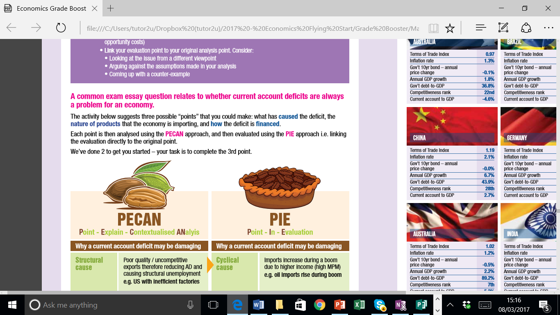
Exam focus – exam technique: essay structure

Slide 13
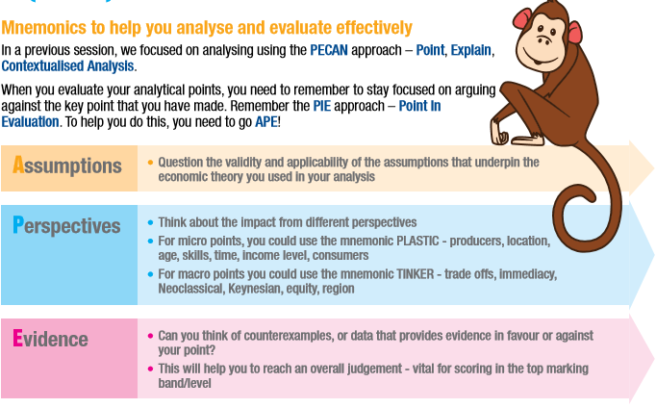
Exam focus – exam technique: essay structure
This suggested evaluation technique has been adapted directly from the “top band” response descriptors from the Edexcel sample assessment materials

Slide 14
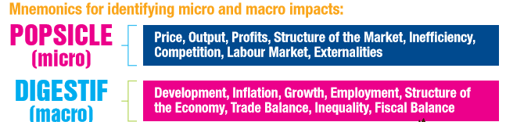
Exam focus – exam technique: “micro and macro”

Slide 15
Practising the “micro and macro” impacts
A rise in oil prices
A fall in the value of the £
Increasing number / strength of trade blocs
Improved global transport infrastructure
Rising development levels in sub-Saharan Africa
Increased environmental legislation

Slide 16
Micro and Macro effects of rising oil prices
Micro
Lower Profits for energy using firms
Rising Efficiency as other costs are cut
More green energy so fewer externalities
Falling demand for labour → lower wages
Macro
Cost-push inflation pressure
Rising trade deficit for UK
Less tax revenue from businesses
Risk of Dutch Disease & lower HDI

Slide 17
Obvious synoptic topics
Labour Markets
Productivity, Poverty / inequality
Micro – wage rates, labour market failure etc
Financial Markets
Micro – analysis of different markets e.g. bonds; types of bank & objectives; bubbles
Macro – monetary policy, operation of the Central Bank, financial regulation
Behavioural Economics
Micro – decision making, factors influencing D&S
Macro – nudges for fiscal policy, supply side policies etc
Technological issues, and competition policy
Factors influencing market structures / costs / external economies of scale
Factors affecting LRAS
Macro – SRAS and costs, LRAS position, unemployment, flexibility
Externalities
Micro – types of market failure
Macro – disadvantages of growth and international trade
Development Economics
Micro - Commodity markets, inequality, health & education
Macro – policies, trade

Slide 18
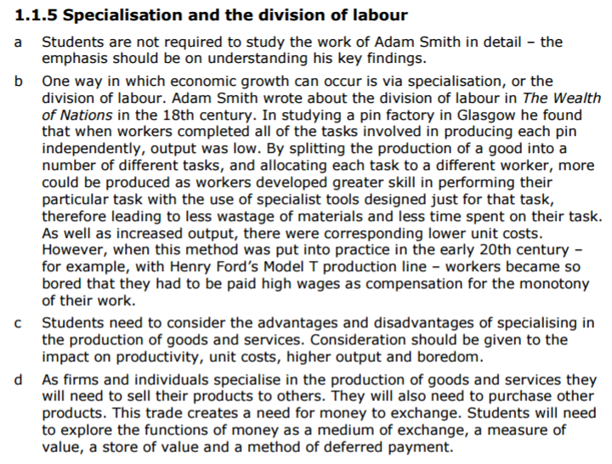
Synoptic Revision – using the Getting Started Guide
Examples! Micro - Secondary school depts, MINI car factory Macro – commodity v manufacturing specialisation
Link with diminishing marginal returns and the SRAC – also important to think about the need for money rather than barter…functions of money include “medium of exchange” and “store of value”
How does this link with capitalism – exploitation of workers? Greater inequality?
Adam Smith also relevant to ‘what makes a good tax’ i.e. cheap to implement & collect, easy to understand etc
Could also link with comparative advantage…what about the Prebisch Singer hypothesis?

Slide 19
Synoptic Revision – using case studies
Define key terms
Mind-map the connections
On March 8th, China reported its first quarterly trade deficit in 3 years. The value of imports increased 38.1% on the year previously, as rising incomes in China caused rising demand for imported luxuries, and also as the price of oil rose. The value of exports unexpectedly fell. Economic analysts across the world were stunned by the news, having forecast a strong trade surplus.
The trade deficit is unlikely to be sustained, however. China’s GDP growth rates are slowing, and this will in turn reduce the growth of income, so fewer imports will be sucked in to the economy. Last weekend, the government announced that its official annual growth target had been cut to 6.5%.
China’s trade policies were in the media spotlight during Donald Trump’s presidential campaign, as he argued that China was using too many protectionist measures such as subsidising export industries and refusing inwards FDI by US firms.
Positive YED therefore imports are normal goods
What are the problems with forecasting?
Circular Flow of Income: national output = national income
Targets – can promote stability, but also cause myopia
One country’s trade surplus is another’s trade deficit…
Protectionism diagrams – subsidies, tariffs, quotas

Slide 20

Final top tips
Use old exam papers and create your own micro questions within macro papers (and vice versa)
Take a look at legacy WJEC economics exam papers – already synoptic
Make it part of everyday teaching – mini case studies, newspaper articles etc
Drill students on diagrams – mix up micro and macro so that they practise correct labelling and quick thinking
Ensure definitions tests are frequent and cover words used in both micro and macro

Slide 21







Alternative resources – tutor2u PowerPoint games
Looking for new ways to liven up your classroom with starters, plenaries and quick (but fun!) assessments of progress?
http://www.tutor2u.net/acatalog/powerpoint-games-based-learning.html

Slide 22
Today’s resources
Today’s resources will also appear on the tutor2u economics Facebook pages and the tutor2u blog
https://www.facebook.com/groups/edexceleconomicsteachers/
Upcoming free webinars:
Wednesday evenings at 8pm – a short series on financial markets for students, with Geoff Riley
Mondays at 12.30pm – a short series on financial markets for teachers, with Ruth Tarrant

