Slide 1


Industry research to help get top grades in you’re A-level microeconomics exams

Slide 2
Researching an industry of your choice
Some exam questions now require you to answer using examples from “an industry of your choice.”
Top students will become a mini expert on one or more interesting sectors /markets
Choose examples where supply and demand conditions are changing impacting on profits
Where external factors such as globalisation, new technologies etc. are having an influence

Slide 3
Here are ten recommended industries (UK)
Food-to-go retailing
Challenger banks
Renewable energy companies
Retail grocery market
E-vehicles and infrastructure
Craft beer manufacturing
Vegan foods
Low cost gym industry
Cinema industry / online streaming
Sports fashion footwear and clothing

Slide 4
Good sources of information
Investor relations section of a business web site (often full of useful market information)
Use your FT for Schools subscription for recent articles on an industry/business of your choice
Business data services such as Statista
Industry profiles from PWC, Deloitte and others
Annual reports from industry regulators such as OFCOM
Market investigations from the Competition and Markets Authority
Notes:
I’ll provide some links in the comments section of this video

Slide 5
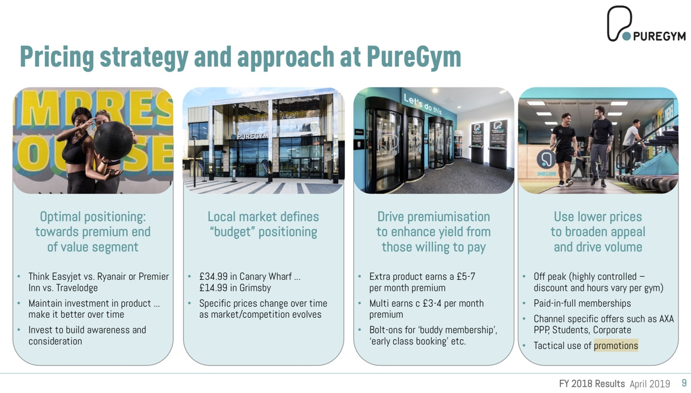
Investor relations annual reports

Slide 6
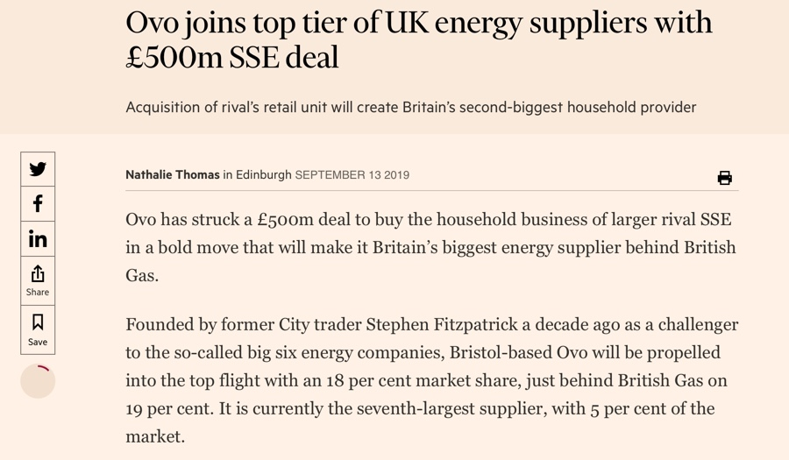
FT for Schools news articles / background

Slide 7

Industry research can offer important insights

Slide 8
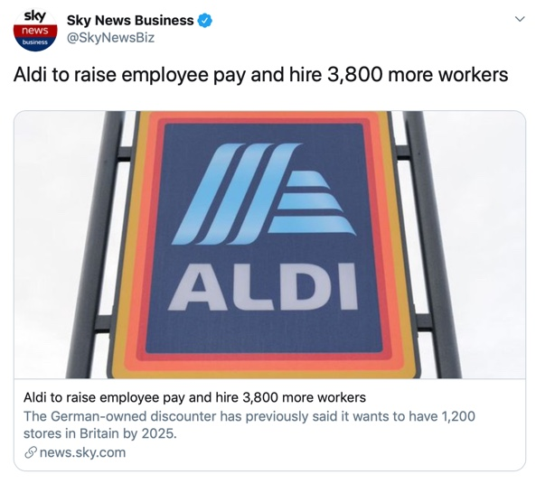
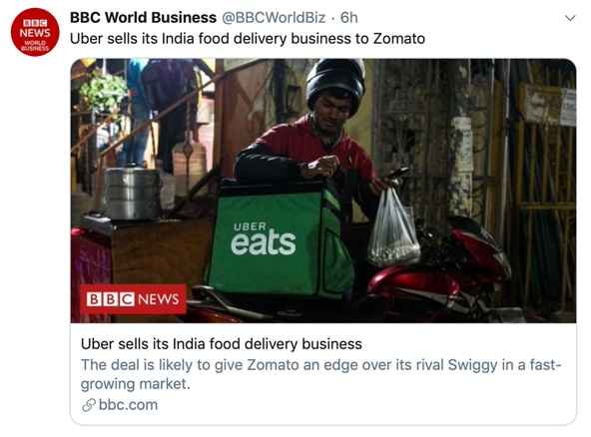
Make use of data & research available through social media

Slide 9
Industry / Market Profile ____________________

Slide 10
Leading Firms in the Market | Market Share (%) | Latest reported profits / losses
Key factors affecting industry demand / revenues
Key factors affecting industry supply / costs
Examples of challenger businesses that have entered the market / industry + comment on their strategies / types of competition
Examples of government interventions in this industry or examples of innovation from established / new businesses
Comment on what type of market structure this industry resembles / examples of recent merger and takeover activity etc.
Notes:
You can download a copy of this PowerPoint template if you want to amend (improve) this slide and use for your own research

Slide 11
Industry research to help get top grades in A level micro

