Slide 1

Economic Wellbeing
Economic wellbeing as a macroeconomic objective

Slide 2
Additional objectives of macroeconomic policy
Balancing the budget and reducing the national debt
Improving level of economic well-being
Better regional balance in the UK economy
Improved access to key public services
Improved global competitiveness
Environmental sustainability

Slide 3
Indicator
Living Wage UK (£ per hour)
UK unemployment rate (% of the labour force)
Very high satisfaction with life (% of all adults people reporting)
% of population who report being always or often lonely
Healthy life expectancy at birth for males (life expectancy = 80.8)
% of adult population who report having a disability
Average age in years of a first-time buyer in the housing market
UK HDI ranking out of 188 countries (clue: France is 21st)
UK competitiveness ranking out of 164 nations
% of people mostly or completely satisfied with their job
£8.45
4.7%
29%
5%
63 years
19%
30 years
16th
7th
55%

Slide 4
Indicator
% of people in a household on an annual income 60 per cent below the median income
Median wealth per household
Real median household income (clue Mean income = £28,000)
Average total debt per household – including mortgages
NEETs (% of people aged 16-24)
Percentage of UK adults aged 16 to 64 with no qualifications
UK Palma Ratio (for 2015)
UK Gini-Coefficient (for 2015)
Mean years of completed schooling
Per cent of the electorate voting in the General Election (2015 figure)
16%
£225,000
£26,332
£56,000
12%
8%
1.3
0.33
13 years
66%

Slide 5
Economic Well-Being
The measure of a nation’s well-being goes beyond the level of and rate of growth of GDP. Economic well-being is a multi-dimensional concept.
Surveys of Life Satisfaction
Years of healthy life expectancy
Median Household Income
Household Net Wealth
Percentage of people in vulnerable employment
Civic / democratic participation rates
Notes:
Presents indicators that adjust or supplement more traditional measures such as GDP to give a more rounded and comprehensive basis for assessing changes in economic well-being

Slide 6
Well-Being – Real Median Household Income
Median income is the income of the middle household if all households are ranked from the lowest income to the highest.
A household's disposable income is made up of all its earnings and investment income (including private pensions), plus cash benefits received from the state, minus direct taxes such as Income Tax and Council Tax.

Slide 7

A recent RSA/Ipsos Mori survey found that 59% of respondents working the gig economy are in professional, creative and administrative fields, with 18% providing skilled manual services (such as plumbing); 20% of the respondents worked as couriers or drivers, and another 17% in personal services such as cleaning. (Source: Coyle, NIESR, May 2017)

Slide 8
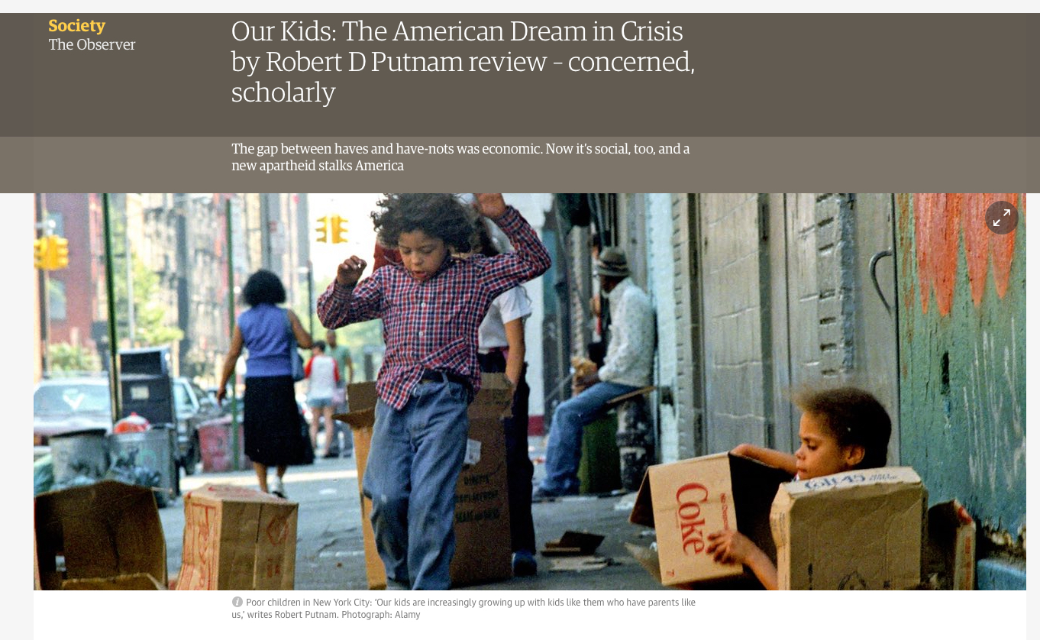
Finding out more
Putnam has written extensively on the concept of social capital and trust

Slide 9
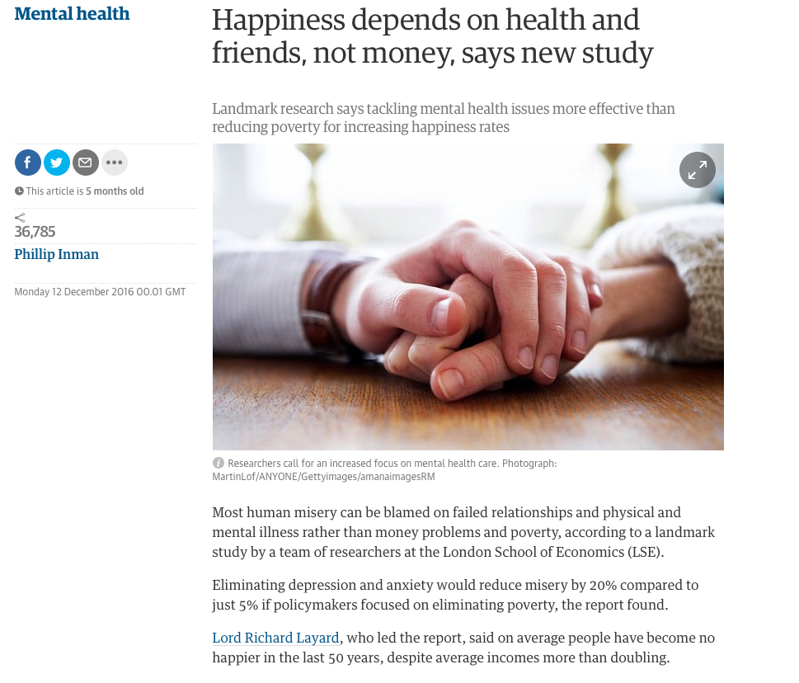
Finding out more
Richard Layard OE is a world-renowned expert in the economics of mental health and wellbeing

Slide 10



Slide 11
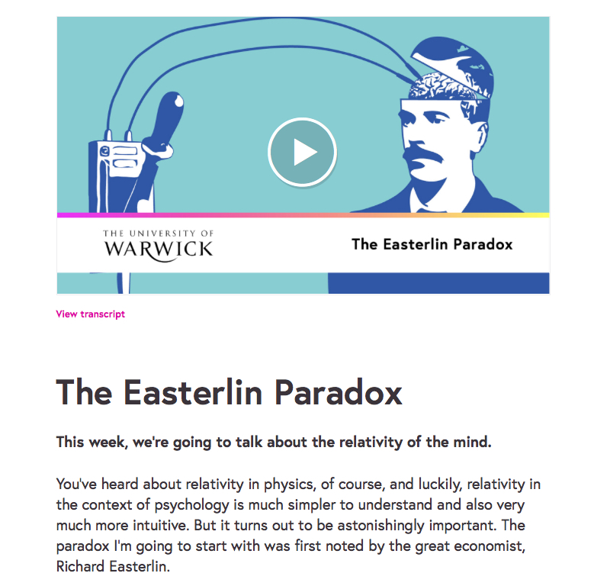
The Easterlin Paradox
The Easterlin Paradox – relative income / consumption becomes more important once people have escaped extreme poverty

