Slide 1

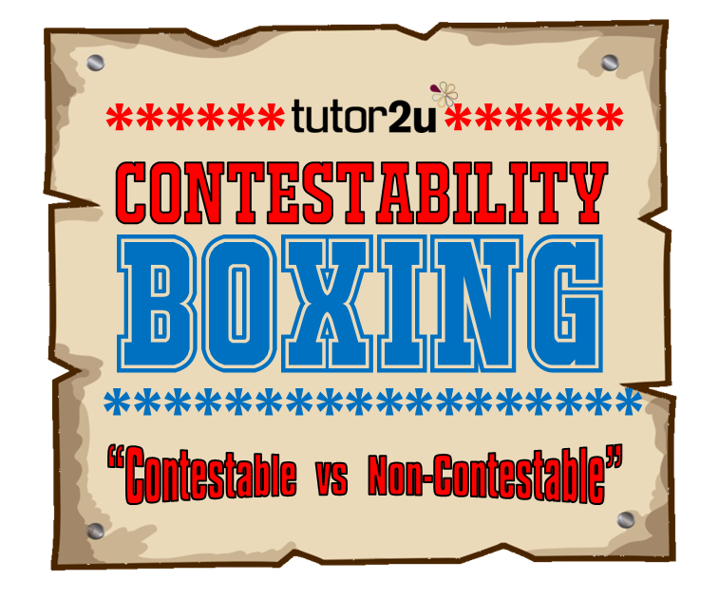




Teacher’s Instructions
Contestability Boxing!
You are about to be presented with 6 different markets. Do you think they would win a ‘contestability’ boxing match?
You will be given 7 characteristics of a contestable market on cards alongside the boxing ring template. For each of markets presented to you, arrange your cards on your boxing ring to show whether that element would make the market more contestable or less contestable.
Click to start
Click to start

Slide 2



1
High Street Banking
Click to continue

Slide 3



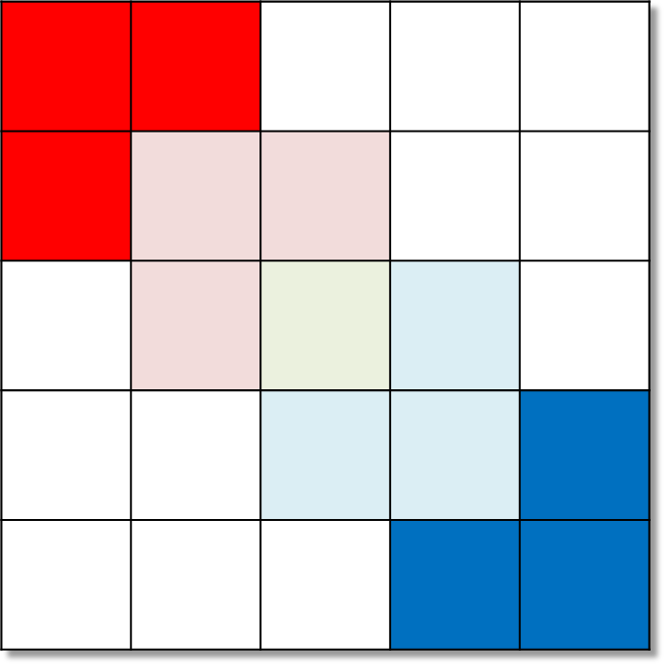


 |  | Easy access to raw materials
 | Access to skilled labour |  | Easy access to technology for production
 |  | Absence of sunk costs | Perfect information for supplier | Low consumer loyalty
 |  |  | Little regulations
Market:
High Street Banking
Little contestability
Click here for answers
Next>>

Slide 4
0
N. | Characteristics
1 | Absence of sunk costs
2 | Low consumer loyalty
3 | Little regulation
4 | Easy access to technology for production
5 | Perfect information for supplier
6 | Easy access to raw materials
7 | Access to skilled labour
Contestable
1 | 2
3 | 4 | 5
 | 6 | 7 | 8
 |  | 9 | 10 | 11
 |  |  | 12 | 13
Incontestable
 | Market | 1 | 2 | 3 | 4 | 5 | 6 | 7 | Outcome
1 | High Street Banking | 9 | 11 | 12 | 8 | 10 | 5 | 6 | Little contestability
2 | Smartphone | 12 | 7 | 8 | 10 | 9 | 13 | 7 | Little contestability
3 | Walking tours of historic city | 1 | 2 | 5 | 3 | 6 | 4 | 8 | Highly contestable
4 | Fast food restaurant | 8 | 6 | 11 | 7 | 9 | 4 | 2 | Some contestability
5 | Budget hotels | 4 | 5 | 8 | 6 | 7 | 9 | 3 | Some contestability
6 | Streaming video service | 3 | 4 | 5 | 8 | 7 | 6 | 9 | Some contestability

Slide 5
The aim of this resource is to stimulate discussion and analysis of markets with regards to how ‘contestable’ they may be. The students will apply the characteristics of market contestability to 6 markets and assess which of those characteristics apply most to each market.
Before starting, edit the tables on slide 4 to fit your needs (see next slide for editing instructions). Print out a ‘Boxing ring template’ (slide 7) for each student or pair and a set of characteristic cards (slide 8) for each student.
Run the slideshow from slide 1 and click on ‘Click to start’. Explain the purpose of the activity and hand out the boxing rings and characteristic card to each student or pair.
Click on ‘Click to start’. The next slide shows the first market to be considered. Click on ‘Click to continue’ to start the 3 minute timer.
The students have 3 minutes to place their cards the template. If they think the characteristic when applied to the market on show would show that the market is highly contestable then they should place the card on the 3 bright red colours. If they are not quite highly contestable characteristics they can place them on the light red boxes. If they think the characteristics would make the market highly incontestable they can place the cards on the dark blue boxes (and light blue if only marginally incontestable). A neutral characteristic can be place on the green square.
On completion ask for student responses and discuss. Reveal the teacher solution by clicking on ‘Click here for answers’. Discuss how your own answer contradicts or supports the student responses.
Repeat this with the other 5 markets.
Teacher’s Instructions

Slide 6
You can edit the characteristics, chosen markets and their level of contestability using the tables on slide 4.
The blue table is for characteristics. You must have 7 characteristics but they can be altered in this table.
Input the markets that you want to analyse in column 2 of the red table. For each market, allocate a square number for each characteristic that will show your answer on the boxing ring. The number for each square is coded using the diagram in the top right hand corner of slide 4. So, if you think that characteristic 1 should be in square 12, input the number 12 in the column headed ‘1’ of the red table.
For each market, also add an ‘outcome’ in the final column of the red table. This can be outcomes such as ‘highly contestable’ or simply ‘contestable’ or ‘incontestable’.
On completion ensure that you run the slideshow from slide 1 - this will update all of the other slides including the ‘printable’ slides 7 and 8.
Editing Instructions

Slide 7

Boxing Ring Template
For each market that is listed on the screen place your characteristics on the ring to the left.
If you think that the characteristic makes the market highly contestable then place in the dark red squares. If partially contestable place them in the lighter red squares. Likewise place the characteristics in the dark or light blue if you think the characteristics make the market incontestable. If the characteristic is neutral place in the green square.
Get ready to justify your answer!

Slide 8
Absence of sunk costs | Low consumer loyalty | Little regulations | Easy access to technology for production | Perfect information for supplier | Easy access to raw materials | Access to skilled labour
Absence of sunk costs | Low consumer loyalty | Little regulations | Easy access to technology for production | Perfect information for supplier | Easy access to raw materials | Access to skilled labour
Absence of sunk costs | Low consumer loyalty | Little regulations | Easy access to technology for production | Perfect information for supplier | Easy access to raw materials | Access to skilled labour
Absence of sunk costs | Low consumer loyalty | Little regulations | Easy access to technology for production | Perfect information for supplier | Easy access to raw materials | Access to skilled labour
Absence of sunk costs | Low consumer loyalty | Little regulations | Easy access to technology for production | Perfect information for supplier | Easy access to raw materials | Access to skilled labour
Characteristics
Cut out a set of cards for each student (or team).

