Slide 1





June 28th 1914 Archduke Franz Ferdinand and his wife Sofia are assassinated in Sarajevo, Bosnia.
May 7th German U-boat torpedoes British liner Lusitania with the loss of American lives, creating a crisis.
June 30th Germans use Flame throwers for the first time at the Battle of Ypres.
September 25th The Allied Offensive focuses on Loos The British use gas for the first time but the wind blows
this over their own troops.
July 28th 1914, Austria-Hungry declares war on Serbia.
Allied landing at Gallipoli, a campaign that would last 7 months and 250,000 casualties.
September 5th, Tsar Nicholas II takes personal control over the Russian Army.
July 29th, Great Britain warns Germany that it can not remain neutral. German troops cross into France.
January 31st First poison gas attack. February 18th, German blockade by U-boats begins. All ships are viable targets.
October 12th Nurse Edith Cavell is executed by Germans for helping POWs escape. She becomes a British heroine.
August 1st to August 4th. Germany declares war on Russia and France. Britain gives order for troops to mobilize.
British Expeditionary Force lands in France. (BEF)
August 11th ‘Your King and country need you’ slogan is published for the first time. 100,000 sign up within 2 weeks.
.
January 19th, First Airborne attack on British Soil at Great Yarnmouth. Five civilians killed.
October 31st Steel helmets introduced on the British Front.
August 26th The Battle of Le Cateau. BEF suffers 8,000 casualties. Sept 6th First battle of the Marne.
October 19th First battle of Yypres. November 22nd. Trenches are established across the whole of the Western Front.
December 21. First German Air Raid in Britain in the form of Zeppelins.
December 15th Sir Douglas Haig replaced Sir John French as the Commander of the BEF.

Slide 2
July 14th, The Battle of Bazentin Ridge markers the end of the first Somme Offensive. The British fail to break the German line.
July 1st, The Battle of the Somme sees 750,000 Allied soldiers along a 25 mile front. The first day is the largest lost in British History.
June 4th the Russian offensive begins on the Eastern Front. It nearly cripples Austria-Hungary.
December 20th Allies complete the evacuation of 80,000 solders in Gallipoli, not one soldiers is killed during the withdrawal. January 8th Gallipoli ends.
July 23 The Battle of Pozieres Ridge marks the second Somme Offensive. 17,000 die.
April 29th Besieged garrison at Kut surrenders after 143 days. 3,000 British and 6,000 India troops become POWs. Most will die.
Lord Kitchener sails for Russia on board HMS Hampshire. The Ship is minded off Orkney. Kitchener is lost along with 643 other men.
March 9th Germany declares war on Portugal, Austria follows suit.
February 21st The Battle of Verdun starts with a German offensive. The Battle will last 10 months and over 1 million men will become casualties.
January 1916 passes the Military Service Act (becomes law on 25th May)
August 28. Italy declares war on Germany.
September 26, the Battle of Thiepval. Tanks play a crucial role in the capture of this village.
December 7th David Lloyd George elected Prime Minister
December 12th 1916, Germany delivers Peace Note to Allies suggesting compromise.
December 18th, the Battle of Verdun ends. It is the longest and costliest battle on the Western Front.
January 31st 1917. Germany announces the continuation of unrestricted submarine warfare. Hoping to starve Britain into submission.
The US severs diplomatic relations with Germany on February 3rd.
February 21st, The Great German Withdrawal begins. Falling back and establishing the Hindenburg line.
March 15th 1917. Tsar Nicholas II abdicates from the Russian throne. Moscow falls to Revolutionaries.

Slide 3
June 7th, The Battle of Messines Ridge, the British take the ridge with few casualties and detonate 19 mines under German trenches. The explosion is reportedly heard from England.
April 9th 1917, the Battle of Arras, The British successfully employ new tactics of creeping barrages, the graze fuse and counter battery fire.
April 6, US declares war on Germany. Troops begin to mobilize immediately.
March 26th, First Battle of Gaza, Palestine. British troops fail and withdraw.
March 15th. Demise of Russia frees German troops for the Western Front.
June 13 Germans launch the first major heavy bomber raid over London. Killing 162 people.
June 25th First US troops arrive in France.
June 31, the third Battle of Ypres begins with some success.
August 20, the Third Battle of Verdun begins, French progress regains the lost territory.
October 19th The last airship raid on Britain is carried out by 11 Zeppelins.
The 2nd Battle of Passcherdaele begins with 20,000 men. Costs the Allies 12,000 casualties for a gain of a few hundred yards.
November 10th Battle of Passchendaele ends. After months of fighting the Allies have advance just 5 miles.

Slide 4
October 4th, German and Austrian peace proposal is sent to the American president requesting armistice.
September 30, the Allies take Damascus securing the Middle East.
The Great British Offensive on the Cambrai line leads to the storming of the Hindenburg line.
December 11 1917, Britain liberates Jerusalem, ending 673 years of Turkish rule.
October 18th British and American troops launch attacks at the Battle of the Selle. Flanders is liberated.
September 22. The Great Allied Balkan Victory.
January 16th Riots break out in Vienna and Budapest as the Austro-Hungarians express unhappiness with the war.
March 3, Soviet Russia is at peace with Germany and her allies at Brest-Litovsk.
October 29th German sailors aboard the fleet t Jade mutiny and refuse to engage the British.
July 15th Second Battle of the Marne ends in irreplaceable German casualties. The defeat leads to the cancellation of the planned invasion of Flanders.
Operation Blucher, the 3rd Spring Offensive is launched by the Germans. The French hold the line due to the US troops assisting.
March 22, German Operation Michael is a complete success with a new storm-trooper assault.
November 3rd Austria Hungary signs an armistice with the Allies. November 8th negotiations begin with Germany
May 19, German Air Force launches its largest and last raid on London. 49 Civilians are killed.
March 23 1918, German assaults now reach the Somme line. The greatest air battle takes place. 70 involved.
January 18th 1919. Paris Peace conference begins.
June 28th, Treaty of Versailles is signed.
At 5.00am The Armistice is signed, it comes into effect at 11:00am. At 10:57 Private George Lawrence is killed. He is the last solider to die in the Western Front.
April 29 The Battle of the Lys ends. 3 British Divisions hold off 13 German divisions.
April 5, German spring offensive halts as Allies hold he line.
March 28, German offensive halted due to the role of US troops.

Slide 5
Q. Give one long term cause of World War One. Explain in detail to move forward a bonus step. A. Militarism, Alliances, Imperialism, Nationalism | Q. How long did the average troop spend on the front line? A. About 15% of their time. | Q. How many casualties were there on the first day of the Battle of the Somme? A. 60,000 | Q. How many death’s were there on the first day of the Battle of the Somme? A. 20,000
Q. Who was in charge at the Battle of the Somme? Why is he often referred to as a Donkey leading Lions? A. Haig. For poor leadership and the battle is seen as a failure. | Q. How long did the Battle of the Somme last? A. Four months, finishing in November 1916. | Q. What was the intention of the Battle of the Somme? A. To relieve pressure from the other lines especially at Verdun. To inflict casualties on the Germans. | Q. What were the nicknames for the British and German troops? A. The Jerry’s and the
Q. Which countries formed the Triple Entente? A. Russia, France and Great Britain | Q. Which countries formed the Triple Alliance? A. Austria-Hungary, Germany and Italy. | Q. How many men had enlisted (joined the army) by 1914? A. By Christmas 1914 over ONE million had joined up. | Q. What was the term used for someone who refused to join the war. Explain the punishment for an extra step. A. A conscientious Objector. Death by firing squad.
Q. What does propaganda mean and what forms did it come in for a bonus step. A. Propaganda is governments or politicians trying to get people to believe something. Posters and Radio. | Q. What is conscription and when was it introduced? A. In 1916 Men aged between 18 and 41 could be forced to join the army. | Q. How many conscientious objectors were there? A. Around 16,000 were sentenced to death. However NO executions took place. | Q. What was the middle ground between two opposing trenches called? A. NO MAN’S LAND.

Slide 6

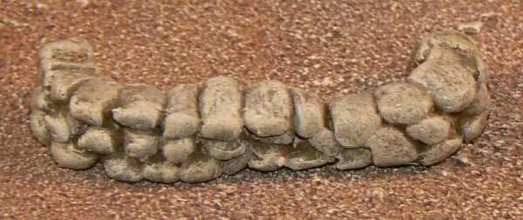
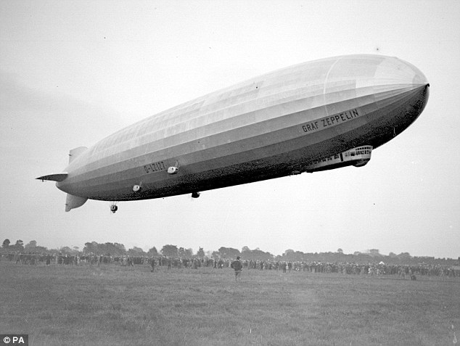
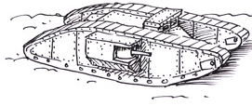
Q. Draw a rifle and bayonet. | Q. Draw sandbags and tell me their purpose. | Q. What was artillery? A. Weapons that fire shells a long distance and explode on impact. Destroying either lives or entrenchments. | Q. What does ‘War of Attrition’ mean? A. Attempt to win by wearing the enemy out through continual losses.
Q. Act out going over the top A. They need to climb out of one trench, in the face of heavy artillery fire and run towards the enemy trench whilst under small arms fire…Award up to 2 bonus steps | Q. Draw a WW1 Tank. | Q. Draw a Zeppelin | Q. What is the Armistice and when was it signed? A. The peace agreement ending WW1 was signed at 5am on the 11th November 1918.
Q. What was the Schlieffen Plan? A. The plan to invade and defeat France quickly before turning attention Britain by Germany. | Q. Many felt WW1 would be over by Christmas 1914, why wasn’t it? A. Once the German advance on the Western Front had been stopped neither side was able to progress. | Q. What was the Battle of Verdun and why was it important? A. It was a vicious battle for the town of Verdun, a matter of pride for the French. | Q. What is meant by the phrase ‘lions led by donkeys’? A. It is a metaphor to illustrate the incompetent generals and the brave soldiers.
Q. How did new technology make WW1 different? A. Destructive technology meant casualties of war were far higher and warfare became more defensive. | Q. Why did Russia leave the war? A. Terrible losses combined with poor lines of supply led to two revolutions in 1917. The communist government took Russia out of the war. | Q. What year did the USA join the war? A. 1917 | Q. Describe the conditions in the trenches. A. Award up to two spaces for more detailed answers including the time spent.

Slide 7
Q. How many military and civilian casualties due to WW1? A. Over 16 millions deaths and 20 million wounded. | Q. How much (in today’s money) was spent on WW1? A. Roughly £145 billion… | Q. What new military developments occurred in WW1. Award up to 3 steps forward for each correct answer. A. Gas, Artillery, Trench, Tanks, Air warfare, Submarines… | Q. Total British Armed Forces? A. Over 8.5 million men available for deployment.
Q. How many British soldiers died in WW1. A. 956,703. (1 for close, 2 spaces for spot on). | Q. How many men (out of 9) sent to France became a casualty. A. Five out of Nine. | How many British soldiers do not have identified graves. A. 148,750 (1 for close, 2 spaces for spot on). | Q. What was the name and age of the youngers soldier to serve. A. Sidney Lewis, aged 12, fighting at the Somme aged 13.
Q. Where did the Battle of the Somme take place? A. North France, between Britain and German troops. | Q. When was the permanent Cenotaph built in London? A. 1920 | Q. How has WW1 been commemorated over time? A. Commemoration started in 1916 with personal shrines and developed into local memorials. The IWGC was established to mark graves across Battlefields. | Q. What does the IWGC stand for? A. Imperial War Grave Commission.
Q. Draw a quick diagram of a trench. Labeled! Award up to 3 steps for accuracy. | Q. Draw a quick diagram of a British solder. Labeled! Award up to 3 steps for accuracy. | Q. What does the white poppy represent and when was it introduced? A. Represents peace it was introduced in 1933. | Q. When were Poppies introduced? A. 1921.

