Slide 1

Landmark Supreme Court Cases
A Level Government & Politics
Students should be able to:
Identify the several landmark supreme court cases
Explore the in case ruling
Recall the detail of the cases for use in exams
Evaluate the power of the supreme court

Slide 2
Landmark Cases
What are landmark cases?
Landmark cases are Supreme Court cases which significantly alter the status quo in the US.
They link well with judicial philosophy. It is often the case that more landmark cases are decided under activist courts rather than restrained courts

Slide 3
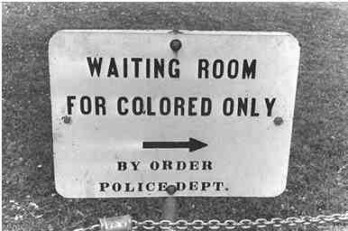
Plessy v Ferguson 1896
Upheld segregation as constitutional with the reference to separate but equal
Arose from the Louisiana Separate Car Act for Rail carriages

Slide 4
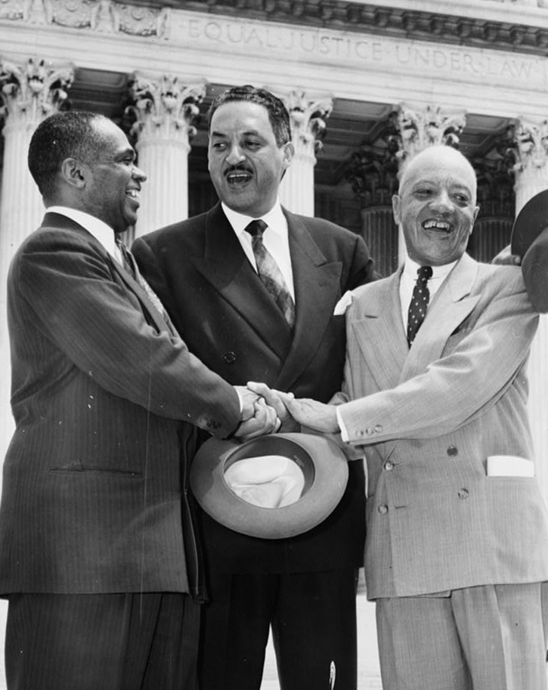
Brown v Board of Education 1953
This case overturns Plessy v Ferguson 1896
Established that separate was inherently unequal in the provision of facilities
Paved the way for integration of blacks and whites
Ruled on through the Equal Protection Clause of the 14th Amendment
One of the top lawyers for this case, Thurgood Marshall went on to become a Supreme Court judge

Slide 5
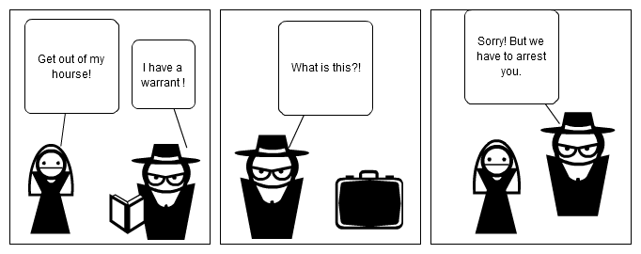
Mapp v Ohio 1961
Ruled that evidence obtained in the violation of the Fourth Amendment cannot be used in court
Arose from a dispute in Ohio which police didn’t have a warrant and found large amounts of pornography

Slide 6
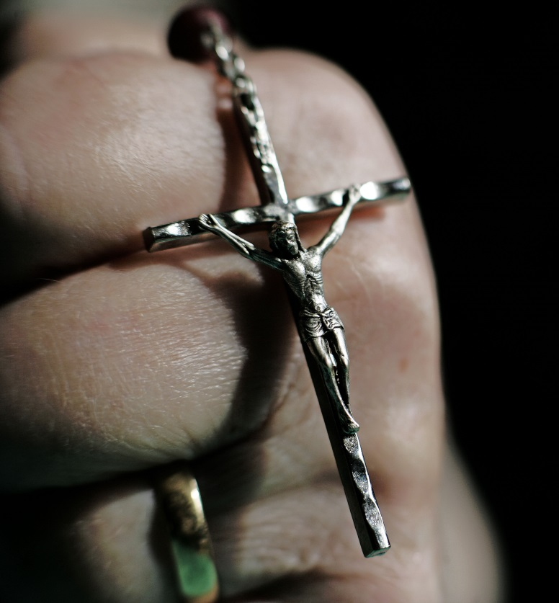
Engel v Vitale 1962
Ruled that it is unconstitutional for school prayers in public schools
This violates the First Amendment
This was the basis for more cases such as Wallace v Jaffree which banned meditation in Alabama

Slide 7
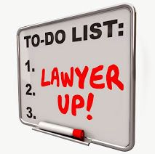
Gideon v Wainwright 1963
Under the Sixth Amendment right to counsel is a fundamental right
States must provide defence counsel should the defendant be unable to afford it

Slide 8
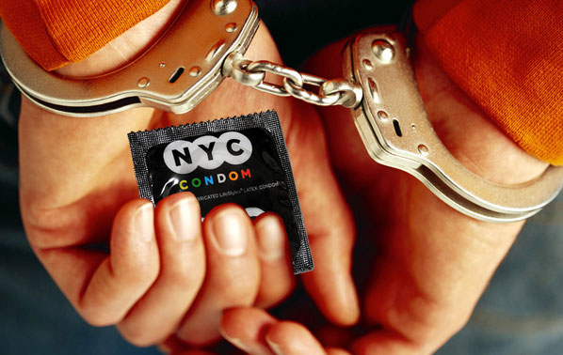
Griswold v Connecticut 1965
Protected the right to Privacy
Connecticut law prohibited the use of contraception
Supreme court ruled that it violated the right to marital privacy
Key Question: Does the constitution provide for a specific right to privacy?

Slide 9
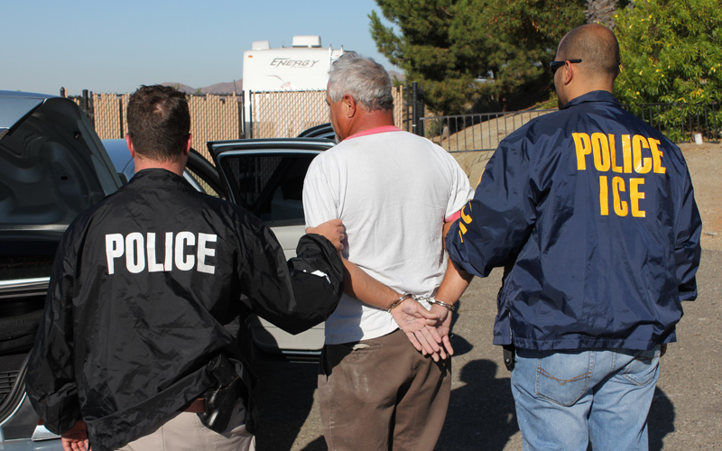
Miranda v Arizona 1966
Ruled that the accused must be read their legal rights prior to questioning by the police
Basis is the fifth amendment which protects against Self Incrimination
You may often hear that reading a suspect their rights is known as Miranda rights. It comes from this case

Slide 10
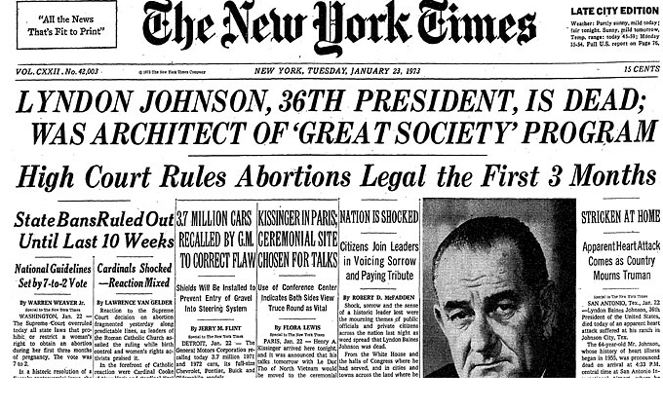
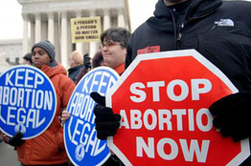
Roe v Wade 1973
Ruled that abortion was legal in the first trimester
Found on the right to Privacy under the due process clause of the 14th Amendment
Texas law made it illegal to assist a woman to get an abortion
Key Question: Is this legislating from the bench?

Slide 11
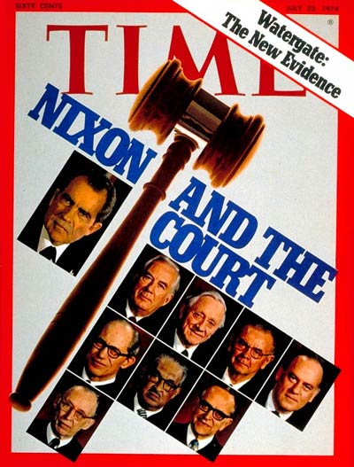
United States v Nixon 1974
Ruled that no person not even the President is completely above the law
Also ruled that the President cannot use executive privilege as an excuse to withhold evidence in criminal trials
This is the start of the Nixon Impeachment. It helps uncover the smoking gun tapes

Slide 12
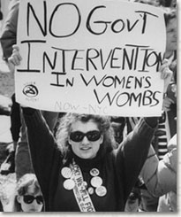
Planned Parenthood v Casey 1992
Rules on abortion in Pennsylvania were challenged
The court upheld the right to an abortion but ruled that 1 out of 5 restrictions was unconstitutional
The State of Pennsylvania required many ‘hoops’ to be jumped through before an abortion could take place

Slide 13
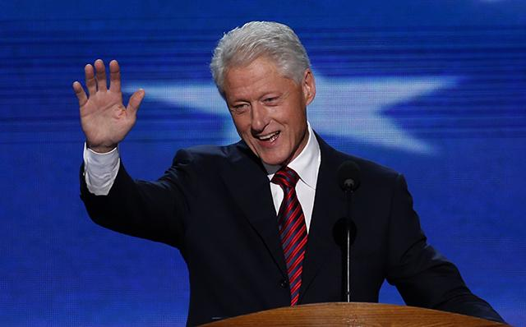
Clinton v City of New York 1998
Ruled that the Line Item Veto from the Line Item Veto Act of 1996 was unconstitutional as it gave the President power to amend legislation duly passed by Congress
43 state governors have the power of Line Item Veto.
The Line Item Veto almost made a comeback in February 2012

Slide 14
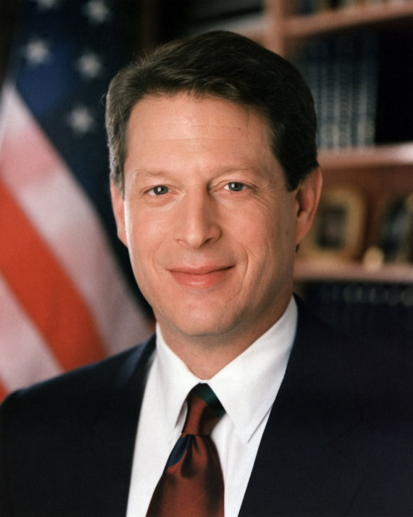
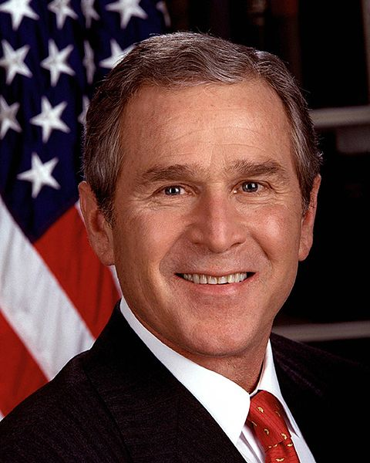
Bush v Gore 2000
Votes in Florida were close
Supreme Court ruled that manually recounting a precinct was wrong and the entire state must be recounted
Proper recounting by deadline of Dec 12 would be unconstitutional
The decision effectively ruled Bush as the winner of the 2000 Presidential Election

Slide 15
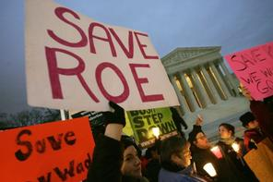
Gonzales v Carhart 2007
Court upheld the Partial-Birth Abortion Ban of 2003
It did not impose a burden on the ability to have an abortion as presented under Roe v Wade and Planned Parenthood v Casey
Commentators have called this the turning point of conservatism in the Roberts Court

Slide 16
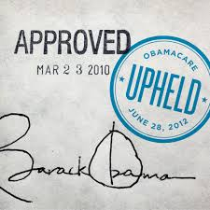
NFIB v Sebelius 2012
Court upheld Affordable Care Act requiring Americans to purchase Health Insurance by 2014
Roberts ruled that a mandate to buy insurance was an exercise of Congress’ power to collect taxes

Slide 17
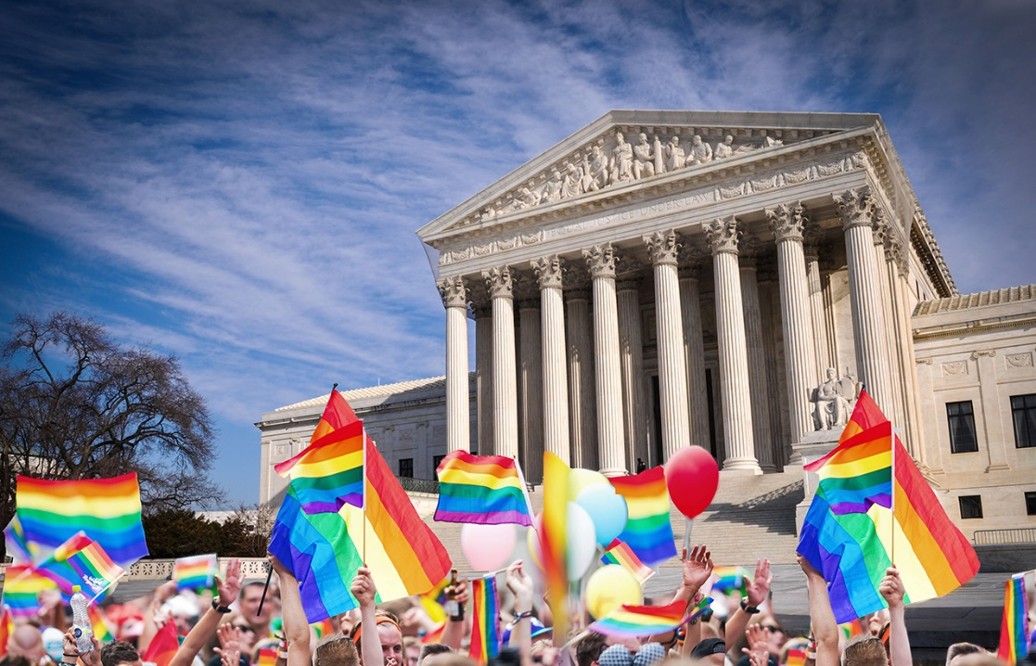
Obergefell v Hodges 2015
Court ruled that the Equal Protection Clause of the Constitution guarantees the right to marry for same sex couples
This overturned Baker v Nelson and effectively legalised same-sex marriage in the United States

Slide 18
Landmark Supreme Court Cases
A Level Government & Politics
Students should be able to:
Identify the several landmark supreme court cases
Explore the in case ruling
Recall the detail of the cases for use in exams
Evaluate the power of the supreme court

