Slide 1
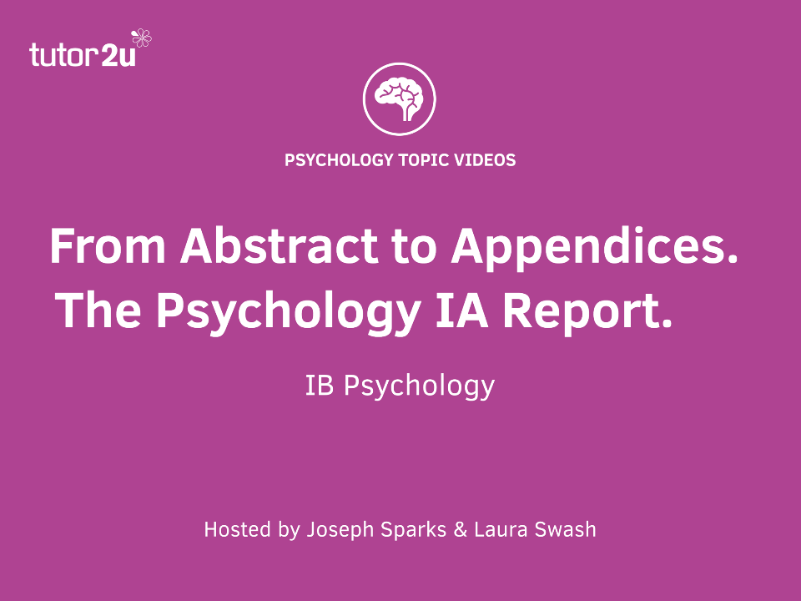

Slide 2
Other IB Psychology Webinars coming up
Brain & behaviour: More than genetics? Mon 31 October 8.30pm GMT
Cognitive Psychology: How to use theories of memory. Wed 2 Nov 4.30pm GMT
Social Psychology: Stereotype formation and effects. Wed 9 Nov 4.30pm GMT
Quality answers for Qualitative Methods papers. Tues 15 Nov 8.30pm GMT
Notes:
We’ll also be asking you after this what you would like more of.

Slide 3

From Abstract to Appendices
Supporting your students with their IB Diploma Psychology IA
Welcome to the first in our series of Psychology IB Diploma webinars.
Aims of this webinar:
Identify the 4 main problems students have with the IA
Suggest solutions
Suggest some ideas to help your organisation of the IA
Notes:
The picture on the right could be a student struggling with the IA, or teacher struggling to mark it! That’s why I chose it. The IA report time can be hard on both teachers and students.

Slide 4
A couple of questions
For how many years have you been supporting students with the IA?
How many Psychology students do you personally have this year, for the IA?
Notes:
Please type your answer in the chat, so we get a feel for this, and Joseph will take a look.

Slide 5
A Quick IA Overview
HL (20% grade)
1500-2000 words
Background studies needed
SL (25% grade)
1000-1500 words
No background studies needed
Inferential statistics calculated
Just descriptive statistics
28 marks
20 marks
One IV and one DV
One IV and one DV
Notes:
Teaching time – HL 40 hrs and SL 30 hrs.

Slide 6

4 Student Challenges
Choosing a suitable study
Planning their IA experiment and report
Managing their time
Writing within the word limit
Notes:
There are others, but these seem to be the 4 main ones that come up over and over again. The first three challenges often lead to the last one.

Slide 7

Choosing a Suitable Study
Students find it hard to choose a study to replicate
Control their choice: Feasible? Ethical? One IV and DV? Data level?
Choose one from our list of studies
Notes:
Note for JSP: Link to IB IA Series on tutor2u here (when I upload); Screen shot of webpage.

Slide 8
Suitable Studies
Bransford, J.D. & Johnson, M. K. (1972). Contextual prerequisites for understanding: some investigations of comprehension and recall. Journal of Verbal Learning and Verbal Behavior, 11, 717-726
Loftus, E.C. & Palmer, J. (1974). Reconstruction of Automobile Destruction: An Example of the Interaction between Language and Memory. Journal of Verbal Learning and Verbal Behaviour, 13, 585-589
Peterson, L.R. & Peterson, M.J. (1959) Short-term retention of individual verbal items. Journal of Experimental Psychology, 58, 193-198
Rashidi, N. (2011). The Effect of Classical Music on the Reading
Comprehension of Iranian Students . Theory and Practice in Language Studies,1, (1 ) 74-82, January 2011
Stroop, J. Ridley. (1935). Studies of interference in serial verbal reactions. Journal of Experimental Psychology, 18, 643-662
Notes:
Here is our list of suitable studies. Of course there are many more, but students really can’t go wrong with these. We will be providing a linked list, with hyperlinks to websites where you can find the originals, very shortly.

Slide 9

Planning the IA
Students do not have a clear vision of the IA
Have a hard copy for them to look at
Write abstract first*
[*More on that later!]
Use graphics to help them structure

Slide 10
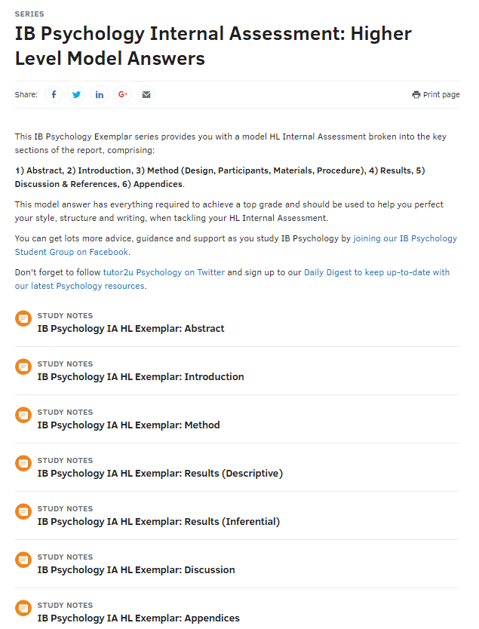
IA Example
On the tutor2u site you will find a model answer for both HL and SL.
Visit: www.tutor2u.net/psychology
Click ‘series’
Either:
  IB Psychology Internal Assessment HL
  IB Psychology Internal Assessment SL

Slide 11
A Graphic Showing the Structure of the IA
Introduction
Abstract
Method
Design
Results
Descriptive
Discussion
References
Participants
Materials
Procedure
Inferential [HL only]
Appendices
[Contents page – not required, but useful]
Notes:
Here is a graphic I made for students, to give them an overview. There are 4 main parts to the IA, and this helps them focus. I suggest they make their own.

Slide 12
Writing Within the Word Limit
Writing within the word limit
Have a suggested word count for each section
Use a ‘reduce your words’ exercise
Notes:
This is a big challenge and it is a struggle when they have come to the end and are several hundred words over the count. Don’t let that happen. Check words after each main section.

Slide 13
Suggested Minimum Word Counts
Section | HL | SL
Introduction | 500 | 350
Method | 500 | 450
Results (Descriptive) | 150 | 150
Results (Inferential) | 150 | -
Discussion | 600 | 500
Total | 1900 | 1450

Slide 14
Example of a Word-Reducing Exercise
Sample | Reduced
The original study that I am replicating is Loftus and Palmer’s study which is a study where they look at how memory can be reconstructed. (25 words) | This experiment is a partial replication of Loftus and Palmer’s (1974) research into the reconstruction of memory. (17 words)
While the research was fairly successful and the results were similar to those that were found in the original study that was replicated, there were also some problems and limitations, which I will now write about. (36 words) | My results supported the findings of the original study. However, there were some methodological limitations: (15 words)
The experimental design that I decided to use was an independent samples design. (13 words) | Independent samples design was used. (5 words)
Notes:
It is quite easy to make your own exercise.

Slide 15
Managing their time
Managing their time
Deadline for each section
Clear beginning to end timeline
Notes:
Time management often arises from the earlier problems – time wasted choosing a study that turns out not to be suitable, in reducing words, in not understanding the format and feeling overwhelmed.

Slide 16
Deadline for Each Section
Day before Deadline
Group by study
Group read of relevant section
H/W
Student revises section
Deadline Day
Give in section for teacher written feedback
Peer feedback according to criteria
Notes:
If someone is not ready, then they may not join in with the group read lesson, but instead have to complete their section by the end of the lesson. Group the students together by the study they have chosen to replicate, where possible. They have to bring enough printouts for the group members to have one each. They should also read their own work out loud. We all know how many typos and repetitions we can find just by reading our work aloud. Small groups of 3 or 4 is plenty. The whole group reads the section and gives feedback > student revises it> goes to teacher who gives verbal or written feedback (if they want, remember only once allowed!)

Slide 17
Possible Timelines
Start before summer break > winter break
Start just after summer break > just after winter break
All within one month
Start before summer break > end with IA writing day
Notes:
Ideas from group?

Slide 18
IA innovation (1)
Student writes abstract first
Teacher reviews suitability of expt and method
Student revises or proceeds with IA
After completing IA, student completes abstract
Notes:
Abstract contains following: Statement of aim and hypotheses; Summary of methods; Summary of results; Conclusion
This means it is in fact a map of the IA. Of course the results cannot yet be entered nor the conclusion finalised, but all the rest can be written.

Slide 19
Writing the Abstract First – Early Abstract
This experiment will be a partial replication of Diemand-Yauman et al.’s (2011) research into disfluency and learning, in which they demonstrated that material written in italicized or bold font (disfluent font) was better learnt and more easily recalled than material written in an easier to read (fluent) font (Diemand-Yauman et al., 2011). The aim of this experiment is to investigate if a list of words written in an italicized disfluent font would be better remembered than the same list written in a fluent font.
An independent samples design with 20 students chosen by opportunity sampling will be used to test the experimental hypothesis: Significantly more words will be recalled from a 25-word list written in a disfluent font (Calibri italicized 12 pt) than are recalled from the same word list written in a fluent font (Calibri 12 pt). The null hypothesis is: Any increase in remembered words from the 25-word list written in a disfluent (italicized) font will not be significant. Any observed increase is due to chance.
17 and 18 year old student participants will be randomly allocated, by distribution of word lists, to the experimental (disfluent) or the control (fluent) group. They will be given 10 minutes to learn the words on their list, and another 10 minutes to try and recall them in writing.
The mean number of words remembered from the disfluent font word list was ____ with a SD of ______ and the mean number of words remembered from the fluent font word list was ______ with a SD of _____ The Mann-Whitney U test was applied and the difference was found to be/not to be significant at the p< 0.05 level. Therefore the null hypothesis was accepted/rejected, and the conclusion drawn that disfluency does/ does not result in a significant increase in recall.
Word count: ______
Notes:
The red is what will need to be changed at the end.

Slide 20
Writing the abstract first - Final Abstract
This experiment is a partial replication of Diemand-Yauman et al.’s (2011) research into disfluency and learning, in which they demonstrated that material written in italicized or bold font (disfluent font) was better learnt and more easily recalled than material written in an easier to read (fluent) font (Diemand-Yauman et al., 2011). The aim of this experiment was to investigate if a list of words written in an italicized disfluent font would be better remembered than the same list written in a fluent font.
An independent samples design with 20 students chosen by opportunity sampling was used to test the experimental hypothesis: Significantly more words will be recalled from a 25-word list written in a disfluent font (Calibri italicized 12 pt) than are recalled from the same word list written in a fluent font (Calibri 12 pt). The null hypothesis is: Any increase in remembered words from the 25-word list written in a disfluent (italicized) font will not be significant. Any observed increase is due to chance.
17 and 18 year old student participants were randomly allocated, by distribution of word lists, to the experimental (disfluent) or the control (fluent) group. They were given 10 minutes to learn the words on their list, and another 10 minutes to try and recall them in writing.
The mean number of words remembered from the disfluent font word list was 19.6 with a SD of 2.76 and the mean number of words remembered from the fluent font word list was 17.5 with a SD of 2.17. The Mann-Whitney U test was applied and the difference was found not to be significant at the p< 0.05 level. Therefore the null hypothesis was accepted, and the conclusion drawn that disfluency does not result in a significant increase in recall.
Word count: 288

Slide 21
IA innovation (2)
Teacher approves IA plan
Student writes materials (consent form, etc.)
Student conducts experiment
IA writing day – draft IA report is written
Student gathers background reading
Notes:
Student needs to do a LOT of work before coming to the IA writing day. Then it can be done. A teacher has assured me of that ☺ Opinions?

Slide 22
IA Innovation (3)
Sample IAs available to read
Suitable original studies to read
Student ethics committees
Notes:
Suitable original studies should be available in hard copy. IAs in hard copy – anonymised from previous years is fine. Set up a student ethics committee to which a student has to present their plan.

Slide 23
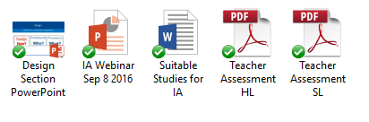
Downloadable Resources
Today’s resources will be posted in John Crane’s FB Group.
OR
Sign up to our Daily Digest: http://www.tutor2u.net/dailydigest and receive an email tomorrow morning directing you to the resources.
Don’t forget to check our Model HL/SL IAs on the tutor2u website.
Notes:
Other ideas for Webinars? Currently we have planned:

Slide 24
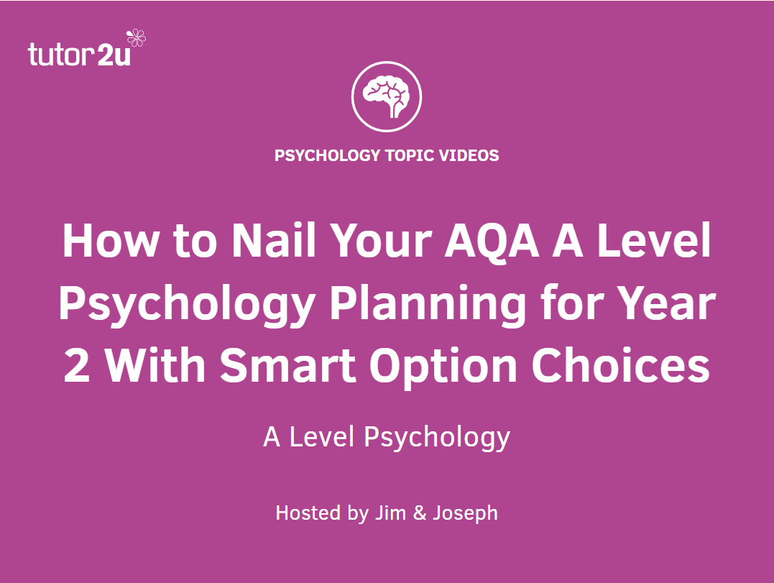
Don’t forget to sign up for our future webinars: www.tutor2u.net/psychology/events
Please follow us on Twitter @tutor2upsych and spread the word…
Encourage your students to join our Student FB Community: ‘IB Psychology Student Group’.
If you ever need any advice, support or guidance, email: joseph@tutor2u.net
Any Questions?

