Slide 1
Design
A guide for the IB Psychology IA design section
Design
How?
Participants
Who?
Procedure
What?

Slide 2
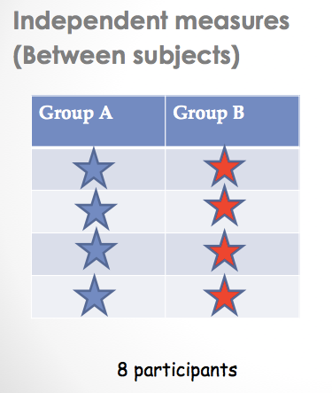
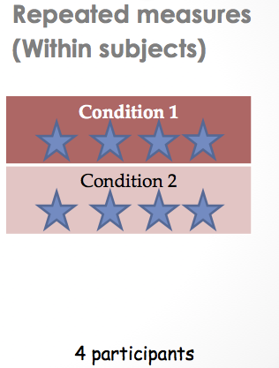
Design
Independent measures / samples (between subjects) or Repeated measures (within subjects)?
Notes:
Independent measures is when there are two separate subject groups.
Repeated measures is when there are two separate subject conditions, but the same people are in each condition.

Slide 3
Design
Independent measures
Repeated measures
No order effects
Can use single blind design
X Intra- and inter-
group variability in
participants
X Need more participants
than in repeated measures
design
Fewer participants needed
Less participant variability
X Order effects can change
participants’ behaviour
X Fatigue can change
participants’ behaviour

Slide 4
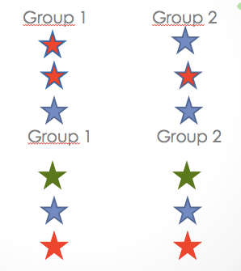
To Control Participant Variability
Random allocation to groups
Matched pairs allocation to groups
Notes:
If there is little variability in the whole group of participants then random allocation to groups should control sufficiently for this. however, Matched pairs design is very important if your participants are rather mixed and their random allocation to the two conditions might result in, for example, a middle-aged person’s memory being compared with that of an 18 year old student’s. Of course, they might be the same, but the age and different backgrounds mean that these are uncontrolled variables that might affect your results. So, in this case, you should sort the sample of participants into matched pairs as much as possible, and allocate one of each pair to each condition.

Slide 5
To Control Order Effects
Counterbalancing (alternate numbers)
Participant | Condition 1 | Condition 2
1 | First | Second
2 | Second | First
3 | First | Second
4 | Second | First
5 | First | Second
6 | Second | First
7 | First | Second
8 | Second | First
9 | First | Second
10 | Second | First
Notes:
Participants can be assigned to the first condition randomly, by the toss of a coin, which does not guarantee equal numbers in each condition, or each odd-numbered participant have condition 1 first, and each even-numbered participant have condition 2 first.
This should be carried out to counteract order effects, but if one condition is the control condition, then whether this comes first or second may affect the results and should be discussed. (i.e. in the Stroop test)

Slide 6
Independent and Dependent Variables
The IV is manipulated and the DV is measured under two conditions.
Manipulated
Group/Cond 1
Group/Cond 2
IV
DV
Notes:
Your independent and dependent variables have to be clearly identified, using the appropriate terms relating to your experiment. If your experiment is looking at how a waiting period affects recall, then the IV is the presence or absence of a waiting period and how many seconds/minutes that period is and the DV is the number of words/items recalled.

Slide 7
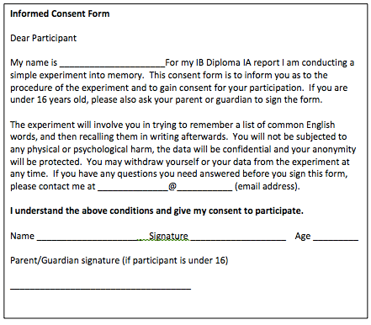
Ethics
Note how you met the ethical guidelines by having an informed consent sheet, a standardized instruction sheet and a debriefing sheet, all of which informed participants of the procedure and their rights to withdraw themselves and their data at any time.
Notes:
You must remember to direct your reader to the documents in the Appendices, not merely state that you used them.

