Slide 1

How to convince people – tips and tricks for scientific writing and presenting
Dr Viktoria Stein, PhD
Assistant Professor, Leiden University Medical Centre
Co-editor in chief, International Journal of Integrated Care
Co-CEO VM Partners Integrating Health and Care
www.ijic.org

Slide 2
The reviewing process explained

Slide 3
How does the reviewing process work?
“Bad science is bad science regardless of whether the study addressed an important clinical issue, whether results are “statistically significant”, or whether they prove your point…” (Greenhalgh 2001, p. 39)
At IJIC (and many other journals):
Editors-in-chief screen and decide, whether article goes into peer review or not
At least 2 reviewers, double-blinded, and give recommendations
Editors-in-chief decide whether to ask for revisions or reject after review
Once accepted, publication in real time

Slide 4
What are reviewers looking for in an article?
First question to ask:
Is it integrated care?
Further questions to ask:
Why was the study done? What was the hypothesis?
What type of study was done? Was this appropriate?
Does the study add new findings to the literature? Is it innovative?
What was measured? How? Was it appropriate?
Was there a follow-up? Was that adequate?
What are the lessons learned? Transferability? Scalability?
!!!PLEASE, always have a look at the author guidelines BEFORE preparing your article!!!

Slide 5
How to increase your chances of getting published

Slide 6
Questions to consider before writing an article
Who is my audience? Who should get my message?
How international is my research?
Which research methods did I use?
How important is the Impact Factor?
Did I comply with the journal’s requirements?
Which journals are available in my field of research?
Do I know someone in the editorial board?
Tipps to consider:
  Always cite articles from the journal you want to publish in!
  Always cite articles from your own research group!
  Don’t forget to acquire a vote from the ethical commission!

Slide 7
How to structure your article?
Introduction (Problem/Background)
  Why is your topic up to date?
  What is the story behind your research?
  What is your defined research question?
Methods
  Which method(s) did you use.
  How did you conduct your research.
Results
  What did you find out?
Discussion
  What is the answer to your research question?
  What implications do your results have regarding the background and the current literature?
  How do your findings fit into the context of current literature?
Conclusion
  Are your results transferable to other countries / contexts?
  What has been achieved by this article?
  Which (follow-up) questions remain or result from your research?
!!!!!!Look at the author guidelines!!!!!
https://www.ijic.org/about/submissions/#author-guidelines

Slide 8
Common mistakes, which may lead to rejection
Overall topic doesn’t fit the journal
Fuzzy title – title promises more than the text delivers
Abstract doesn’t fit the text
Lack of background information (where, why, who)
Methods not explained well
Discussion too long, no storyline, not based on context literature, too many/too few messages
Missing strengths and limitations
Conclusion not based on findings, no recommendations for future research

Slide 9
Common mistakes: examples
Overall topic doesn’t fit the journal
“…it never becomes clear what exactly the Primary health care centres (PHCC) are offering as regards the diabetes and hypertension patients and what that has to do with integrated care. In fact, integrated care isn’t mentioned once throughout the text. The other findings they present concerning independent predictors do not strike me as new evidence either[…]The one important message this article has, is, that the health care team plays a pivotal role in the management and control of chronic disease, but no details or new findings are presented. The authors say that one centre stood out concerning the results of their patients but they offer no explanation as to why that is so – on the contrary, they claim there are no differences in staff or resources. Overall, it seems a bit disjoint.”

Slide 10
Common mistakes: examples
Lack of background information (where, why, who)
“The authors describe a research study that considers multiple health domains through a comprehensive school-based intervention. They make a persuasive case why multiple domains should be considered and describe the detail of their project. However, this manuscript is very confusing as to whether this project is complete or not complete. Clearly the authors intend to use this article to explain their methods and others to explain their outcomes, but they alternate considerably between past, present, and future tenses in describing this study, making it very confusing to follow the status of their project. If the project is complete, it would be nice to hear how well the expected methods worked. If the project is not underway (unlikely since they describe it starting in 2005), the authors should stick to the future tense in describing their plans. If the project is still currently underway, perhaps the authors can give us insight into how it is going so far, including successes and challenges. “

Slide 11
Common mistakes: examples
Methods not explained well
“The article also has some methodological deficiencies where a clearer motivation why content analysis was used is needed. Also the level of transcription (verbatim) is not motivated why it was chosen. Working with natural occurring data, such as this, has a number of strengths and weaknesses that must be taken into account se for example Speer, S. (2007). Natural and contrived data. In Alasuutari, P., Brannen, J. & Bickman, L. (eds.). The handbook of social research. London: Sage. “
Creating expectations that are not met
e.g. Promising a practice example that is never described or substituted by a virtual example. Failing to deliver on the aims set forth in the introduction.
Strengths and limitations
Correct form: Sandwich formate similar to correct feedback formula

Slide 12
Common mistakes: examples
Discussion too long, no story line, not based on context literature, too many/too few messages
Conclusion not based on findings, no recommendations for future research
„The aim described in the intro and the results in the discussion and conclusion sections do not correspond. In the introduction it is laid out that the article will explore why Quality Management is a part of Risk Management and not the other way round, as stated in the literature. In the Results and Conclusion sections, however, the authors very convincingly state the commonalities of QM and RM and rather argue for an integrated approach. The aim to prove that QM is a part of RM is not reached, and only mentioned in a sideline, mentioning a new ISO guideline. Moreover, the authors contradict their own aim in the text. For the article proving the aim would not even be necessary, because it actually argues very convincingly that an integrated QM/RM is sensible, important and advantageous.“

Slide 13
How to please the editor/reviewer?
Aims and motivations of an editor:
  Raise the impact factor
  Attract renown names
  Publish high impact articles
  Raise awareness/money for the journal
Aims and motivations of a reviewer:
  Help colleagues to improve a manuscript
  Give advice
  Recommend own literature
  Stay up to date with what’s going on

Slide 14
Specifics to consider for conference abstracts
Conveys a convincing story in limited words
Needs to stick to overall structure of article/conference prerequisites
Focus on the essential: what are the key messages of your article/work/presentation?
Needs to achieve 2 aims:
  Clearly state what was done
  Incite interest to learn more

Slide 15
How to give a convincing presentation

Slide 16

Before you start
What is the aim of my presentation?
  Conference, project proposal, PhD thesis,…
Who am I speaking to?
  Colleagues, students, scientific audience, potential project partners, mixed audience
What are my key messages?
What do I want the audience to do after my presentation?
  Discussion / Ask questions
  Take home (a) message
  Get in contact with me
  Remember me
http://www.marketlikeachick.com/wp-content/uploads/2010/04/Tell-Your-Story-300x299.jpg

Slide 17

How to prepare the presentation
What is your story?
  Clear narrative is most important: make sure you have a good story board
  Tell the key facts – leave the rest!
  Different kinds of stories:
    present scientific study
    teaching a class
    presenting a proposal
How much are you willing to invest?
What should be the impact?
Make sure your audience is able to understand you
  Language, content, humor !!
http://astoriedcareer.com/MyStory.jpg

Slide 18
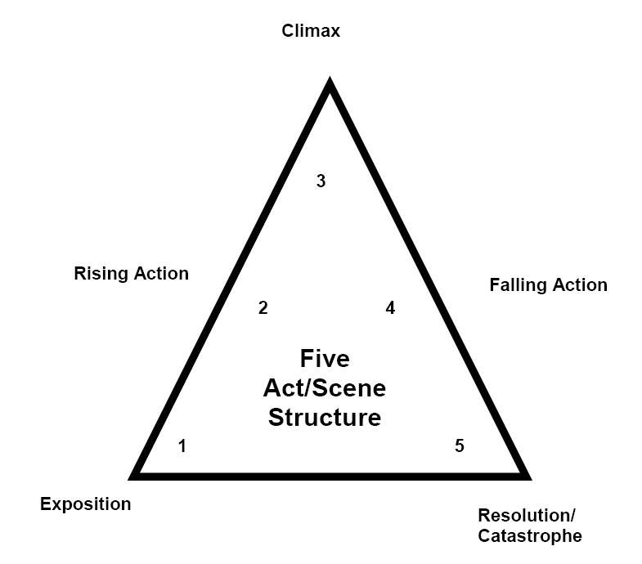
How to build an effective presentation
  Keep in mind:
    You want the audience to pay attention
    Raise curiosity
    Find something surprising/
    interesting/unorthodox
http://edubuzz.org/drama/files/2010/06/tension-one.jpg

Slide 19
How to prepare the slideshow
Never ever present slides you have to apologise for!
Never ever apologise for your slides!
Slides should be a visual help for your talk
Be very careful with animations
Be careful with figures and tables:
  Danger of losing the audience
  Give it a context and keep it easy
  Walk your audience through the data
  and explain what is going on
http://cdn.blogsdna.com/wp-content/uploads/2009/12/Slideshow-Icon.png

Slide 20
How to prepare the slideshow
Rules of thumb (for conference presentations):
Not more than 5 bullets or 8 lines
1 slide = 1 minute
Not more than 3 colors
No full sentences
The simpler the design, the better
http://cdn.blogsdna.com/wp-content/uploads/2009/12/Slideshow-Icon.png

Slide 21
The time has come...
In Advance
Practice your presentation with volunteers
Be in time and make sure the laptop, presenter, etc is working
Find the session chair, introduce yourself and ask how they will organise the session
Take a look at how the presentation actually looks on the screen
Make yourself familiar with the room
http://www.sportmentalcoaching.info/images/Haende-klatschend.jpg

Slide 22

The time has come...
Let’s go
You can only be convincing, if you’re convinced!
Tell your story!
Know what is on your slides!
Stand up, speak clearly and slowly!
Don’t be afraid of questions!
Earn yourself applause ;-)!
http://www.sportmentalcoaching.info/images/Haende-klatschend.jpg

Slide 23
Never forget to ...
Introduce yourself (unless this was done by the chair)
Manage your own time
Prepare how and where to cut, if necessary
Have a last sentence that clearly signals you’re done
Think of likely questions and adequate responses
For confident presenters: refer to relevant issues discussed in prior presentations or panels
http://www.sportmentalcoaching.info/images/Haende-klatschend.jpg

Slide 24


Slide 25
Finally...
Being nervous is ok, but you needn’t be scared.
Don’t be afraid of questions!
YOU ARE THE EXPERT!
Practice makes perfect.
http://www.sportmentalcoaching.info/images/Haende-klatschend.jpg

Slide 26
Helpful literature
Punch KF. Introduction to Social Research. Quantitative and Qualitative Approaches. 3rd edition SAGE Publications 2014.
Punch KF. Developing Effective Research Proposals. 3rd edition SAGE Publications 2016.
Aveyard H. Doing a Literature Review in Health and Social Care. A Practical Guide. 4th edition Open University Press 2018.
Greenhalgh T. How to Read a Paper. The basics of evidence-based medicine and health care. 6th edition Wiley-Blackwell 2019.

